Slide 1

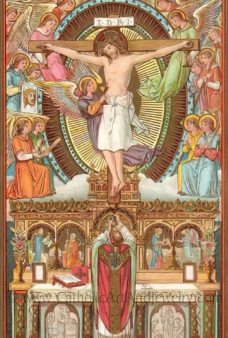
Credo
St. John Paul II University Parish
RCIA 2023-2024
LOVING JESUS DEEPLY

Slide 2
prayer

Slide 3
Preliminaries

Slide 4
What have i signed up for?
Phase 1 - 9 Weeks
Period of Evangelization: Inquirer
Phase 2 - 14 weeks
Rite of Welcoming -> Baptized: (Christian) Candidate for Initiation
Rite of Acceptance -> Unbaptized: Catechumenate
Initiation
Baptized: Confirmation and Eucharist
Unbaptized: All Sacraments: Baptism, Confirmation and Eucharist
Phase 3 - 7 weeks
Mystagogy
Deepening understanding of sacraments and participation in the Church after Easter Vigil

Slide 5
What have i signed up for?
To increase your REASON about the LORD
To increase your FAITH & LOVE of the LORD

Slide 6
What have i signed up for?
To love the Lord your God with all your HEART, MIND, SOUL and STRENGTH!

Slide 7
What have i signed up for?
To get your questions answered...

Slide 8
What have i signed up for?
To grow in relationship with God, and in this community of believers

Slide 9
Journal
What does it mean to be Christian?
What does it mean to be Catholic?

Slide 10
Part I: Faith and Doctrine

Slide 11
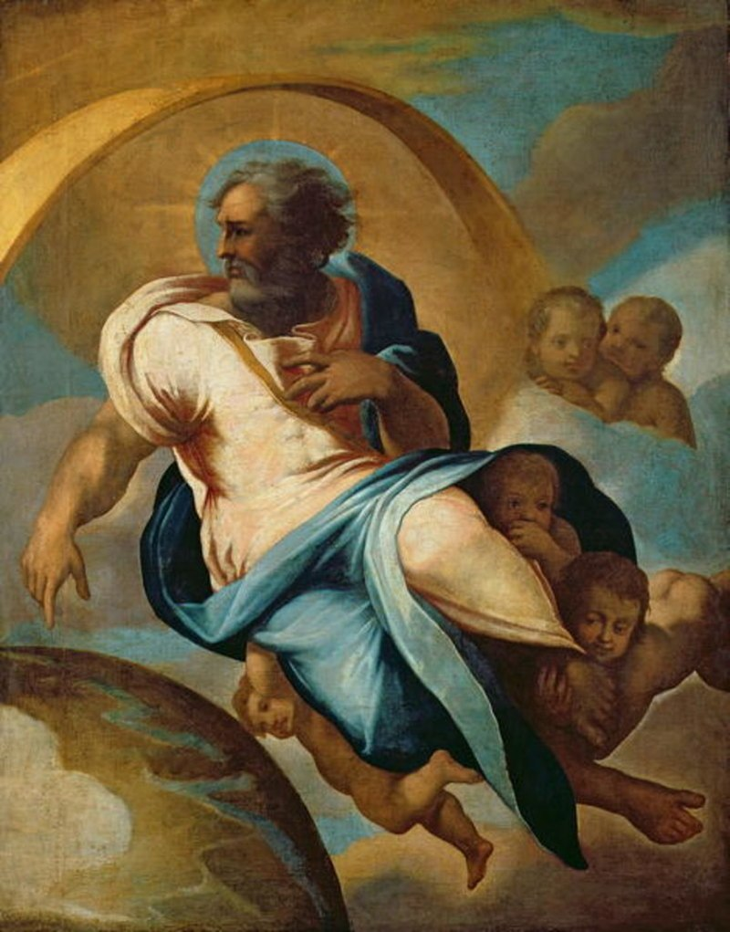
Chapter 1: Knowing and Desiring God

Slide 12
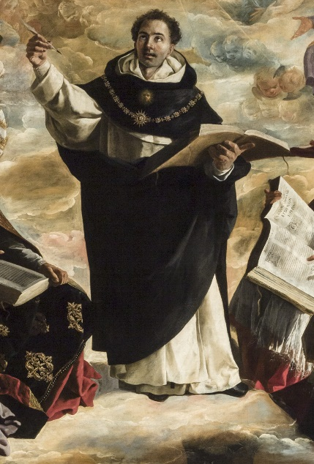
Scripture Reading: Wisdom 13:1-9
For all men who were ignorant of God were foolish by nature; and they were unable from the good things that are seen to know him who exists, nor did they recognize the craftsman while paying heed to his works; but they supposed that either fire or wind or swift air, or the circle of the stars, or turbulent water, or the luminaries of heaven were the gods that rule the world. If through delight in the beauty of these things men assumed them to be gods, let them know how much better than these is their Lord, for the author of beauty created them. And if men[b] were amazed at their power and working,

Slide 13
Scripture Reading: Wisdom 13:1-9
let them perceive from them how much more powerful is he who formed them. For from the greatness and beauty of created things comes a corresponding perception of their Creator. Yet these men are little to be blamed, for perhaps they go astray while seeking God and desiring to find him. For as they live among his works they keep searching, and they trust in what they see, because the things that are seen are beautiful. Yet again, not even they are to be excused; for if they had the power to know so much that they could investigate the world, how did they fail to find sooner the Lord of these things?

Slide 14
Chapter 1: Knowing and Desiring God
Key points from video
Any study of the Catholic Faith begins with knowing that God exists
Faith and reason are two gifts God gave us to know that he exists
It is possible for human reason to discover God.
We look at the world and realize there must be some cause for everything.
Despite the power of human reason, there are many other things God wants to show us that we could never find on our own.
Though many in contemporary culture have abandoned belief in God, a desire for God is written into the fabric of our being.

Slide 15
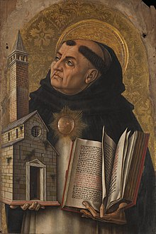
Wisdom of the Saints
Human beings have an innate desire to move from effects to causes and this desire does not rest until it arrives at the first cause, which is God – St. Thomas Aquinas

Slide 16
Chapter 1: Discussion Questions
1. See CCC 309 and 37
2. See CCC 32
3. See CCC 296
4. See CCC 36
What do you think are the main obstacles that keep people from believing in God?
Explain what St. Thomas meant when he argued that we can learn about God by looking at the things he has created.
How is God like and artist? How is he different than an artist?
Which is more ‘normal’ or ‘natural’: or believe or not believe in God?

Slide 17
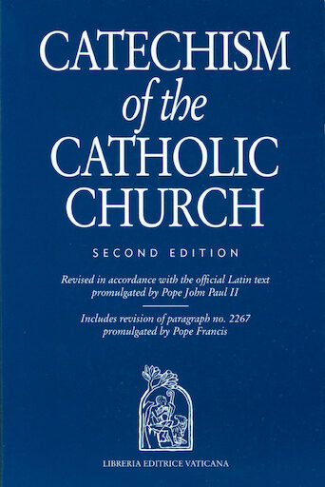
From the Catechism
All creatures bear a certain resemblance to God, most especially man, created in the image and likeness of God. The manifold perfections of creatures - their truth, their goodness, their beauty all reflect the infinite perfection of God. Consequently we can name God by taking his creatures" perfections as our starting point, "for from the greatness and beauty of created things comes a corresponding perception of their Creator". – CCC 41

Slide 18
Chapter 1: Life Application Questions
1. What are some of the earliest memories you have of thinking about God?
2. Have you ever been challenged to think about whether you really believe in God? What was the cause? Explain how you reacted.
3. Have you ever been struck by the beauty of creation and led to think about God?

Slide 19

Chapter 1: Key Terms
Key Terms
Human reason: the intellectual capacity of human beings. For the Catholic vision of the human person, human reason is a natural gift from God that he gave to us so we could know the truth.
Philosophy: The systematic use of human reason in order to discover truths about the world
Atheism: the position that hold that God does not exist
Agnosticism: The position that holds that God may or may not exist and that certainty is not available. The agnostic person does not claim faith or disbelief.
Creation out of nothing (Ex nihilo): The way in which God creates; that is, without any pre-existing material. God’s act of creation brings thing into existence from nothing

Slide 20
Closing Scripture: Acts 17:26-28
And he made from one every nation of men to live on all the face of the earth, having determined allotted periods and the boundaries of their habitation, that they should seek God, in the hope that they might feel after him and find him. Yet he is not far from each one of us, for ‘In him we live and move and have our being’; as even some of your poets have said, ‘For we are indeed his offspring.’

Slide 21
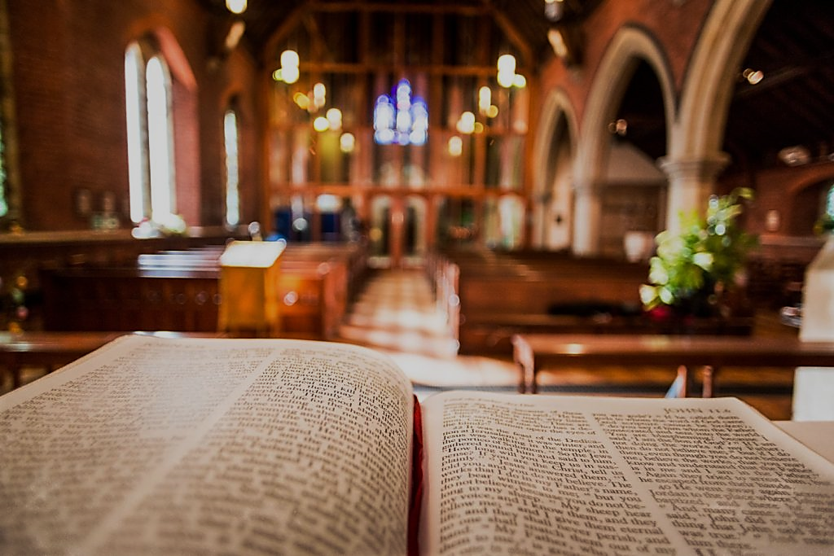
Chapter 2: Revelation and Faith

Slide 22

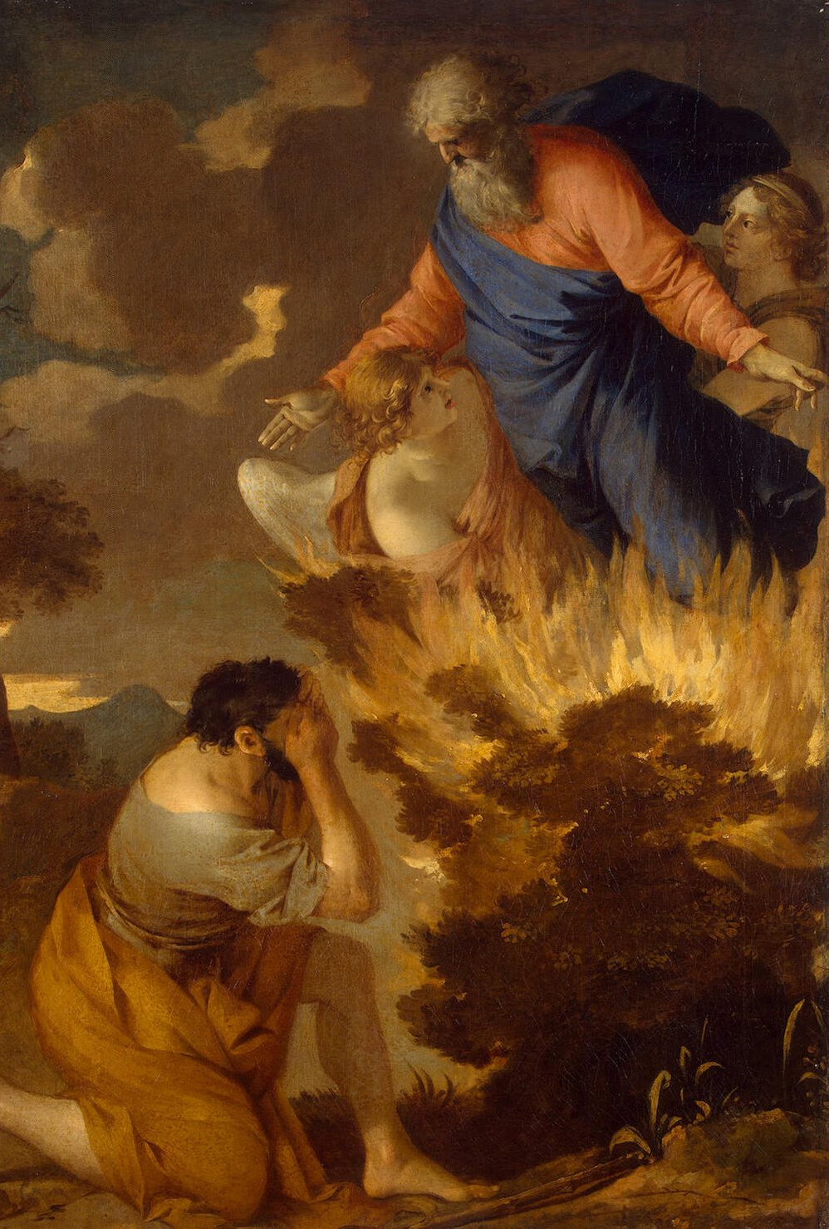
Scripture reading: Ephesians 1:3-10
Blessed be the God and Father of our Lord Jesus Christ, who has blessed us in Christ with every spiritual blessing in the heavenly places, even as he chose us in him before the foundation of the world, that we should be holy and blameless before him. He destined us in love to be his sons through Jesus Christ, according to the purpose of his will, to the praise of his glorious grace which he freely bestowed on us in the Beloved. In him we have redemption through his blood, the forgiveness of our trespasses, according to the riches of his grace which he lavished upon us. For he has made known to us in all wisdom and insight the mystery of his will, according to his purpose which he set forth in Christ as a plan for the fulness of time, to unite all things in him, things in heaven and things on earth.

Slide 23
Chapter 2: Revelation and Faith
Key points from video
Supernatural faith is a gift from God that allows us to know God personally and believe in his revelation.
Revelation is God’s self-disclosure by which he shares his life with us in Christ.
God reveals himself through the prophetic writings of the Old Testament and the apostolic writings of the New Testament.
The Catholic Church is subordinate to Scripture but has the authority to define without error what is revealed in Scripture. This solemn function pertains to the Catholic Bishops who exercise the Magisterium, or teaching office, of the Catholic Church, under the Bishop of Rome, the Pope.
While God is the principal author of Scripture, at the same time, human authors were inspired to write in the literary forms of their respective times and places.
The Scriptures should be read within the context of the apostolic traditions and the Tradition of the Catholic Church, which assures a faithful and consistent reading down through time.

Slide 24
From the Catechism
God, who "dwells in unapproachable light", wants to communicate his own divine life to the men he freely created, in order to adopt them as his sons in his only-begotten Son. By revealing himself God wishes to make them capable of responding to him, and of knowing him and of loving him far beyond their own natural capacity. – CCC 52

Slide 25
Chapter 2: Discussion Questions and Life Application Questions
Life Application Questions
1. How have you come to faith in Christ, his reality and presence? Are you aware of his living personal presence? How can we allow this sense to grow in us?
2. What role does Scripture play in your life, and what authority does it have?
3. Why are the Church and her teaching important for you understanding of who God is?
Discussion Questions
1. Is it reasonable to be open to divine revelation? What does it offer us that natural knowledge of God does not provide?
2. What does it mean to say that faith is a supernatural gift received into the human mind?
3. What does it mean to say that Scripture is inspired? Why is it important that the human authors of Scripture are true authors?
4. Why are Tradition and the Magisterium of the Church essential to the right interpretation of Scripture?

Slide 26
Chapter 2: Key Terms
Key Terms
Supernatural faith: Supernatural faith is a gift from God that allows us to know God personally and believe in his revelation.
Revelation: The manifestation of God in Christ by which he teaches us who he truly is and communicates to us a participation in his own life so that we might live in communion with him.
Reasons of Credibility: Signs God has given to human reason to demonstrate that the teaching of the Catholic faith comes from God (Christ’s resurrection, other miracles, the witness of the saint’s lives, the longevity and continuity of the Church, etc.).
Divine Inspiration: The grace by which the Holy Spirit enlightened human authors of Scripture so that they would commit to writing those truths that God intended to reveal to the human race.
Tradition: The apostolic and post-apostolic customs, sacramental practices, and doctrines of the Church that provide a living society in which the truth of God is transmitted and the Faith is practiced over the centuries.
Magisterium: The teaching office of the Catholics bishops in communion with the Pope, the successor of Peter, who safeguards the communion of the whole Church.

Slide 27
Closing Scripture 1 Timothy 6:14-16
I charge you to keep the commandment unstained and free from reproach until the appearing of our Lord Jesus Christ; and this will be made manifest at the proper time by the blessed and only Sovereign, the King of kings and Lord of lords, who alone has immortality and dwells in unapproachable light, whom no man has ever seen or can see. To him be honor and eternal dominion. Amen.

Slide 28
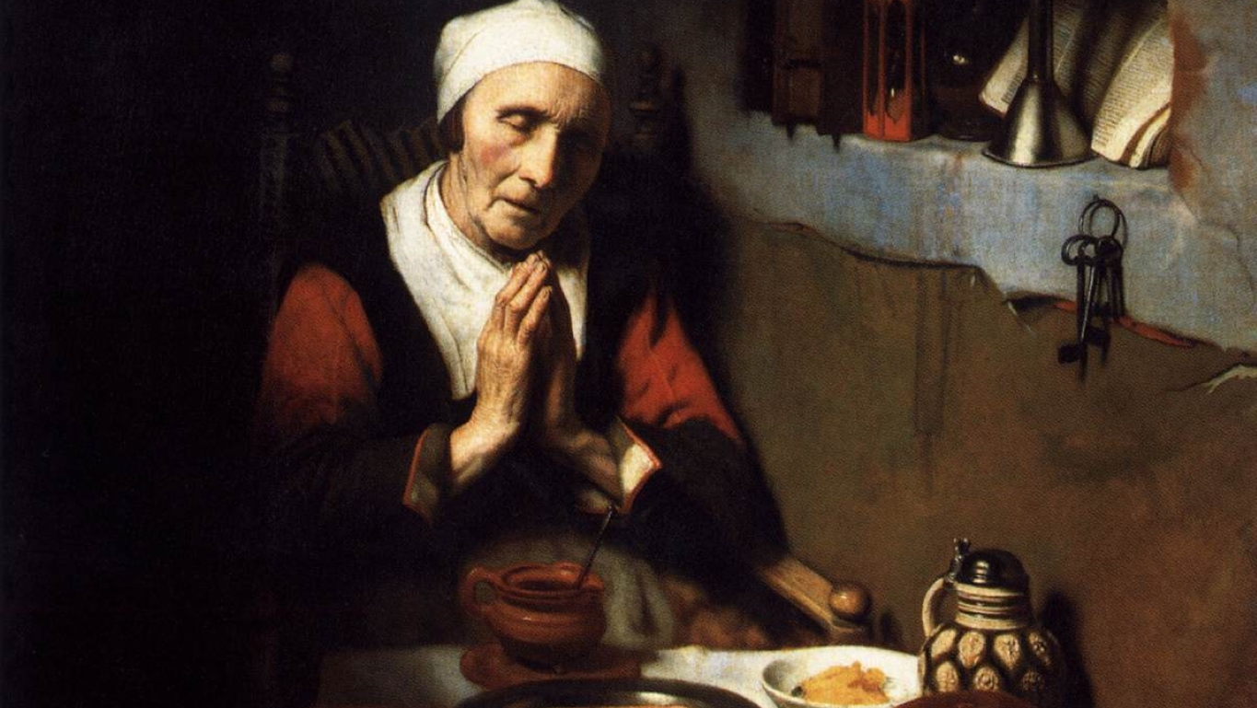
Introduction to Prayer and The Sacraments

Slide 29
Scripture Reading: Matthew 6:5-15
“And when you pray, you must not be like the hypocrites; for they love to stand and pray in the synagogues and at the street corners, that they may be seen by men. Truly, I say to you, they have their reward. But when you pray, go into your room and shut the door and pray to your Father who is in secret; and your Father who sees in secret will reward you. “And in praying do not heap up empty phrases as the Gentiles do; for they think that they will be heard for their many words. Do not be like them, for your Father knows what you need before you ask him. Pray then like this:
Our Father who art in heaven, Hallowed be thy name. Thy kingdom come, Thy will be done, On earth as it is in heaven. Give us this day our daily bread; And forgive us our debts, As we also have forgiven our debtors; And lead us not into temptation, But deliver us from evil.
For if you forgive men their trespasses, your heavenly Father also will forgive you; but if you do not forgive men their trespasses, neither will your Father forgive your trespasses.

Slide 30
Chapter 3: Introduction to Prayer and the Sacraments
Key points from video
The goal of the Christian life is to become like God – to “become partakers of the divine nature” (2 Peter 1:4)
Prayer is the raising of our minds and hearts to God.
Prayer involves both body and soul in one coordinated movement to God.
Prayer takes four main forms: adoration, contrition, thanksgiving, and supplication.
A sacrament is an “efficacious sign of grace, instituted by Christ and entrusted to the Church, by which divine life is dispensed to us” (CCC 1131)
A sacrament is a peculiar type of sign that actually causes what it signifies.

Slide 31
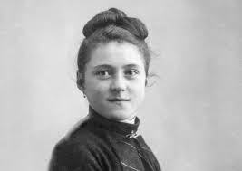
Wisdom of the Saints
For me, prayer is a surge of the heart; it is a simple look turned toward heaven, it is a cry of recognition and of love, embracing both trial and joy. – St. Thérèse of Lisieux

Slide 32
Chapter 3: Discussion Questions
1. See CCC 364 and CCC 2562
2. See CCC 2624, 2630, and 2558
3. See CCC 1116
What role does the body play in prayer?
In what sense are the four kinds of prayer interconnected? How are they united in their origin and end?
How is it that the sacraments are said to cause grace?

Slide 33
From the Catechism
Christian prayer is a covenant relationship between God and man in Christ. It is the action of God and of man, springing forth from both the Holy Spirit and ourselves, wholly directed to the Father, in union with the human will of the Son of God made man. – CCC 2546

Slide 34
Chapter 3: Life Application Questions
1. Do you think of prayer primarily as a conversation between friends or as a burdensome obligation? Why is that so, and how can your prayer move toward conversation with God?
2. Which form of prayer do you think you practice most often: adoration, contrition, thanksgiving, or supplication? Why might that be? Where might God be prompting growth?
3. How do you hope to see the sacraments “work” in your life?

Slide 35
Chapter 3: Key Terms
Key Terms
Prayer: The raising of our hearts and minds to God.
Liturgy: The participation of the Church in the “work of God” through divine worship and the proclamation of Gospel. Through the liturgy, Christ, our High Priest, continues the work of our redemption through the Church’s celebration of the mystery of his passion, death, and resurrection. CCC 1067-1069
Adoration: The prayer that acknowledges God as God, Creator, and Savior, the Lord and Master of all that exists. Adoration is due to God alone who creates and saves man and who answers our prayers. It is the highest reverence that can be shown to someone through the worship of sacrifice.
Sacrament: An efficacious sign of grace, instituted by Christ and entrusted to the Church, by which divine life is dispensed to us.

Slide 36
Closing Scripture Philippians 4:4-7
Rejoice in the Lord always; again I will say, Rejoice. Let all men know your forbearance. The Lord is at hand. Have no anxiety about anything, but in everything by prayer and supplication with thanksgiving let your requests be made known to God. And the peace of God, which passes all understanding, will keep your hearts and your minds in Christ Jesus.

Slide 37
Chapter 4: The Most Holy Trinity

Slide 38
Scripture Reading: John 14:2-10
In my Father’s house there are many dwelling places. If it were not so, would I have told you that I go to prepare a place for you? And if I go and prepare a place for you, I will come again and will take you to myself, so that where I am, there you may be also. And you know the way to the place where I am going.” Thomas said to him, “Lord, we do not know where you are going. How can we know the way?” Jesus said to him, “I am the way, and the truth, and the life. No one comes to the Father except through me. If you know me, you will know my Father also. From now on you do know him and have seen him.”
Philip said to him, “Lord, show us the Father, and we will be satisfied.” Jesus said to him, “Have I been with you all this time, Philip, and you still do not know me? Whoever has seen me has seen the Father. How can you say, ‘Show us the Father’? Do you not believe that I am in the Father and the Father is in me? The words that I say to you I do not speak on my own; but the Father who dwells in me does his works.

Slide 39
Chapter 4: The Most Holy Trinity
Key points from video
Belief in the Trinity is the central claim of Christianity
There are two main mistakes we can make regarding the Trinity: to think that the three persons are separate from each other or to think that they aren’t really distinct from each other.
St. Thomas Aquinas built on St. Augustine’s insights by using an analogy for the Trinity where he describes the process of thinking, or imagining, one’s own self in the mind.
The Word of God proceeds by way of intellect, and the Holy Spirit by way of love.
Christians worship God in a Trinitarian form, including the words we use.

Slide 40
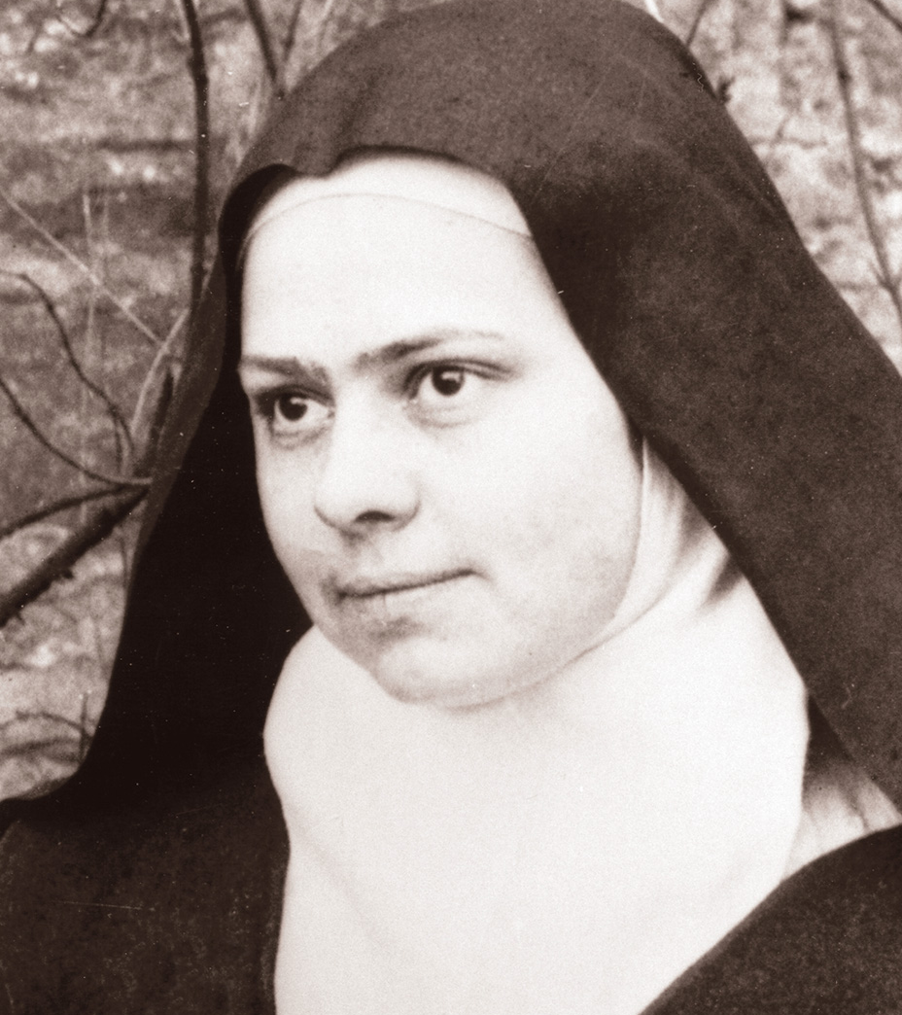
Wisdom of the Saints
O Eternal Word, utterance of my God, I want to spend my life listening to you, to become totally teachable so that I might learn all from you…O Consuming Fire, Spirit of Love, overshadow me so that the Word may be, as it were incarnate again in my soul…And you, O Father, bend down towards your poor little creature. Cover her with your shadow, see in her only your beloved son in who you are well pleased. – St. Elizabeth of the Trinity

Slide 41
Chapter 4: Discussion Questions
Why is belief in the Trinity so important for Christians?
How do the names “Father” and “Son” help us understand the mystery of the Trinity?
Are the Divine persons really different beings, or different gods?
How does the analogy of forming a word in your mind help to understand the relation between the Father and his Eternal Word?

Slide 42
From the Catechism
The mystery of the Most Holy Trinity is the central mystery of Christian faith and life. It is the mystery of God in himself. It is therefore the source of all the other mysteries of faith, the light that enlightens them. It is the most fundamental and essential teaching in the "hierarchy of the truths of faith". The whole history of salvation is identical with the history of the way and the means by which the one true God, Father, Son and Holy Spirit, reveals himself to men "and reconciles and unites with himself those who turn away from sin". – CCC 234

Slide 43
Chapter 4: Life Application Questions
1. How important is it for you to understand something about who God is, in person? How might this help you in your prayer life?
2. What might you say to someone who claimed that God cannot be a Trinity?
3. What is the significance for you that you Christian life begins by being baptized in the name of the Father, and of the Son, and of the Holy Spirit?

Slide 44
Chapter 4: Key Terms
Key Terms
Trinity: The mystery of the one God in three Persons: Father, Son, and Holy Spirit
Divine Person: The term used to describe the Father, Son, and Holy Spirit in their real relation to and distinction from one another within the unity of the Blessed Trinity. Each of the Divine Persons is fully God and is absolutely equal to the other two. Each Person is a ‘subsistence’ or a subsisting relation in the one divine nature. CCC 252.
Divine Nature: The divinity or the divine essence. The one divine substance. Each of the three distinct persons of the Trinity is entirely God, who is one by the divine nature (CCC 253).
Consubstantial: Of the very same substance or being. This term is used in the Nicene Creed in order to emphasize that the Divine Persons are of the very same, single divine substance or being. It underlines the oneness and unity of the Divine Persons. (This term was originally chosen to correct the heretical view of Arianism, which claimed that the Son was a separate being than the Father, and thus, not truly God.)
Arianism: The ancient heresy, associated with a priest named Arius, which taught that the Son was not eternal like the Father, but rather was only begotten by the Father in time. On this view, the Son was a separate being than the Father, and thus, less than the Father and not truly God. Arius claimed that the Son was not “consubstantial” with the Father.
Sabellianism: The ancient heresy, associated with a theologian named Sabellius, which claimed that the distinctions between the Divine Persons were not really “in” God but were only how the one God appears to us as he acts in the world. On this view, the Divine Persons are not really or really existing in God, they are just “appearances” as we look at God from our perspective.

Slide 45
Closing Scripture Ephesians 4:4-6
There is one body and one Spirit, just as you were called to the one hope that belongs to your call, one Lord, one faith, one baptism, one God and Father of us all, who is above all and through all and in all.

Slide 46
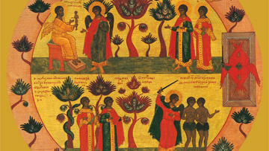
Chapter 5: Creation and the Fall

Slide 47
Opening Prayer
O God our Father, creator of heaven and earth, you have made us in your own image and likeness and given us dominion over the earth. Help us to use wisely the things of the earth so as to attain the things of heaven. Through Christ our Lord. Amen.

Slide 48
Opening Scripture: Genesis 1:26-31
Then God said, “Let us make man in our image, after our likeness; and let them have dominion over the fish of the sea, and over the birds of the air, and over the cattle, and over all the earth, and over every creeping thing that creeps upon the earth.” So God created man in his own image, in the image of God he created him; male and female he created them. And God blessed them, and God said to them, “Be fruitful and multiply, and fill the earth and subdue it; and have dominion over the fish of the sea and over the birds of the air and over every living thing that moves upon the earth.” And God said, “Behold, I have given you every plant yielding seed which is upon the face of all the earth, and every tree with seed in its fruit; you shall have them for food. And to every beast of the earth, and to every bird of the air, and to everything that creeps on the earth, everything that has the breath of life, I have given every green plant for food.” And it was so. And God saw everything that he had made, and behold, it was very good. And there was evening and there was morning, a sixth day. – Genesis 1:26-31

Slide 49
Chapter 5: Creation and the Fall
Key points from video
The two creation narratives of Genesis reveal theological truths about the nature of creation.
God created the world out of nothing and sustains it in being. God freely created the world to show forth and share his goodness.
Intelligent creatures (angels and men) are the highest part of creation and are capable of knowing and loving. A human being is a composite of body and a spiritual soul. The souls is directly created by God.
God’s Revelation about creation does not conflict with the authentic findings of the natural sciences.
The first human beings were created in a state of friendship with God but fell away through a free choice against him known as original sin.
Sin has wounded man’s relationship with God, with others, and with himself. Nevertheless, human nature remains fundamentally good and may be healed and transformed through God’s grace.

Slide 50
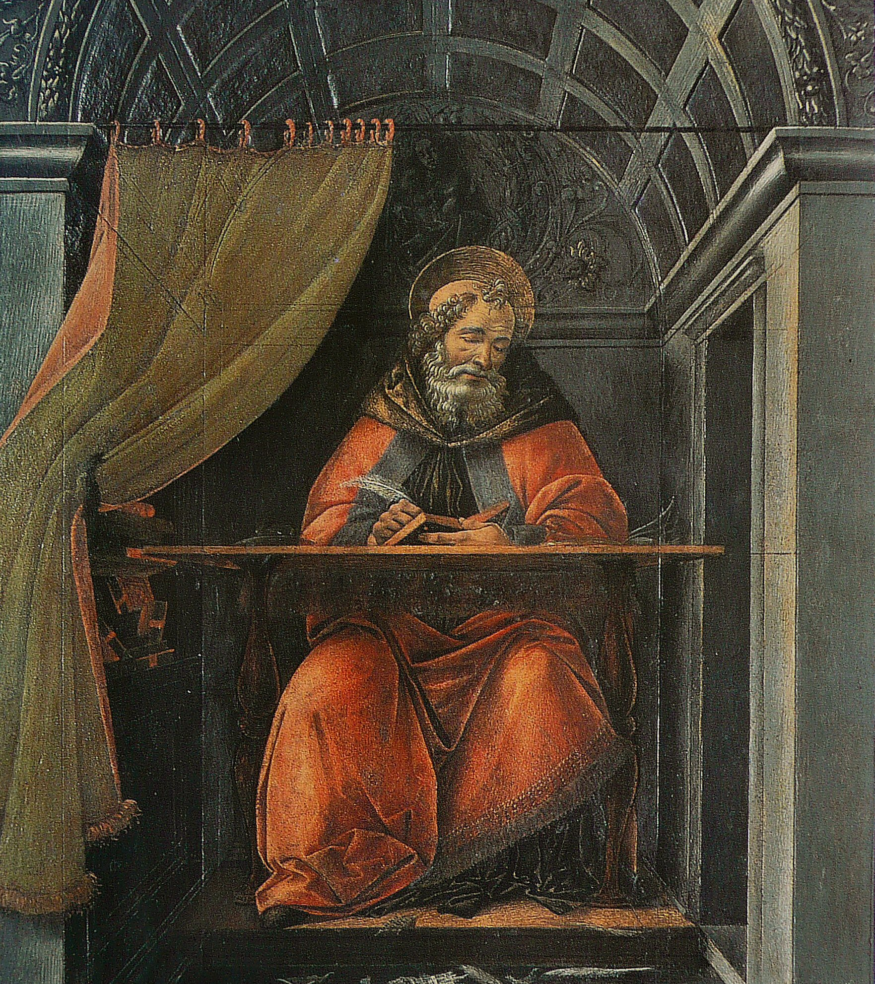
Wisdom of the Saints
We look upon the heavens and the earth, and they cry aloud that they were made. It was you, Lord, who made them: for You are beautiful, and they are beautiful: You are good, and they are good: You are, and they are. – St. Augustine

Slide 51
Chapter 5: Discussion Questions
Why did God create? Why did he make many different kinds of things? See CCC 319 and CCC 339
Explain the place of the human person in creation. What makes human beings different from other animals? What makes human beings different from angels?
Why do the true findings of physics or biology fail to threaten the Catholic understanding of creation? How does the human soul come about?
How is our life different than the life of Adam and Eve in paradise? How has original sin affected humanity?

Slide 52
From the Catechism
The doctrine of original sin is, so to speak, the "reverse side" of the Good News that Jesus is the Savior of all men, that all need salvation and that salvation is offered to all through Christ. The Church, which has the mind of Christ, knows very well that we cannot tamper with the revelation of original sin without undermining the mystery of Christ. –CCC 389

Slide 53
Chapter 5: Life Application Questions
1. How is the Catholic doctrine of creation different from your previous understanding of the world? How do you think it’s different from the average person’s understanding today?
2. The doctrine of creation reveals that God created you in his image and that he wants you to be happy with him forever. Explain what this means for you and how you would like to grow in your identity as a child of God.
3. Have you ever found it very difficult to choose what you know is right and good? How does the doctrine of original sin help make sense of your experience?

Slide 54
Chapter 5: Key Terms
Key Terms
Creation accounts: The two accounts at the beginning of the book of Genesis. They are not intended to be strictly historical accounts but rather reveal theological truths that form the fundamental basis for Catholic reflection on the nature of God’s creation.
Spiritual soul: The immaterial component of the human person. Described as “the breath of life” in the book of Genesis (Gn. 2:7), the soul is endowed with an intellect and will. The soul survives death and makes man capable of friendship with God through grace.
Original justice: The state of human beings before the fall characterized by intimate communion with God and harmony within man, harmony between man and woman, and harmony with the whole of humanity.
Original sin: The sin by which the first human beings disobeyed the commandment of God, choosing to follow their own will rather than God’s. In addition, the term describes the fallen state of human nature that affects every person born into the world.
Concupiscence: the weakness in doing good that we experience as an effect of original sin.

Slide 55
Closing Scripture 1 Corinthians 15:21-22
For as by a man came death, by a man has come also the resurrection of the dead. For as in Adam all die, so also in Christ shall all be made alive.

Slide 56
Closing Prayer
O Lord, good Father, who in your providence have entrusted the earth to the human race, grant we pray, that with the fruits harvested from it we may be able to sustain life and, with your help, always use them to promote your praise and the well-being of all. Through Christ our Lord. Amen.

Slide 57
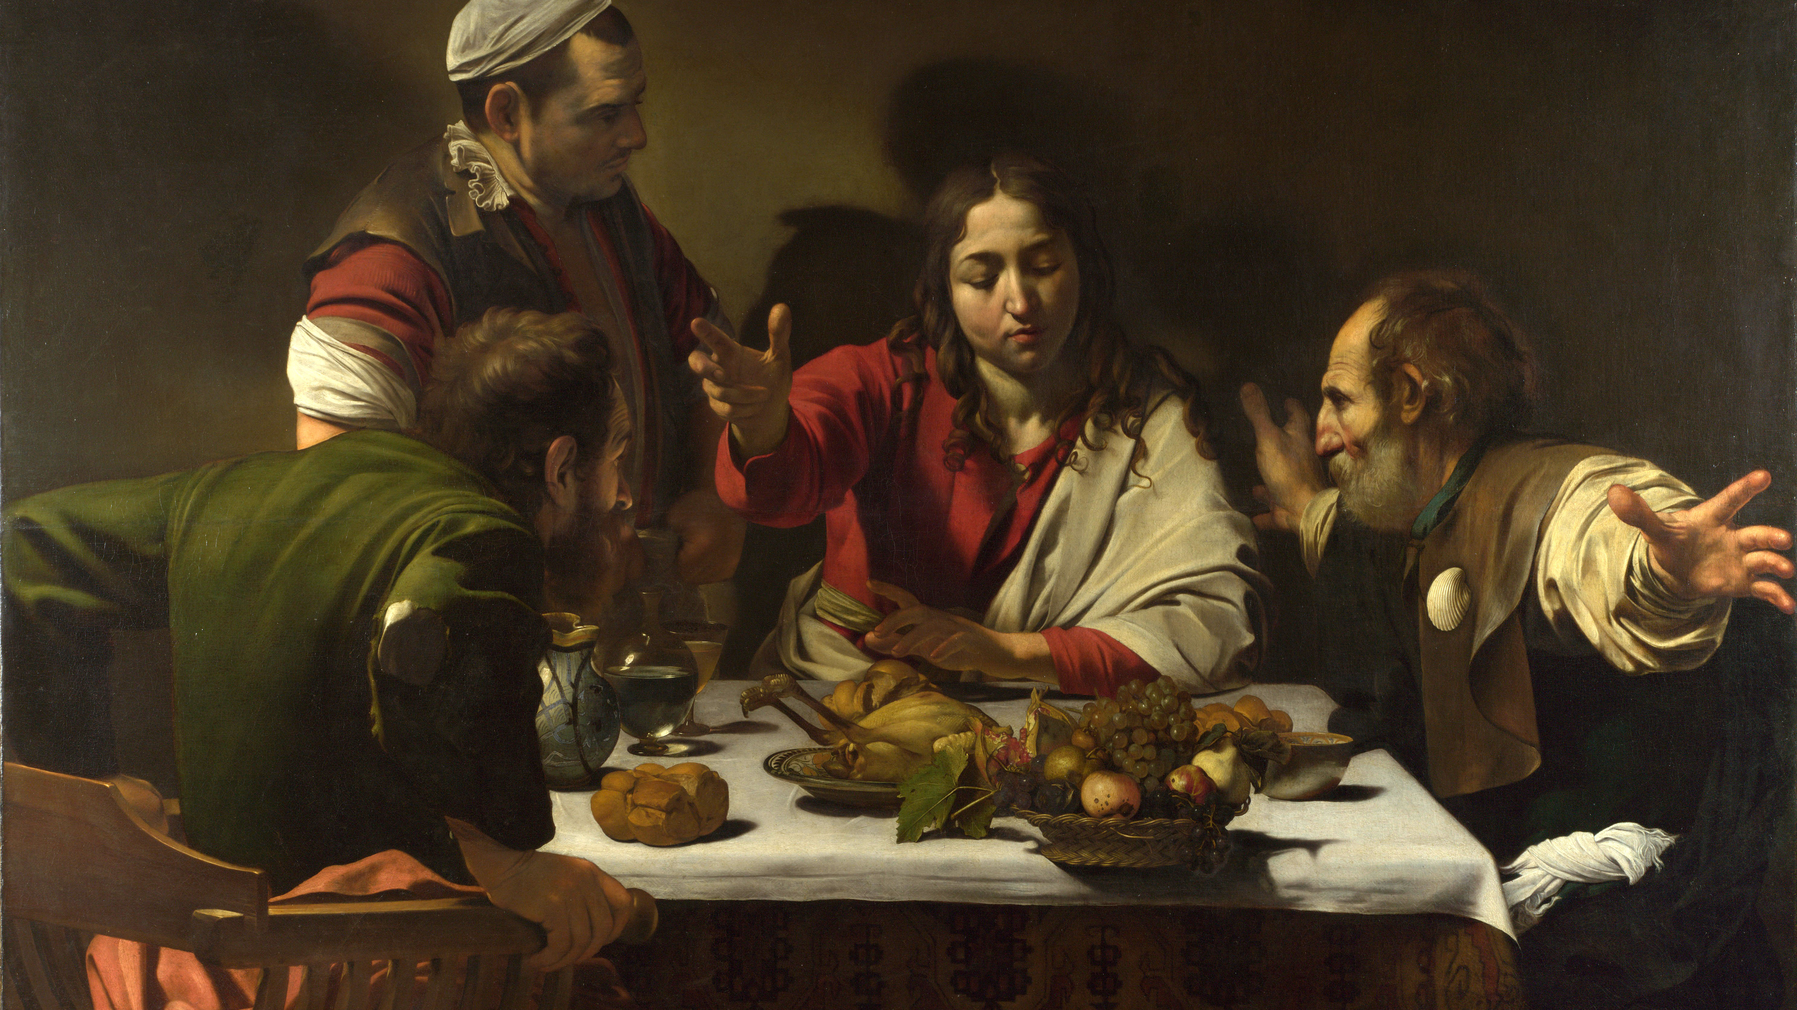
Chapter 6: Encountering Jesus in the Scriptures

Slide 58
Opening Prayer
O God our Father, creator of heaven and earth, you have made us in your own image and likeness and given us dominion over the earth. Help us to use wisely the things of the earth so as to attain the things of heaven. Through Christ our Lord. Amen.

Slide 59
Opening Scripture: Genesis 1:26-31
Then God said, “Let us make man in our image, after our likeness; and let them have dominion over the fish of the sea, and over the birds of the air, and over the cattle, and over all the earth, and over every creeping thing that creeps upon the earth.” So God created man in his own image, in the image of God he created him; male and female he created them. And God blessed them, and God said to them, “Be fruitful and multiply, and fill the earth and subdue it; and have dominion over the fish of the sea and over the birds of the air and over every living thing that moves upon the earth.” And God said, “Behold, I have given you every plant yielding seed which is upon the face of all the earth, and every tree with seed in its fruit; you shall have them for food. And to every beast of the earth, and to every bird of the air, and to everything that creeps on the earth, everything that has the breath of life, I have given every green plant for food.” And it was so. And God saw everything that he had made, and behold, it was very good. And there was evening and there was morning, a sixth day. – Genesis 1:26-31

Slide 60
Chapter 6: Encountering Jesus in the Scriptures
Key points from video
The Christian faith proclaims the truth that Jesus is alive in the present tense.
Christians are seeking above all to know Christ according to his deepest identity.
There are important things that history can tell us about Jesus and the time in which he lived his earthly life. For example, the religious, social, and political background of first-century Palestine; the different groups, or “parties,” in Judaism at that time (like Pharisees and Sadducees); the significance for a first-century Palestinian Jew of things Jesus is reported to have said, etc.
Knowing the true identity of Jesus is only possible by faith, yet a faith fully consistent with history.
Faith is built on what happened in history, and history points to faith.

Slide 61
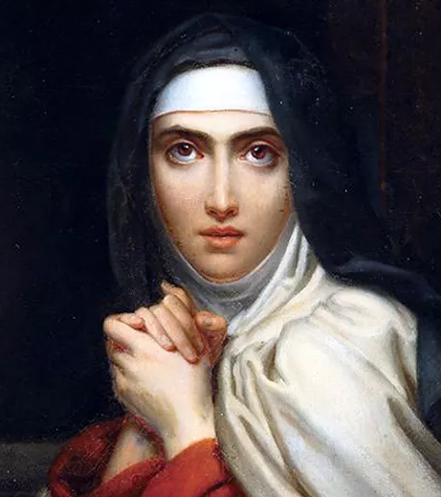
Wisdom of the Saints
[Jesus] will show us the way; we must look at His life – that is our best pattern. What more do we need than to have at our side so good a Friend, Who will not leave us in trials and tribulations, as earthly friends do?…When we are busy, or suffering persecutions or trials, when we cannot get as much quiet as we should like, and at seasons of aridity, we have a very good Friend in Christ. We look at Him as a Man; we think of His moments of weakness and times of trial; and He becomes our Companion. Once we have made a habit of thinking of Him in this way, it becomes very easy to find Him at our side. – St. Teresa of Avila

Slide 62
Chapter 6: Discussion Questions
Why is purely historical knowledge about Jesus insufficient for the Christian?
How does Scripture communicate to us the deepest, true identity of Jesus?
How can history be used well and how can it be misused, in coming to know Jesus?
What does it mean to say “the whole Bible is about Christ”?

Slide 63
From the Catechism
Jesus accepted Peter's profession of faith, which acknowledged him to be the Messiah, by announcing the imminent Passion of the Son of Man. He unveiled the authentic content of his messianic kingship both in the transcendent identity of the Son of Man "who came down from heaven", and in his redemptive mission as the suffering Servant: "The Son of Man came not to be served but to serve, and to give his life as a ransom for many." Hence the true meaning of his kingship is revealed only when he is raised high on the cross. Only after his Resurrection will Peter be able to proclaim Jesus' messianic kingship to the People of God: "Let all the house of Israel therefore know assuredly that God has made him both Lord and Christ, this Jesus whom you crucified."–CCC 440

Slide 64
Chapter 6: Life Application Questions
How well do you think you know Jesus as a person? What might you do to come to know Him better?
When others ask you about Jesus, what do you say? What should you tell them?
Have you ever been challenged about whether it is reasonable to believe that Jesus is the Son of God? How did you respond? How would you like to respond if you were asked today?

Slide 65
Chapter 6: Key Terms
Key Terms
Christ: From the Greek translation of the Hebrew word Messiah, which means “anointed.” (In the Old Testament, prophets, priests, and kings were anointed with oil.) In the case of Jesus, being called “Christ” or “the Christ” corresponded to the Jewish expectation of a messiah who would save his people.. Further, the Gospels depict him as “anointed” in his human nature with the Holy Spirit for the sake of his saving mission.
Gnostic Gospels: Later texts (in some cases, written several centuries after Christ) that combine elements of Christian belief with other elements of Ancient Near-Eastern religions, producing a Christian-seeming form of what is in fact an early heresy or, in some cases, perhaps even a non-Christian religion. These so-called “gospels” are sometimes touted by skeptics as providing an alternative account of the life of Jesus. They are not regarded by serious historians as credible evidence, however, since they originated much later than Jesus, were likely composed in geographic locations distant from Palestine, and do not indicate familiarity with the life and customs of first-century AD Palestine (that is, the historical context in which Jesus in fact lived.)

Slide 66
From St. Pope John Paul II
In Christ and through Christ God has revealed himself fully to mankind and has definitively drawn close to it; at the same time, in Christ and through Christ man has acquired full awareness of his dignity, of the heights to which he is raised, of the surpassing worth of his own humanity, and of the meaning of his existence. – Redemptor Hominis (The Redeemer of Man), no. 11

Slide 67
Closing Scripture 1 Corinthians 1:22-25
For Jews demand signs and Greeks seek wisdom, but we preach Christ crucified, a stumbling block to Jews and folly to Gentiles, but to those who are called, both Jews and Greeks, Christ the power of God and the wisdom of God. For the foolishness of God is wiser than men, and the weakness of God is stronger than men.

Slide 68
Closing Prayer
Leader: Our Help is in the name of the Lord.
Response: Who made heaven and earth
All make the sign of the cross

Slide 69
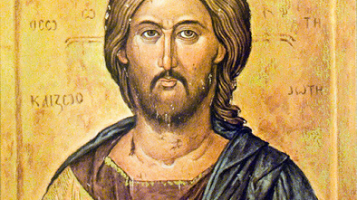
Chapter 7: Jesus Christ: True God and True Man

Slide 70
Opening Prayer
Pour forth, we beseech you, O Lord, your grace into our hearts, that we, to whom the Incarnation of Christ your Son was made known by the message of an Angel, may by his Passion and Cross be brought to the glory of His Resurrection. Who lives and reigns with you in the unity of the Holy Spirit, one God, for ever and ever. Amen.

Slide 71
Opening Scripture: Luke 1:26-28
In the sixth month the angel Gabriel was sent from God to a city of Galilee named Nazareth, to a virgin betrothed to a man whose name was Joseph, of the house of David; and the virgin’s name was Mary. And he came to her and said, “Hail, full of grace, the Lord is with you!” But she was greatly troubled at the saying, and considered in her mind what sort of greeting this might be. And the angel said to her, “Do not be afraid, Mary, for you have found favor with God. And behold, you will conceive in your womb and bear a son, and you shall call his name Jesus. He will be great, and will be called the Son of the Most High; and the Lord God will give to him the throne of his father David, and he will reign over the house of Jacob for ever; and of his kingdom there will be no end.” And Mary said to the angel, “How can this be, since I have no husband?” And the angel said to her, “The Holy Spirit will come upon you, and the power of the Most High will overshadow you; therefore the child to be born^{[h]} will be called holy, the Son of God. And behold, your kinswoman Elizabeth in her old age has also conceived a son; and this is the sixth month with her who was called barren. For with God nothing will be impossible.” And Mary said, “Behold, I am the handmaid of the Lord; let it be to me according to your word.” And the angel departed from her.

Slide 72
Chapter 7: Jesus Christ: True God and True Man
Key points from video
“The Word became flesh” (Jn 1:14). We call this the Incarnation, which literally means enfleshment.
Scripture teaches us that Jesus is true God and true man. This is one of the most important tenets of the Christian faith.
The Incarnation is a remedy for sin, and it repairs the fall of our first parents.
As man, Jesus is anointed by the Holy Spirit at the first moment of his conception, and this is manifested at his baptism in the Jordan.
In his humanity, Jesus possessed every spiritual gift and grace possible for a man.

Slide 73
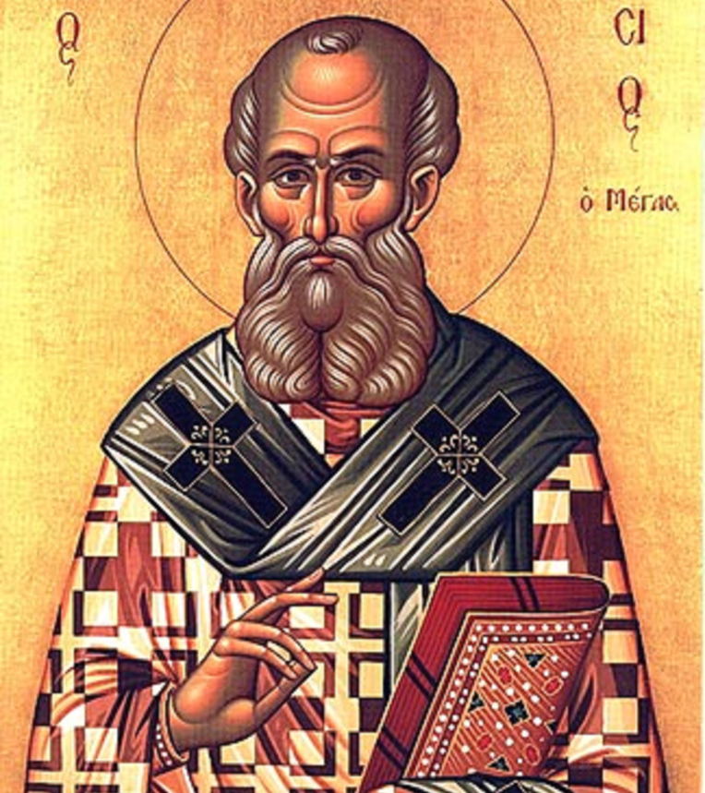
Wisdom of the Saints
The Son of God became man so that we might become God. – St. Athanasius of Alexandria

Slide 74
Chapter 7: Discussion Questions
What does it mean to say that the Word “became flesh”?
How does Scripture typically explain why the Son became man?
In what sense was Jesus “anointed” with the Holy Spirit?
What is the purpose of the miracles of Jesus?

Slide 75
From the Catechism
The unique and altogether singular event of the Incarnation of the Son of God does not mean that Jesus Christ is part God and part man, nor does it imply that he is the result of a confused mixture of the divine and the human. He became truly man while remaining truly God. Jesus Christ is true God and true man. During the first centuries, the Church had to defend and clarify this truth of faith against the heresies that falsified it. -CCC 464

Slide 76
Chapter 7: Life Application Questions
Think about the fact that God is inviting you to be his adopted son or daughter. What does this mean for you and your life?
What might you do concretely in your life to learn more deeply from Jesus, the perfect teacher and revealer of God?
How are you led closer to God as you come to know Jesus and encounter him in the Eucharist?

Slide 77
Chapter 7: Key Terms
Key Terms
Incarnation: Literally “enfleshment.” It refers to the Word becoming flesh (see Jn 1:14), his becoming man. More generally, the term refers to the fact that the Son of God assumed human nature and became man in order to accomplish our salvation in that same human nature. Jesus Christ, the Son of God, the second Person of the Trinity, is both true God and true man, not part God and part man.
Co-eternal: A term used to express how the Son exists eternally with the Father and the Holy Spirit. There is no moment when one existed without the others.
Anointing: an act of consecrating someone for a special mission through the imposition of oil, as when David was anointed king (see 1 Sm 16:12-13). In fulfilment of the Old Testament prophecies, Jesus was anointed by the Holy Spirit as priest, prophet, and king. Christ (in Hebrew, Messiah) means the one “anointed” by the Holy Spirit.

Slide 78
From Pope Pius XII
But after the unhappy fall of Adam, the whole human race, infected by the hereditary stain, lost their participation in the divine nature, and we were all "children of wrath.” But the all-merciful God "so loved the world as to give His only-begotten Son,” and the Word of the Eternal Father with the same divine love assumed human nature from the race of Adam - but as an innocent and spotless nature - so that He, as the new Adam, might be the source whence the grace of the Holy Spirit should flow unto all the children of the first parent. Through the sin of the first man they had been excluded from adoption as children of God; through the Word incarnate, made brothers according to the flesh of the only-begotten Son of God, they receive also the power to become the sons of God. – Mystici Corporis Christi, no. 12

Slide 79
Closing Scripture Galatians 2:20
I have been crucified with Christ; it is no longer I who live, but Christ who lives in me; and the life I now live in the flesh I live by faith in the Son of God, who loved me and gave himself for me.

Slide 80
Closing Prayer
Leader: Our Help is in the name of the Lord.
Response: Who made heaven and earth
All make the sign of the cross

Slide 81
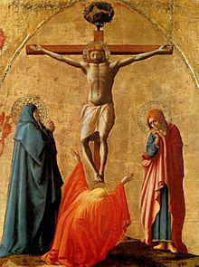
Chapter 8: Jesus Christ: Our Savior and Redeemer

Slide 82
Opening Prayer
Almighty Father, you sent your only begotten Son into the world to redeem the human race from sin. Give us the grace to believe in Jesus Christ, the one true mediator between God and men, so that recognizing your mercy, we may come by his grace to the promise of eternal life. Amen.

Slide 83
Opening Scripture: Philippians 2:5-11
5 Have this mind among yourselves, which is yours in Christ Jesus, 6 who, though he was in the form of God, did not count equality with God a thing to be grasped, 7 but emptied himself, by taking the form of a servant, being born in the likeness of men. 8 And being found in human form, he humbled himself by becoming obedient to the point of death, even death on a cross. 9 Therefore God has highly exalted him and bestowed on him the name that is above every name, 10 so that at the name of Jesus every knee should bow, in heaven and on earth and under the earth, 11 and every tongue confess that Jesus Christ is Lord, to the glory of God the Father.

Slide 84
Chapter 8: Jesus Christ: Our Savior and Redeemer
Key points from video
The suffering and death of Christ are mysteries that reveal to us who God is, his solidarity with us and love for us, and his victory over the powers of evil.
The atonement is the reconciliation of God and man effected by Christ's sacrificial death. Christ offered himself to the Father in reparation for human sins.
Christ suffered during his passion in both his body and soul. His spiritual grief stemmed especially from his confrontation with the gravity of human sinfulness and his contrition of heart by which he mourned for all human sins.
Christ’s resurrection entails a reunion of body and soul such that Christ can no longer suffer or die but will live forever as man in both body and soul.
Christ’s resurrection is the first moment in God’s new creation, or “recreation,” of the world. His resurrection announces and anticipates the final re-creation of all things and the universal resurrection of the dead.

Slide 85
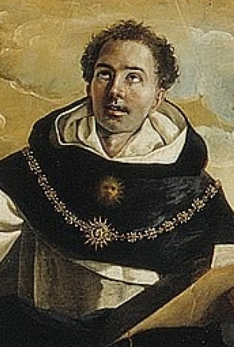
Wisdom of the Saints
There us no virtue that did not have its example on the Cross. So if you seek an example of charity, then “greater love than this no one has, than to lay down his life for his friends” (Jn 15:13)…If you you seek an example of patience, you will find it in its highest degree upon the Cross. Great patience is exemplified in two ways: either when one suffers intensely in all patience, or when one suffers that which he could avoid if he so wished…He could have avoided this suffering, but He did not…The patience of Christ upon the cross, therefore, was of the highest degree…If you seek an example of humility, look upon Him who who is crucified; although He was God, He chose to be judged by Pontius Pilate and to be put to death…”He humbled Himself, becoming obedient unto death, even to the death of the cross” (Phil 2:8) – St. Thomas Aquinas

Slide 86
Chapter 8: Discussion Questions
Why did God become human? Why did Christ suffer the passion and make himself subject to death for our sake?
How does Christ’s obedience and love as man make reparation for sin?
How did Christ suffer during the passion? How was he consoled?
What does it mean to say that Christ is resurrected from the dead?

Slide 87
From the Catechism
Christ's Resurrection was not a return to earthly life, as was the case with the raisings from the dead that he had performed before Easter: Jairus' daughter, the young man of Naim, Lazarus. These actions were miraculous events, but the persons miraculously raised returned by Jesus' power to ordinary earthly life. At some particular moment they would die again. Christ's Resurrection is essentially different. In his risen body he passes from the state of death to another life beyond time and space. At Jesus' Resurrection his body is filled with the power of the Holy Spirit: he shares the divine life in his glorious state, so that St. Paul can say that Christ is "the man of heaven”. (1 Cor 15:35-50) - CCC 646

Slide 88
Chapter 8: Life Application Questions
What does it mean for you that God has suffered a human death like ours? How can that comfort you when you ponder your own mortality?
What does it mean for each of us that Christ has atoned for human sins? Concretely, how can you have access to this mystery?
Is the victory of the Resurrection of practical importance for your life? How so?

Slide 89
From Saint Pope Paul VI
In the human nature united to Himself the Son of God, by overcoming death through His own death and resurrection, redeemed man and re-molded him into a new creation. By communicating His Spirit, Christ made His brothers, called together from all nations, mystically the components of His own Body.
In that Body the life of Christ is poured into the believers who, through the sacraments, are united in a hidden and real way to Christ who suffered and was glorified. – Lumen Gentium, no. 7

Slide 90
Chapter 8: Key Terms
Key Terms
Paschal Mystery: The suffering, death, and resurrection of Christ by which he has revealed himself to us in an ultimate way, reconciled us to the Father, and redeemed the world.
Atonement: The reconciliation of God and man brought about by Christ's suffering and death, and the reparation made by Christ for human sins.
Resurrection: The glorification of Christ's body and soul that took place on Easter night. This is a mystery that endures forever, since Christ lives perpetually as man and is no longer subject to death.

Slide 91
Closing Scripture 1 Corinthians 15:12-14, 20-23
12 Now if Christ is proclaimed as raised from the dead, how can some of you say there is no resurrection of the dead? 13 If there is no resurrection of the dead, then Christ has not been raised; 14 and if Christ has not been raised, then our proclamation has been in vain and your faith has been in vain…20 But in fact Christ has been raised from the dead, the first fruits of those who have died.[f] 21 For since death came through a human being, the resurrection of the dead has also come through a human being; 22 for as all die in Adam, so all will be made alive in Christ. 23 But each in his own order: Christ the first fruits, then at his coming those who belong to Christ.

Slide 92
Closing Prayer
Look down upon me, good and gentle Jesus, while before Your face I humbly kneel and, with burning soul, pray and beseech You fix deep in my heart lively sentiments of faith, hope, and charity; true contrition for my sins, and a firm purpose of amendment. While I contemplate, with great love and tender pity, Your five precious wounds, pondering over them within me and calling to mind the words which David, Your prophet, said to You, my Jesus: “They have pierced My hands and My feet, they have numbered all My bones.” Amen.

Slide 93
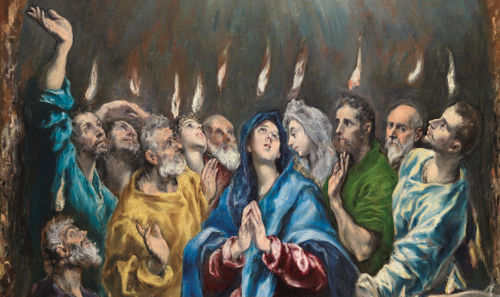
Chapter 9: The Holy Spirit

Slide 94
Opening Prayer
Come, Holy Spirit, fill the hearts of your faithful and kindle in them the fire of your love.
Send forth your Spirit and they shall be created. And you shall renew the face of the earth.
O God, who by the light of the Holy Spirit, did instruct the hearts of the faithful, grant that by the same Holy Spirit we may be truly wise and ever enjoy his consolations.
Through the same Christ Our Lord. Amen.

Slide 95
Opening Scripture: John 14:15-17, 25-26
15 “If you love me, keep my commands. 16 And I will ask the Father, and he will give you another advocate to help you and be with you forever— 17 the Spirit of truth. The world cannot accept him, because it neither sees him nor knows him. But you know him, for he lives with you and will be in you.

Slide 96
Chapter 9: The Holy Spirit
Key points from video
Scripture has a lot to tell us about what the Holy Spirit does in our lives.
The first proper name for this Divine Person is "Holy Spirit."
The Holy Spirit is also associated with love.
A third name for Holy Spirit is "Gift" because the only reason one give a truly gratuitous gift to another, expecting nothing in return, is because of love.
The Holy Spirit really dwells in you like a temple, making you holy like he is holy.

Slide 97
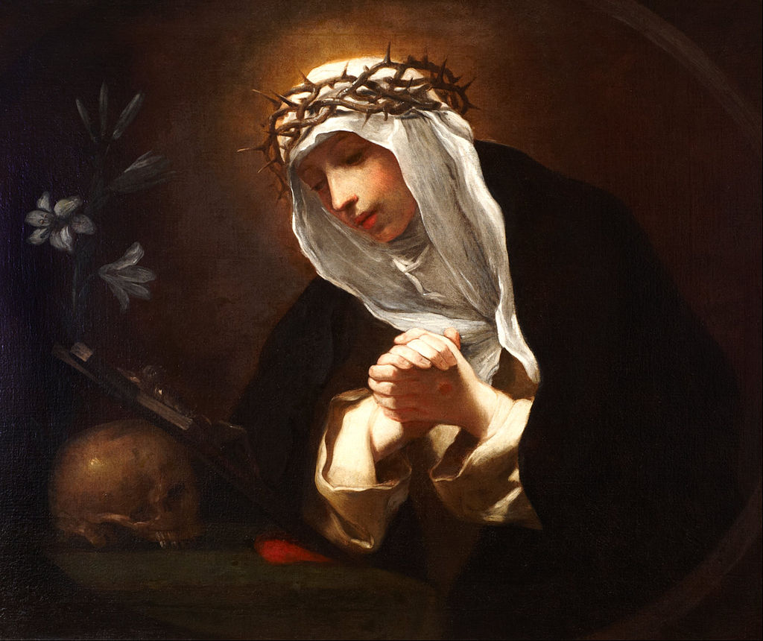
Wisdom of the Saints
The Father says: “When [my Son] had ascended on high, and returned to Me the Father, I sent the Master, that is the Holy Spirit, who came to you with My power and the wisdom of My Son, and with His own clemency, which is the essence of the Holy Spirit. He is one thing with Me, the Father, and with My Son. And He built up the road of the doctrine which My Truth had left in the world. – St. Catherine of Sienna (Message from God the Father)

Slide 98
Chapter 9: Discussion Questions
What are some of the actions that Scripture associates with the Holy Spirit’s activity in our lives?
The Holy Spirit is traditionally associated with love in God. What does that reveal to us about who the Spirit truly is?
What is the Holy Spirit’s place in the life of Jesus?
What is the Holy Spirit’s place in God’s plan of our salvation, coming from Christ?

Slide 99
From the Catechism
734 Because we are dead or at least wounded through sin, the first effect of the gift of love is the forgiveness of our sins. The communion of the Holy Spirit126 in the Church restores to the baptized the divine likeness lost through sin.
735 He, then, gives us the "pledge" or "first fruits" of our inheritance: the very life of the Holy Trinity, which is to love as "God [has] loved us."127 This love (the "charity" of 1 Cor 13) is the source of the new life in Christ, made possible because we have received "power" from the Holy Spirit.128
736 By this power of the Spirit, God's children can bear much fruit. He who has grafted us onto the true vine will make us bear "the fruit of the Spirit: . . . love, joy, peace, patience, kindness, goodness, faithfulness, gentleness, self-control."129 "We live by the Spirit"; the more we renounce ourselves, the more we "walk by the Spirit."130

Slide 100
Chapter 9: Life Application Questions
How have you experienced the gifts or the presence of the Holy Spirit in your life?
If you could ask the Holy Spirit for one special grace above all others, what would it be?
The Holy Spirit is “love in person,” the love of God so infinitely perfect that he is a Divine Person. How can you enter your life more and more on the love of God above all things?

Slide 101
Chapter 9: Key Terms
Key Terms
Procession: Literally, “to come forth.” Theologians began to use this term, which Jesus himself uses in John 8:42, to talk about how he “came forth” from the Father (“coming forth” in the Vulgate Latin translation of the Bible is “processio”). It then came to be used also for the Holy Spirit to designate how the Holy Spirit is “from” both the Father and the Son.
Orthodox Churches: The churches, mostly in the East (or what was formerly the Byzantine empire), that separated from the pope and the Catholic Church in the Great Schism of AD 1054. These churches are generally agreed to have apostolic succession with patriarchs, bishops, priests, deacons, and so forth, and to celebrate the sacraments, but they have some theological disagreements with the Catholic Church (the most famous is about the Holy Spirit) and are not in communion with the Catholic Church.
“Gift in Person”: The traditional name for the Holy Spirit that highlights how the Holy Spirit is eternally apt for being given to us. The Holy Spirit is a Divine Person and exists eternally and would be “Gift in person” even if no creatures existed to whom he could be given. Because he proceeds by way of love, he is eternally suited to being given, since love Is the only reason why a true gift is given.
”Love in Person”: The name for the Holy Spirit that highlights how he proceeds from the Father and the Son as their mutual love: the perfect and infinite bond of love between them. As the Father knows himself in speaking his Word, he also loves himself (and the Son loves the Father) with a personal love who is the Holy Spirit.

Slide 102
From Pope St. John Paul II
The Holy Spirit as Love and Gift comes down, in a certain sense, into the very heart of the sacrifice which is offered on the Cross. Referring here to the biblical tradition, we can say: He consumes this sacrifice with the fire of the love which unites the Son with the Father in the Trinitarian communion. And since the sacrifice of the Cross is an act proper to Christ, also in this sacrifice he "receives" the Holy Spirit. - Donimum et Vivificatem, no. 41

Slide 103
Closing Scripture Ephesians 4:4-6
There is one body and one Spirit, just as you were called to the one hope of your calling, ⁵ one Lord, one faith, one baptism, ⁶ one God and Father of all, who is above all and through all and in all.

Slide 104
Closing Prayer
Leader: Our Help is in the name of the Lord.
Response: Who made heaven and earth
All make the sign of the cross

Slide 105
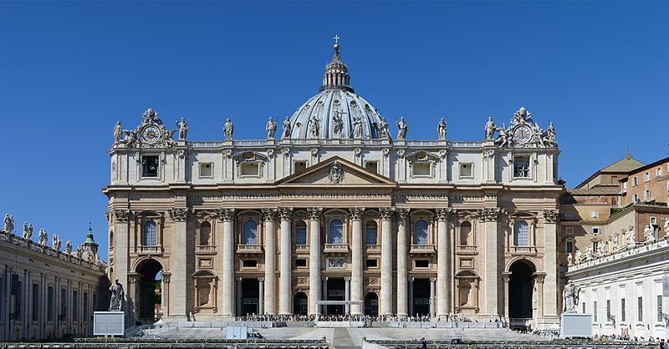
Chapter 10: The Church

Slide 106
Opening Prayer
Lord Jesus Christ, reveal to us the mystery of your Church, which is one, holy, catholic, and apostolic. Grant us the grace to perceive the splendor of the truth taught by your Church, and give us the heartfelt desire to participate in her visible communion. Amen.

Slide 107
Opening Scripture: Colossians 1:17-26
17 He is before all things, and in him all things hold together. 18 He is the head of the body, the church; he is the beginning, the first-born from the dead, that in everything he might be pre-eminent. 19 For in him all the fulness of God was pleased to dwell, 20 and through him to reconcile to himself all things, whether on earth or in heaven, making peace by the blood of his cross.
21 And you, who once were estranged and hostile in mind, doing evil deeds, 22 he has now reconciled in his body of flesh by his death, in order to present you holy and blameless and irreproachable before him, 23 provided that you continue in the faith, stable and steadfast, not shifting from the hope of the gospel which you heard, which has been preached to every creature under heaven, and of which I, Paul, became a minister.
Paul’s Interest in the Colossians
24 Now I rejoice in my sufferings for your sake, and in my flesh I complete what is lacking in Christ’s afflictions for the sake of his body, that is, the church, 25 of which I became a minister according to the divine office which was given to me for you, to make the word of God fully known, 26 the mystery hidden for ages and generations but now made manifest to his saints.

Slide 108
Chapter 10: The Church
Key points from video
The Nicene Creed speaks about the four marks of the Church: one, holy, catholic, and apostolic.
The Church is apostolic because it was founded by Christ who gathered the initial twelve apostles and today remains the institution that stems from these earliest times. Continuity of identity and teaching is maintained down through time by the bishops, who are the successors of the apostles.
The unity of the Church is based on the shared truth, sacramental life, and communion of charity that stands at the heart of the Church.
The Church is holy in her grace (received from Christ), in her sacraments, and in her saints.
The Church is catholic, or ‘universal,’ because she remains present in history, spreading gradually throughout all times and places. The human race is brought into a visible communion of truth and charity in and through the visible life of the Church.
God offers grace and the possibility of salvation to those who are not visible members of the Church. By cooperating with this grace, they can be draw closer to the perfection of communion in the visible life of the Church.

Slide 109
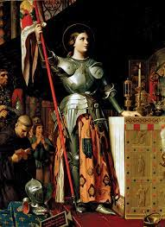
Wisdom of the Saints
About Jesus and the Church, I simply know they’re just one thing, and we shouldn’t complicate the matter. – St. Joan of Arc

Slide 110
Chapter 10: Discussion Questions
Why does the visibility and the public unity of the Church matter?
How is the apostolic teaching of the Church maintained down through time?
What is the holiness of the Church? Where are we assured of its presence?
What is the importance of the visible catholicity or universality of the Church?

Slide 111
From the Catechism
The comparison of the Church with the body casts light on the intimate bond between Christ and his Church. Not only is she gathered around him; she is united in him, in his body. Three aspects of the Church as the Body of Christ are to be more specifically noted: the unity of all her members with each other as a result of their union with Christ; Christ as head of the Body; and the Church as bride of Christ. – CCC 789

Slide 112
Chapter 10: Life Application Questions
What does the visible communion of the Catholic Church offer each of us spiritually in our relationship with God? Do you find yourself respecting the global unity of the Church?
How do past historical figures help inspire us today through their example? How can the saints, then, inspire us to holiness? What is the role they can play in your life?
Does the authority of the Church offer you any comfort? Did it threaten you before? If so, how?

Slide 113
From Pope St. John Paul II
For the Catholic Church…the communion of Christians is none other than the manifestation in them of the grace by which God makes them sharers in his own communion, which is his eternal life…To believe in Christ means to desire unity; to desire unity means to desire the Church. – Ut Unum Sint, no. 9

Slide 114
Chapter 10: Key Terms
Key Terms
Apostolic Deposit of faith: The revelation of Christ transmitted to us by the apostles and safeguarded by the Church.
Apostolic succession: The succession of bishops ordained by previous bishops, tracing all the way back to Christ and the apostles.
Infallibility: The gift of the Holy Spirit to the Church whereby the pastors of the Church (the pope and bishops in union with him) can definitively formulate a doctrine of faith or morals as contain within Revelation for the belief of the faithful. This is not set above the Faith or above Scripture but arises from Christ's institution of pastors in the Church charged with teaching the Gospel and authentically interpreting Divine Revelation and his promise to them of the aid of the Holy Spirit. Normally, the authoritative teaching of the Faith is formulated as the Church acts through the college of bishops with the pope as its head. This can happen in an ordinary way by the repeated proclamation of Church doctrine (the so-called 'ordinary magisterium') or, in an extraordinary way, through an ecumenical council of bishops gathered in communion with the pope. There is also the extraordinary case of 'papal infallibility,' whereby, in extraordinary cases, the pope can 'define' a specific formulation of the Church's belief as binding for belief. He does this by a solemn proclamation in virtue of his supreme apostolic authority as shepherd and teacher of all Christians. Not all opinions or statements of the pope should be considered infallible; rather, only those that are formulated in this special way and designated as such.

Slide 115
Closing Scripture 1 Timothy 3:14-16 (emphasis added)
I hope to come to you soon, but I am writing these instructions to you so that, ¹⁵ if I am delayed, you may know how one ought to behave in the household of God, which is the church of the living God, the pillar and bulwark of the truth. ¹⁶ Great indeed, we confess, is the mystery of our religion:
He was manifested in the flesh, vindicated in the Spirit, seen by angels, preached among the nations, believed on in the world, taken up in glory.

Slide 116
Closing Prayer
Almighty Father, mercifully grant us an understanding of the mystery of the Church and a spiritual desire to enter into the fullness of communion in the Catholic Church. May your Holy Spirit enlighten us so that we may perceive the marks of the Church: her unity, holiness, universality, and apostolic origin. May we be witnesses to Christ in our world today and become in turn defenders of the faith with your help. Through Christ our Lord. Amen.

Slide 117
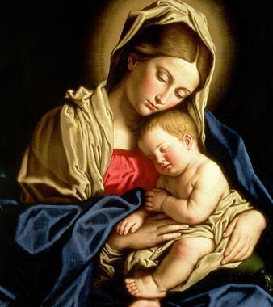
Chapter 11: Mary and the Saints

Slide 118
Opening Prayer
O God, who chose the Blessed Virgin Mary, foremost among the poor and humble, to be the Mother of the Savior, grant, we pray, that, following her example, we may offer you the homage of sincere faith and place in you all our hope of salvation. Through Christ our Lord. Amen.

Slide 119
Opening Scripture: Luke 1:26-28
In the sixth month the angel Gabriel was sent from God to a city of Galilee named Nazareth, ²⁷ to a virgin betrothed to a man whose name was Joseph, of the house of David; and the virgin’s name was Mary. ²⁸ And he came to her and said, “Hail, full of grace, the Lord is with you!” ²⁹ But she was greatly troubled at the saying, and considered in her mind what sort of greeting this might be. ³⁰ And the angel said to her, “Do not be afraid, Mary, for you have found favor with God. ³¹ And behold, you will conceive in your womb and bear a son, and you shall call his name Jesus.
32 He will be great, and will be called the Son of the Most High; and the Lord God will give to him the throne of his father David, 33 and he will reign over the house of Jacob for ever; and of his kingdom there will be no end.”
34 And Mary said to the angel, “How can this be, since I have no husband?” 35 And the angel said to her,
“The Holy Spirit will come upon you, and the power of the Most High will overshadow you; therefore the child to be born will be called holy, the Son of God.
36 And behold, your kinswoman Elizabeth in her old age has also conceived a son; and this is the sixth month with her who was called barren. 37 For with God nothing will be impossible.” 38 And Mary said, “Behold, I am the handmaid of the Lord; let it be to me according to your word.” And the angel departed from her.

Slide 120
Chapter 11: The Blessed Virgin Mary and the Communion of Saints
Key points from video
Many criticize the Catholic Church for the importance it accords to the Blessed Virgin Mary.
The greatest grace of Mary's life is her divine maternity.
Mary is full of grace and enjoys perpetual virginity.
Mary was conceived without original sin by virtue of the merits of her son (Immaculate Conception)
At the Assumption, Mary is taken bodily into heaven to share her Son's victory over death.
We venerate Mary and the saints for the wonders that God has worked in them, and we ask their intercession that God's will come about through their prayers and merits.

Slide 121
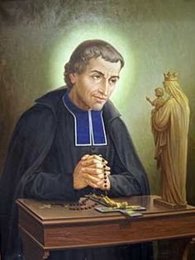
Wisdom of the Saints
We never give more honor to Jesus than when we honor his Mother, and we honor her simply and solely to honor him all the more perfectly. We go to her only as a way leading to the goal we seek – Jesus, her Son. – St. Louis Marie de Monfort.

Slide 122
Chapter 11: Discussion Questions
Why is Mary’s divine maternity (Mother of God) her greatest grace? In what sense do the other myesteries of her life point to this mystery?
What is peculiar about the grace of the Immaculate Conception?
We said that we pray to the saints for their intercession and we give them honor for the grace of God at work in their lives. Do these acts of prayer and veneration distract from the worship of God or enrich it? How?
In what sense is it good or beneficial that God works through the prayers of his saints?

Slide 123
From the Catechism
What the Catholic faith believes about Mary is based on what it believes about Christ, and what it teaches about Mary illumines in turn its faith in Christ.– CCC 487

Slide 124
Chapter 11: Life Application Questions
The doctrines describing Mary’s graces seem so otherworldly that it can be difficult to see what significance the have for our lives. Consider the Immaculate Conception and the Assumption. In what way are these graces encouraging for fallen men and women? How do these mysteries instruct and inspire us?
Mary is truly the mother of the Church – the mother of all Christians. What does it mean for you to know that you have a spiritual mother? How does that shape your prayer?
Cultivating devotion to particular saints is like making heavenly friends. Have you ever felt close to someone you have never met or formed a friendship from a distance? How might that help you think about the saints?

Slide 125
From Saint Pope Paul VI
The Father of mercies willed that the incarnation should be preceded by the acceptance of her who was predestined to be the mother of His Son, so that just as a woman contributed to death, so also should a woman contribute to life. – Lumen Gentium, no. 56

Slide 126
Chapter 11: Key Terms
Key Terms
The Annunciation: The occasion on which the angel Gabriel announced God's plans to Mary and she welcomed his invitation to become the Mother of God. At her word, the Lord was conceived in her womb by the power of the Holy. The Church commemorates this event each year on March 25, nine months before the celebration of the Nativity of the Lord (Christmas).
The Assumption: The occasion on which, at the end of her earthly life, Mary was taken up (assumed) body and soul into heaven. The Church commemorates this event each year on August 15. After enjoying a widespread popular cult (devotion) for many centuries, this doctrine was solemnly defined by the Church in 1950.
The Immaculate Conception: The conception of the Blessed Virgin Mary by the come together of her parents, Saints Joachim and Anne. At her conception, Mary was presented from original sin and filled with an abundance of grace befitting her sublime mission. Thus, the angel Gabriel rightly hailed her as 'full of grace' (Lk 1:28). The Church commemorates this event each year on December 8, nine months before the Nativity of the Blessed Virgin Mary (Mary’s birthday). After enjoying a widespread popular cult (devotion) for many centuries, this doctrine was solemnly defined by the Church in 1854.

Slide 127
Closing Scripture Galatians 4:4-5
But when the time had fully come, God sent forth his Son, born of a woman, born under the law, to redeem those who were under the law, so that we might receive adoption as sons.

Slide 128
Closing Prayer
Ave, María, grátia plena, Dóminus tecum. Benedicta tu in muliéribus, et benedíctus fructus ventris tui, Iesus. Sancta María, Mater Dei, ora pro nobis peccatoribus nunc et in hora mortis nostrae. Amen.
Hail Mary, full of grace, the Lord is with thee, blessed art thou among women and blessed is the fruit of thy womb, Jesus. Holy Mary, Mother of God, pray for us sinners now and at the hour of our death. Amen.

Slide 129
Part II: Sacramental Life and Practice

Slide 130
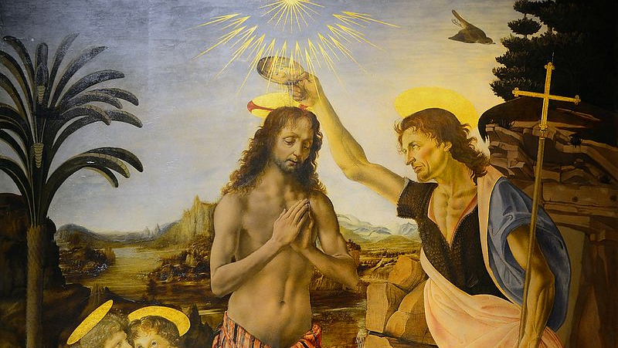
Chapter 12: Baptism and Confirmation

Slide 131
Opening Prayer
Almighty ever-living God, who, when Christ had been baptized in the River Jordan and as the Holy Spirit descended upon him, solemnly declared him your beloved Son, grant that your children by adoption, reborn of water and the Holy Spirit, may always be well pleasing to you. Through Christ our Lord. Amen.

Slide 132
Opening Scripture: Romans 6:3-11
3 Do you not know that all of us who have been baptized into Christ Jesus were baptized into his death? 4 Therefore we have been buried with him by baptism into death, so that, just as Christ was raised from the dead by the glory of the Father, so we too might walk in newness of life.
5 For if we have been united with him in a death like his, we will certainly be united with him in a resurrection like his. 6 We know that our old self was crucified with him so that the body of sin might be destroyed, and we might no longer be enslaved to sin. 7 For whoever has died is freed from sin. 8 But if we have died with Christ, we believe that we will also live with him. 9 We know that Christ, being raised from the dead, will never die again; death no longer has dominion over him. 10 The death he died, he died to sin, once for all; but the life he lives, he lives to God. 11 So you also must consider yourselves dead to sin and alive to God in Christ Jesus.

Slide 133
Chapter 12: Baptism and Confirmation
Key points from video
Baptism is the first of the sacraments; it is the sacrament of rebirth.
Baptism is administered by pouring of or immersion in true water and the recitation of the Trinitarian formula: [Name], I baptize you in the name of the Father and of the Son and of the Holy Spirit.”
Baptism cleanses the soul from original and actual sin and gives sanctifying grace.
Confirmation is administered by the laying on of the hand and anointing with sacred chrism as the minister says: [Name], be sealed with the Holy Spirit.”
Confirmation imparts to the soul a certain maturity and the grace to witness to the Faith.
Both Baptism and Confirmation give “character” – a share in Christ’s priesthood.

Slide 134
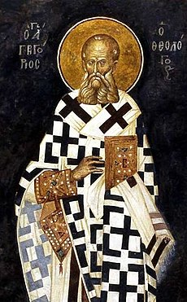
Wisdom of the Saints
[Baptism] is the carriage to God, the dying with Christ, the perfecting of the mind, the bulwark of Faith, the key of the Kingdom of heaven, the change of life, the removal of slavery, the loosing of chains, the remodeling of the whole man…the greatest and most magnificent of the Gifts of God. – St. Gregory of Nazianzus. 329 AD – 390AD

Slide 135
Chapter 12: Discussion Questions
In what sense is Baptism the beginning of Christian life? See CCC 1213, 1266, and 1273.
If the priest pours oil over the head of an unbaptized person and says, “I baptize you in the name of Christ,” is this a valid baptism? See CC 1239 and Matthew 28:19.
Most associate Baptism exclusively with the forgiveness of original sin. What are some other effects of the sacrament of Baptism? See CCC 1262, 1241, 1265, and 1268.
What does Confirmation add to Baptism? See CCC 1285 and 1303.
What sacrament is more necessary, Baptism or Confirmation, and why? See John 3:5 and CCC 1257.

Slide 136
From the Catechism
Holy Baptism is the basis of the whole Christian life, the gateway to life in the Spirit (vitae spiritualis ianua), and the door which gives access to the other sacraments. Through Baptism we are freed from sin and reborn as sons of God; we become members of Christ, are incorporated into the Church and made sharers in her mission: "Baptism is the sacrament of regeneration through water in the word.” – CCC 1213

Slide 137
Chapter 12: Life Application Questions
Why is it significant that the sacraments are associated with healing? From what do you need healing most? How do the sacraments address that need?
How intentionally do Christian live the grace of their baptism? What can you learn from their example? How do you hope to live your own?
What does it mean for you to give witness to the Faith? How do you hope for the grace of Confirmation to play out in your life?

Slide 138
From Pope Eugene IV 1383-1447 AD
The effect of this sacrament [confirmation] is that in it the Holy Spirit is given for strength, as he was given to the apostles on the day of Pentecost, in order that Christians may courageously confess the name of Christ. – Exsultate Deo

Slide 139
Chapter 12: Key Terms
Key Terms
Sacrament: A sign that causes grace, instituted by Christ and entrusted to the Church, by which divine life is dispensed to us.
Character: An indelible spiritual mark which is the permanent effect of the sacraments of Baptism, Confirmation, and Holy Orders, by which a person is given a new permanent configuration to Christ and a specific standing in the Church.; the reception of these sacraments is never repeated.
Grace: The free and undeserved gift that God gives us to respond to our vocation to become his adopted children, by which we receive a share in the divine nature.
Spiritual adoption: The transformation by which one becomes a child of God by the reception of grace, typically communicated in the sacrament of Baptism.

Slide 140
Closing Scripture Mark 1:9-11
But when the time had fully come, God sent forth his Son, ⁹ In those days Jesus came from Nazareth of Galilee and was baptized by John in the Jordan. ¹⁰ And just as he was coming up out of the water, he saw the heavens torn apart and the Spirit descending like a dove on him. ¹¹ And a voice came from heaven, “You are my Son, the Beloved;^{[h]} with you I am well pleased.”

Slide 141
Closing Prayer
By this holy water and by Your Precious Blood, wash away all my sins, O Lord, Amen.
- A prayer recited while blessing oneself with Holy Water.

Slide 142
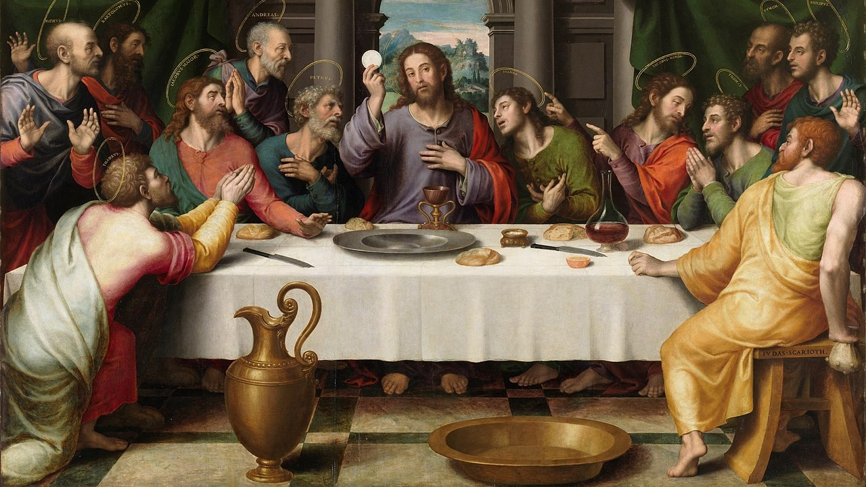
Chapter 13: The Eucharist

Slide 143
Opening Prayer
Almighty Father, open our mind and hearts like those of the disciples on the road to Emmaus, that we may come to recognize Jesus in the breaking of the bread. Grant us the grace of faith in his real presence in the Holy Eucharist – body, blood, soul, and divinity – that we might be consoled by his presence and strengthened perpetually by the bread of heaven. Through Christ our Lord. Amen.

Slide 144
Opening Scripture: John 6:47-68
Very truly, I tell you, whoever believes has eternal life. ⁴⁸ I am the bread of life. ⁴⁹ Your ancestors ate the manna in the wilderness, and they died. ⁵⁰ This is the bread that comes down from heaven, so that one may eat of it and not die. ⁵¹ I am the living bread that came down from heaven. Whoever eats of this bread will live forever; and the bread that I will give for the life of the world is my flesh.”
52 The Jews then disputed among themselves, saying, “How can this man give us his flesh to eat?” 53 So Jesus said to them, “Very truly, I tell you, unless you eat the flesh of the Son of Man and drink his blood, you have no life in you. 54 Those who eat my flesh and drink my blood have eternal life, and I will raise them up on the last day; 55 for my flesh is true food and my blood is true drink. 56 Those who eat my flesh and drink my blood abide in me, and I in them. 57 Just as the living Father sent me, and I live because of the Father, so whoever eats me will live because of me. 58 This is the bread that came down from heaven, not like that which your ancestors ate, and they died. But the one who eats this bread will live forever.” 59 He said these things while he was teaching in the synagogue at Capernaum.
60 When many of his disciples heard it, they said, “This teaching is difficult; who can accept it?” 61 But Jesus, being aware that his disciples were complaining about it, said to them, “Does this offend you? 62 Then what if you were to see the Son of Man ascending to where he was before? 63 It is the spirit that gives life; the flesh is useless. The words that I have spoken to you are spirit and life. 64 But among you there are some who do not believe.” For Jesus knew from the first who were the ones that did not believe, and who was the one that would betray him. 65 And he said, “For this reason I have told you that no one can come to me unless it is granted by the Father.”
66 Because of this many of his disciples turned back and no longer went about with him. 67 So Jesus asked the twelve, “Do you also wish to go away?” 68 Simon Peter answered him, “Lord, to whom can we go? You have the words of eternal life.

Slide 145
Chapter 13: The Eucharist
Key points from video
The New Testament contains four distinct accounts of the Last Supper narrative in which Christ instituted the Most Holy Eucharist.
From the earliest centuries, the Church taught consistently that Christ’s body and blood are truly present in the Eucharist.
The Church uses the term “transubstantiation” to refer to the change of the substance from bread into the Body of Christ and from into the blood of Christ.
The truth of Christ’s real presence in the Eucharist can neither be proven nor disproven by natural reason. It is a revealed truth accessible only by the grace of faith, which gives us insight into this mystery.
The Church is sustained in her earthly pilgrimage by the real presence of Christ in the Blessed Sacrament of the Eucharist.

Slide 146
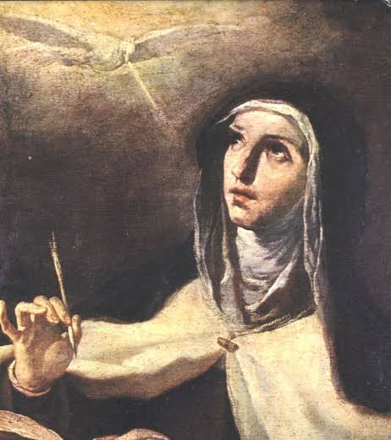
Wisdom of the Saints
If we but passed for a moment to consider attentively what takes place in this Sacrament, I am sure that the thought of Christ’s love for us would transform the coldness of our hearts into a fire of love gratitude. - St. Angela of Foligno

Slide 147
Chapter 13: Discussion Questions
Are there firm foundations in Scripture for the Church’s belief in real presence of Christ in the Eucharist. If so, what are they? See Mk 14:18-25; Mt 26:26-29; Lk 22:14-19; 1 Cor 11:33-36; Jn 6.
How is God able to change bread and wine into the Body and Blood of Christ?
Why does God change the bread and wine into the Body and Blood of Christ but leave the accidental properties of bread and wine present in the altar.
What is transubstantion? Why does the Church use terms like this?

Slide 148
From the Catechism
The Eucharistic presence of Christ begins at the moment of the consecration and endures as long as the Eucharistic species subsist. Christ is present whole and entire in each of the species and whole and entire in each of their parts, in such a way that the breaking of the bread does not divide Christ.– CCC 1377

Slide 149
Chapter 13: Life Application Questions
Have you sought to discover the real presence of Christ in the Blessed Sacrament in your own life? How so? What can you do to help your belief in this reality?
Do elements of Catholic prayer and devotion appeal to you? How does the worship of Christ in the Blessed Sacrament help us discover God?
How can you best prepare yourself spiritually to receive Christ in the Blessed Sacrament?

Slide 150
From Saint Pope Paul Vi
Taking part in the eucharistic sacrifice, which is the fount and apex of the whole Christian life, they offer the Divine Victim to God, and offer themselves along with It.(6*) Thus both by reason of the offering and through Holy Communion all take part in this liturgical service, not indeed, all in the same way but each in that way which is proper to himself. Strengthened in Holy Communion by the Body of Christ, they then manifest in a concrete way that unity of the people of God which is suitably signified and wondrously brought about by this most august sacrament. – Lumen Gentium, no. 11

Slide 151
Chapter 13: Key Terms
Key Terms
Transubstantiation: The change of the whole substance of the bread into the substance of the Body of Christ our Lord and of the whole substance of his Blood.

Slide 152
Closing Scripture 1 Corinthians 10:16
The cup of blessing that we bless, is it not a sharing in the blood of Christ? The bread that we break, is it not a sharing in the body of Christ?

Slide 153
Closing Prayer
Eternal Father, we offer you the Body and Blood, Soul, and Divinity of Your Dearly Beloved Son, Our Lord, Jesus Christ, in atonement for our sins and those of the whole world. Amen.

Slide 154
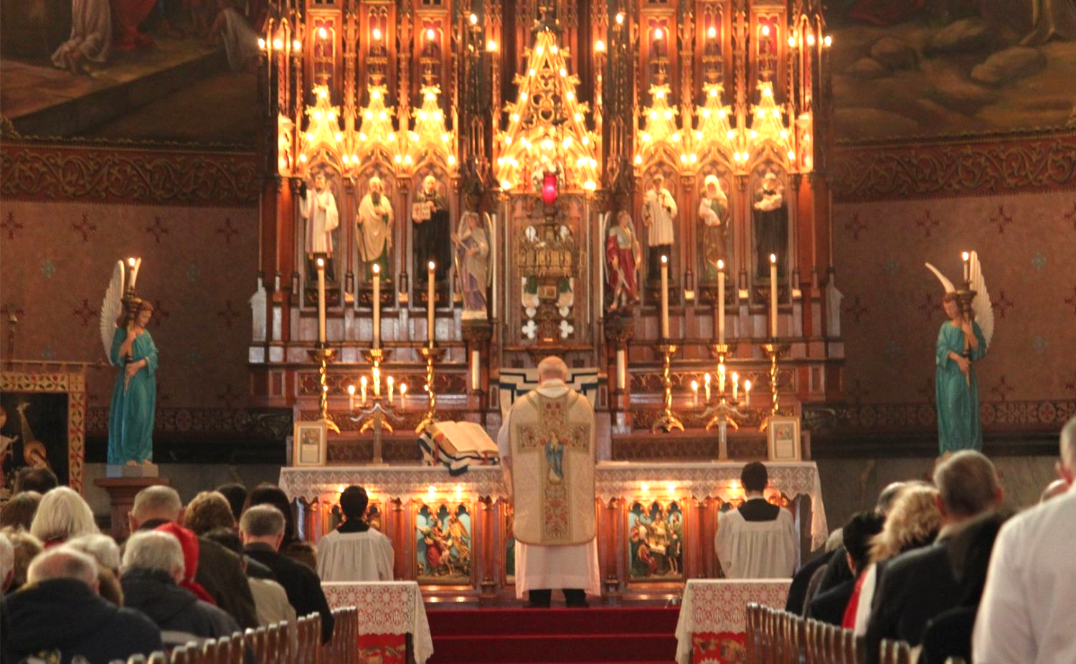
Chapter 14: The Mass and Liturgical Prayer

Slide 155
Opening Prayer
Almighty and ever-living God, your eternal Son humbled himself not only in becoming man but also in giving us his flesh and blood to eat and drink. Help us learn to worship him with devout attention and to benefit from his unfathomable gifts. Amen.

Slide 156
Opening Scripture: 1 Corinthians 10:15-21
15 I speak to sensible people; judge for yourselves what I say. 16 Is not the cup of thanksgiving for which we give thanks a participation in the blood of Christ? And is not the bread that we break a participation in the body of Christ? 17 Because there is one loaf, we, who are many, are one body, for we all share the one loaf.
18 Consider the people of Israel: Do not those who eat the sacrifices participate in the altar? 19 Do I mean then that food sacrificed to an idol is anything, or that an idol is anything? 20 No, but the sacrifices of pagans are offered to demons, not to God, and I do not want you to be participants with demons. 21 You cannot drink the cup of the Lord and the cup of demons too; you cannot have a part in both the Lord’s table and the table of demons.

Slide 157
Chapter 14: The Mass and Liturgical Prayer
Key points from video
The Catholic Church teaches that the sacraments “cause what they signify.” They accomplish in us by grace what they “mean” or point to. There are three distinct aspects that the Eucharist points to and three corresponding distinct effects that it brings about.
The first signification in the Eucharist is that it is food and drink: the Body and Blood of Christ are truly present under the appearances of bread and wine. The Body and Blood of Christ nourish us in the order of grace.
The second signification is the unity of the Church. St. Paul refers to this in 1 Corinthians 10:17. Many grains produce one bread, and many grapes produce one chalice. This signifies that, as we receive the Body and Blood of Christ, we are made one in Christ.
The third signification is that of sacrifice. This imagery is present at the heart of the Mass itself: first, the body is consecrated, and then the blood. This represents the separation of the blood and the body of Christ at the Cross, where his blood is poured out from his wounds as a sacrifice for sin.
The Mass allows the Church to participate in the grace of Christ crucified. In this way, the Church is able to offer Christ’s own merits to the Father for the sake of the world and to unite herself to that sacrifice in faith, hope, and love.

Slide 158
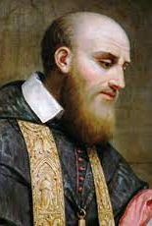
Wisdom of the Saints
When you have received Him, stir up your heart to do Him, homage; speak to Him about your spiritual life, gazing upon Him in your soul where he is present for your happiness; welcome Him as warmly as possible, and behave outwardly in such a way that your actions may give proof to all of His presence. – St. Frances de Sales

Slide 159
Chapter 14: Discussion Questions
What does the Eucharist signify?
What are the scriptural foundations for the Church’s belief that the Eucharist is a sacrifice?
Does the Eucharist cause what it signifies? How so?

Slide 160
From the Catechism
The Eucharist is also the sacrifice of the Church. The Church which is the Body of Christ participates in the offering of her Head. With him, she herself is offered whole and entire. She unites herself to his intercession with the Father for all men. In the Eucharist the sacrifice of Christ becomes also the sacrifice of the members of his Body. The lives of the faithful, their praise, sufferings, prayer, and work, are united with those of Christ and with his total offering, and so acquire a new value. Christ's sacrifice present on the altar makes it possible for all generations of Christians to be united with his offering. –CCC 1368

Slide 161
Chapter 14: Life Application Questions
Of the Catholics you know, how do you see the Mass playing a central role in their lives?
How can you learn to offer your life with Christ in the most holy sacrifice of the Mass? How can your joys and sorrows be occasions to grow closer to the Lord through this sacrament?
Is the Eucharistic sacrifice a repetition of the sacrifice Jesus made on the Cross?

Slide 162
From Saint Pope Paul Vi
It is a good idea to recall at the very outset what may be termed the heart and core of the doctrine, namely that, by means of the Mystery of the Eucharist, the Sacrifice of the Cross which was once carried out on Calvary is re-enacted in wonderful fashion and is constantly recalled, and its salvific power is applied to the forgiving of the sins we commit each day…In offering this sacrifice, the Church learns to offer herself as a sacrifice for all and she applies the unique and infinite redemptive power of the sacrifice of the Cross to the salvation of the whole world – Mysterium Fidei, nos. 27, 32

Slide 163
Chapter 14: Key Terms
Key Terms
Sacrifice of the Mass: The offering of Christ to the Father that the Church is able to make in the Mass by virtue of the grace of the Eucharist. This is not a new sacrifice of Christ but is the presence of the sacrifice of Calvary and its application to us and our lives through the medium of the sacrament of the Eucharist.
Liturgy: The Church’s public and official work of praising God. “Through the liturgy Christ, our redeemer and high priest, continues the work of our redemption in, with, and through his Church (CCC 1069). Personal prayer, the individual cultivation of union with God, is distinct from liturgical prayer, but is essentially complementary to it.

Slide 164
Closing Scripture Colossians 3:15-17
15 Let the peace of Christ rule in your hearts, since as members of one body you were called to peace. And be thankful. 16 Let the message of Christ dwell among you richly as you teach and admonish one another with all wisdom through psalms, hymns, and songs from the Spirit, singing to God with gratitude in your hearts. 17 And whatever you do, whether in word or deed, do it all in the name of the Lord Jesus, giving thanks to God the Father through him.

Slide 165
Closing Scripture Colossians 3:15-17
15 Let the peace of Christ rule in your hearts, since as members of one body you were called to peace. And be thankful. 16 Let the message of Christ dwell among you richly as you teach and admonish one another with all wisdom through psalms, hymns, and songs from the Spirit, singing to God with gratitude in your hearts. 17 And whatever you do, whether in word or deed, do it all in the name of the Lord Jesus, giving thanks to God the Father through him.

Slide 166
Closing Prayer
O Sacred Banquet in which Christ becomes our food, the memory of his passion is celebrated, the soul is filled with grace, and the pledge of future glory is given to us.
LEADER: You gave them bread from heaven.
ALL: Containing every blessing.
LEADER: Let us pray: O God who in this wonderful sacrament have left us a memorial of your passion, help us we pray, so to revere the sacred mysteries, of your body and blood that we constantly feel within ourselves the fruits of your redemption. You who live and reign forever and ever. Amen.
-St. Thomas Aquinas’s prayer for the feast of Corpus Christi

Slide 167
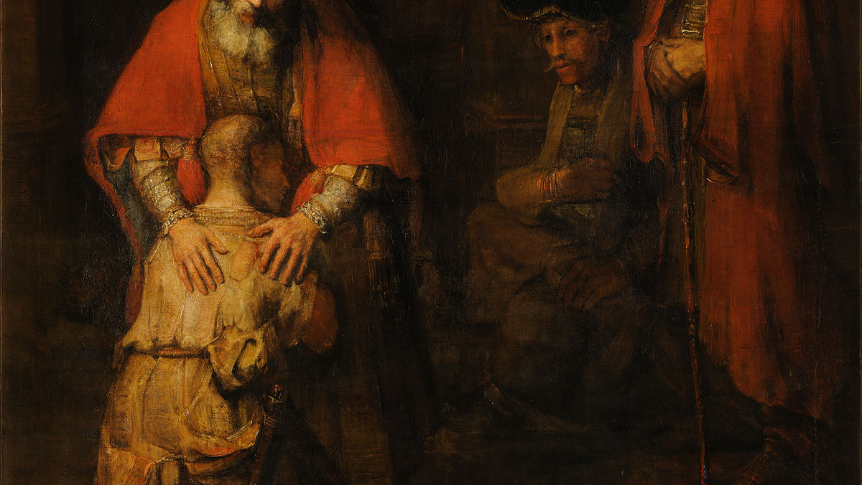
Chapter 15: Confession

Slide 168
Opening Prayer
O God, the Father of mercies, help us to understand our own sinfulness and of the forgiveness you offer us through the sacrament of confession. We ask this through Christ our Lord. Amen.

Slide 169
Opening Scripture: John 20:19-23
19 When it was evening on that day, the first day of the week, and the doors of the house where the disciples had met were locked for fear of the Jews, Jesus came and stood among them and said, “Peace be with you.” 20 After he said this, he showed them his hands and his side. Then the disciples rejoiced when they saw the Lord. 21 Jesus said to them again, “Peace be with you. As the Father has sent me, so I send you.” 22 When he had said this, he breathed on them and said to them, “Receive the Holy Spirit. 23 If you forgive the sins of any, they are forgiven them; if you retain the sins of any, they are retained.”

Slide 170
Chapter 15: Confession
Key points from video
1. The Christian life is a life of continual conversion. Christ instituted confession for the forgiveness of the sins of those already baptized.
2. Christ gave his apostles the power to forgive sins, a power that has been handed down through the centuries to bishops and priests.
3. Sin is an offense against God. Sins can be serious (mortal) or of lesser severity (venial).
4. The sacrament of confession has four parts: contrition, confession, absolution, and penance.
5. An examination of conscience helps prepare one to go to confession.
6. Confession transforms our hearts.

Slide 171
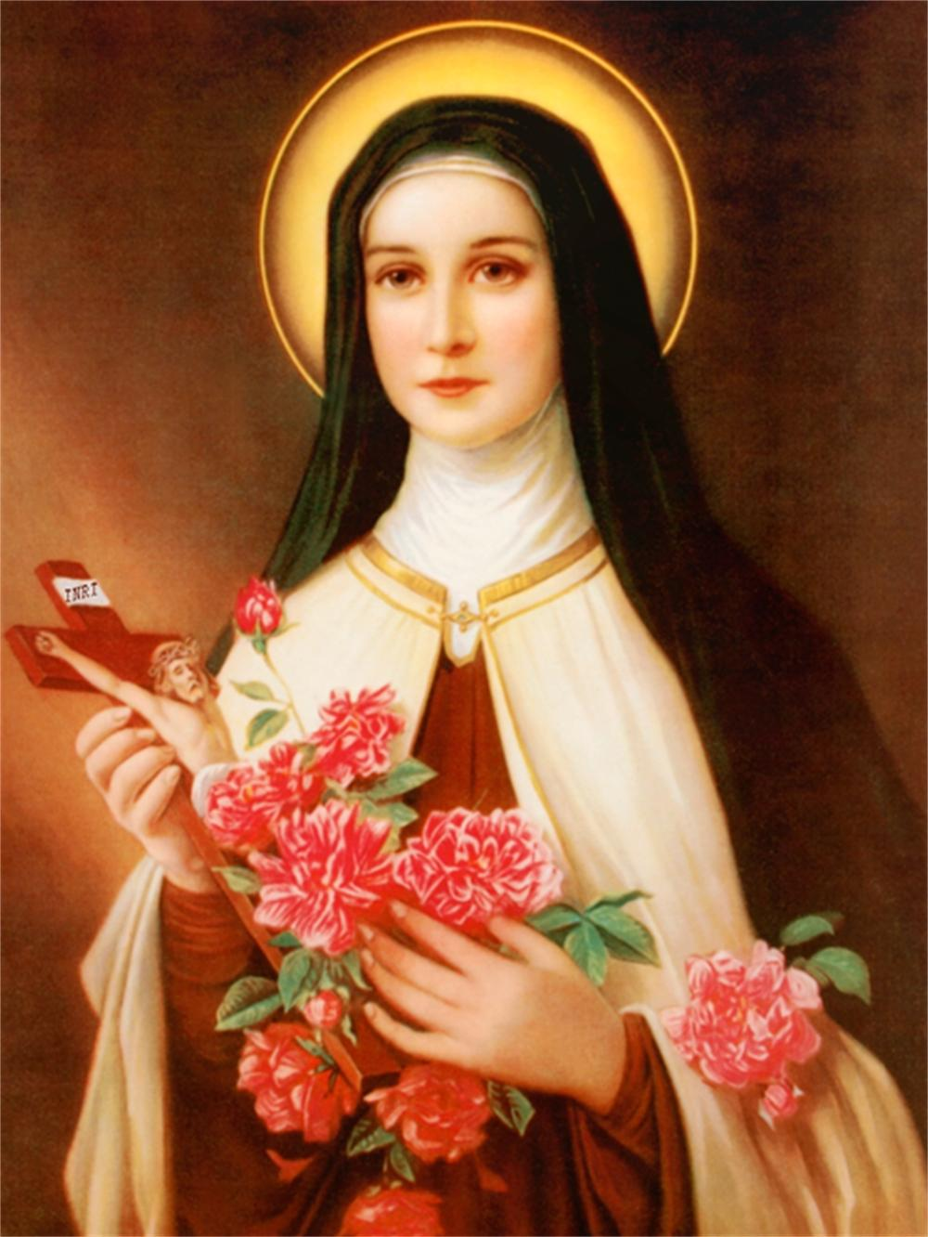
Wisdom of the Saints
Even if I had on my conscience all the sins that can be committed, I would go, my heart broken with sorrow, and throw myself into Jesus’ arms, for I know how much He loves the prodigal child who returns to him. – St. Thérèse of Lisieux

Slide 172
Chapter 15: Discussion Questions
Why did Jesus institute the sacrament of confession?
What are the four parts of confession? Briefly explain each one of them?
What is the difference between mortal and venial sin?
Does a person need to confess all of the mortal sins they remember committing? What other information should be included? Why is it important to confess one’s venial sins as well?

Slide 173
From the Catechism
To return to communion with God after having lost it through sin is a process born of the grace of God who is rich in mercy and solicitous for the salvation of men. One must ask for this precious gift for oneself and for others. – CCC 1489

Slide 174
Chapter 15: Life Application Questions
Think of a time when you asked another person for forgiveness? How do you think going to confession will be the same as that experience? How do you think it will be different?
Faith gives us certainty that God forgives our sins when we make a good confession. Do you think leaving your past sins behind through confession will have a positive effect on your relationship with God and with others? How so?
Do you have any fears or hesitations about confession? Explain how you think God will help you overcome these.

Slide 175
Chapter 15: Key Terms
Key Terms
Sin: An offense against God. It can take the form of a thought, word, or action we do or fail to do. Mortal sins are serious sins that separate us from friendship with God and the life of grace. Venial sins are lesser offenses.
Penance (Satisfactory Penance): In the sacrament of confession, this refers to an action done after receiving forgiveness through absolution to atone or “make up” for sin. This is typically a specific prayer or action assigned by the priest hearing the confession to be done after leaving the confessional. More generally, the term penance can also refer to the interior conversion of heart toward God and away from sin and to external acts like fasting, prayer, and almsgiving.
Examination of Conscience: A prayerful and careful inquiry within oneself to assess how one has sinned and, therefore, what one should confess. This term can also refer to a document listing common sins or posing questions typically used by someone preparing to go to confession.
Firm purpose of amendment: The decision or resolve not to commit sin in the future.
Absolution: The sacramental words in which the priest, through the power entrusted to the Church by Christ, pardons the sins of the penitent (the person who is confessing his or her sins).

Slide 176
From The Council of Trent
The difficulty of confession and the shame at uncovering sins could seem to be burdensome were it not lightened by so many advantages and consolations that will most certainly be granted through the absolution to all who approach the sacrament worthily.
-Session 14, Chapter 5

Slide 177
Closing Scripture Psalm 32:5
Then I acknowledged my sin to you, and I did not hide my iniquity; I said, “I will confess my transgressions to the Lord,” and you forgave the guilt of my sin.

Slide 178
Closing Prayer
O God, who manifest your almighty power above all by pardoning and showing mercy, bestow, we pray, your grace abundantly upon us and make those hastening to attain your promises heirs to treasures of heaven. We ask this through Christ Our Lord. Amen.
-Collect of the twenty-sixth Sunday in Ordinary Time

Slide 179
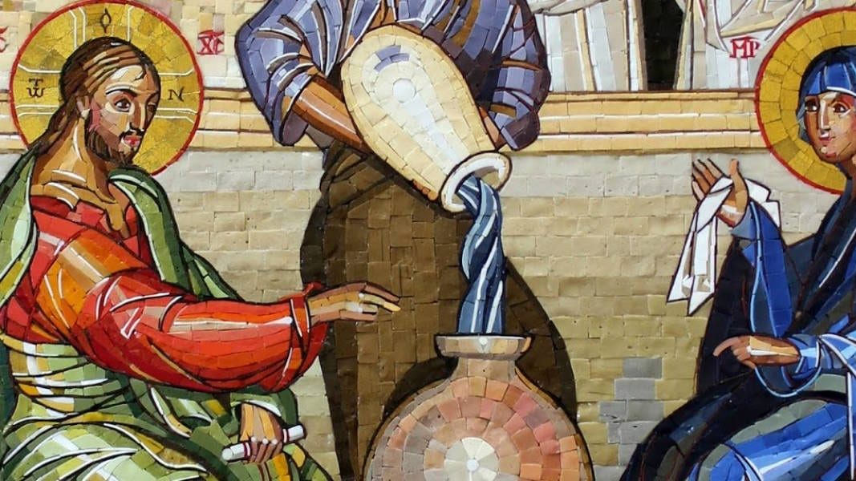
Chapter 16:Marriage

Slide 180
Opening Prayer
O God, Our Father, who made us male and female, help us to know the tremendous dignity of the sacrament of marriage and strengthen husbands and wives by your grace , that they may better manifest the love of Christ for the Church. Through Christ our Lord. Amen.

Slide 181
Opening Scripture: Genesis 2:18-25
18 Then the Lord God said, “It is not good that the man should be alone; I will make him a helper as his partner.” 19 So out of the ground the Lord God formed every animal of the field and every bird of the air, and brought them to the man to see what he would call them; and whatever the man called every living creature, that was its name. 20 The man gave names to all cattle, and to the birds of the air, and to every animal of the field; but for the man there was not found a helper as his partner. 21 So the Lord God caused a deep sleep to fall upon the man, and he slept; then he took one of his ribs and closed up its place with flesh. 22 And the rib that the Lord God had taken from the man he made into a woman and brought her to the man. 23 Then the man said,
“This at last is bone of my bones and flesh of my flesh; this one shall be called Woman, for out of Man this one was taken.”
24 Therefore a man leaves his father and his mother and clings to his wife, and they become one flesh. 25 And the man and his wife were both naked, and were not ashamed.

Slide 182
Chapter 16: Marriage
Key points from video
1. Marriage is not a creation of man for man’s benefit but rather a creation of God for man’s happiness.
2. God created marriage at the very moment he created the human race male and female.
3. Achieving the goods of marriage and parenthood are not mere options in life but the very reason our creation as male and female.
4. The Church affirms that the truth about marriage applies to everyone, at every time, in every place, even if not every time and place recognized and embraced marriage’s full truth.
5. When a baptized man and baptized woman enter marriage, their marriage itself becomes a channel of grace through which God communicates his love to the couple, and through which the couple expresses its love for God and neighbor.
6. Christian reflection on the nature of marriage has long recognized that marriage has two principal ends or purposes: the good of the couple and the procreation and education of children.

Slide 183
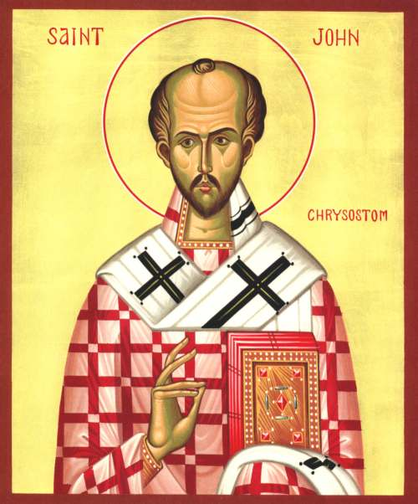
Wisdom of the Saints
There is a certain love deeply seated into our nature that imperceptibly knits together these bodies of ours… Nothing so weld our life together as the love of man and wife. – St. John Chrysostom

Slide 184
Chapter 16: Discussion Questions
When did God create the sacrament of marriage?
While marriage has been remarkably consistent across all times and peoples, what is unique about Christian marriage?
What are the principal ends, or purposes, of marriage, and what marks should a marriage have when these purposes are recognized?

Slide 185
From the Catechism
God who created man out of love also calls him to love the fundamental and innate vocation of every human being. For man is created in the image and likeness of God who is himself love. Since God created him man and woman, their mutual love becomes an image of the absolute and unfailing love with which God loves man. It is good, very good, in the Creator's eyes. And this love which God blesses is intended to be fruitful and to be realized in the common work of watching over creation: "And God blessed them, and God said to them: 'Be fruitful and multiply, and fill the earth and subdue it.– CCC 1604

Slide 186
Chapter 16: Life Application Questions
For those who are married, how does it affect the way you view your own marriage to know that it is a sacrament and a channel of grace just like Holy Communion or Baptism?
What are the greatest challenges and greatest blessings of marriage?
How do marriage and the Christian family serve as the foundation of society? In what ways has the erosion of marriage harmed our culture?

Slide 187
From St. Pope Paul VI
Authentic married love is caught up into divine love…so that this love may lead the spouses to God with powerful effect and may aid and strengthen them in [the] sublime office of being a father or mother.
-Gaudium et Spes, no. 48

Slide 188
Chapter 16: Key Terms
Key Terms
Nuptial blessing: The extended prayer the priest prays over the couple during the Catholic rite of marriage which contains a summary of what the Church believes about this sacrament.
Indissolubility: One of the principal marks of a Christian marriage, which states that the union between man and woman is unable to be divided or destroyed through divorce.
Cohabitation: The act of an unmarried man and an unmarried woman living together and sharing a sexual relationship outside the sacrament of marriage.

Slide 189
Closing Scripture Ephesians 5:31-33
“For this reason a man will leave his father and mother and be joined to his wife, and the two will become one flesh.” This is a great mystery, and I am applying it to Christ and the church. Each of you, however, should love his wife as himself, and a wife should respect her husband.

Slide 190
Closing Prayer
O God, who in your unspeakable providence chose blessed Joseph to be the spouse of your most holy Mother, grant, we beseech you, that we may deserve to have him as our intercessor in heaven, who we venerate on earth as our protector. Who lives and reigns world without end. Amen.

Slide 191
Part III: Christian Moral Life

Slide 192
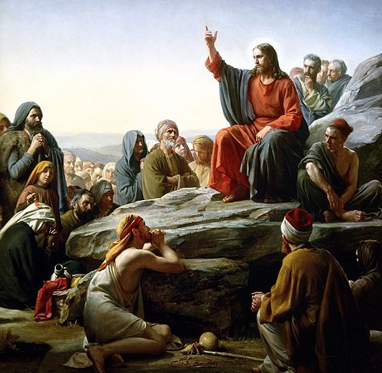
Chapter 17: Happiness and the Christian Moral Life

Slide 193
Opening Prayer
O God, our Father, you have made us and called us to eternal happiness with you. Look upon us in mercy, remove from our lives every evil influence, by your grace direct us to the eternal blessedness of heaven. Through Christ our Lord. Amen.

Slide 194
Opening Scripture: Philippians 4:4-9
4 Rejoice in the Lord always; again I will say, Rejoice.5 Let your gentleness be known to everyone. The Lord is near. 6 Do not worry about anything, but in everything by prayer and supplication with thanksgiving let your requests be made known to God. 7 And the peace of God, which surpasses all understanding, will guard your hearts and your minds in Christ Jesus.
8 Finally, beloved, whatever is true, whatever is honorable, whatever is just, whatever is pure, whatever is pleasing, whatever is commendable, if there is any excellence and if there is anything worthy of praise, think about these things. 9 Keep on doing the things that you have learned and received and heard and seen in me, and the God of peace will be with you.

Slide 195
Chapter 17: Happiness and the Christian Moral Life
Key points from video
1. While the Church Fathers were concerned with obedience to laws and rules, when it came to morality – or being good – they began first with the question of happiness.
2. The goal of life is not to find our greatest happiness in the goods of this life but to cooperate with the graces that God gives us to elevate us to himself, to befriend Jesus Christ, and to follow Christ through the mystery of his passion and death to a participation in his resurrection.
3. The Catechism of the Catholic Church explains that the Christian moral life, which has the beatific vision as its end, is a life composed of virtue, the gifts of the Holy Spirit, and the Beatitudes.
4. The theological virtues – faith, hope, and charity – form the very basis of the Christian moral life. Infused with these virtues at baptism, the Christian moves toward God as his end through real acts of knowing (acts of faith) and real acts of loving (acts of hope and charity).
5. If the theological virtues form the foundation of the Christian life, then the gifts of the Holy Spirit form its crown.
The Beatitudes are markers of Jesus’s life, and the Spirit enables us, through the gifts, to act – to move toward the Father – as Jesus did.

Slide 196
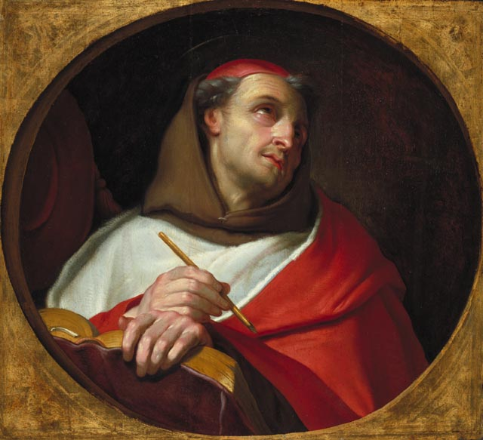
Wisdom of the Saints
Since happiness is nothing else but the enjoyment of the Supreme Good, and the Supreme Good is above us, no one can be happy who does not rise above himself. – St. Bonaventure

Slide 197
Chapter 17: Discussion Questions
Why is the moral life about more than just following rules and laws?
What are the three theological virtues, and what role do they play in the Christian moral life?
Why would charity be the only lasting theological virtue?
What role do the gifts of the Holy Spirit play in the moral life?

Slide 198
From the Catechism
The theological virtues are the foundation of Christian moral activity; they animate it and give it its special character. They inform and give life to all the moral virtues. They are infused by God into the souls of the faithful to make them capable of acting as his children and of meriting eternal life. They are the pledge of the presence and action of the Holy Spirit in the faculties of the human being. There are three theological virtues: faith, hope, and charity. – CCC 1813

Slide 199
Chapter 17: Life Application Questions
Have you ever though morality was just about following rules? Do you find it helpful to know that morality is chiefly about happiness?
What kind of freedom and happiness is available to those who unite their lives to Christ and keep the commandments of God?
How does your love of God help you persevere through difficult times when your faith and hope might be wavering?

Slide 200
From St. Pope John Paul II
6. The dialogue of Jesus with the rich young man, related in the nineteenth chapter of Saint Matthew's Gospel, can serve as a useful guide for listening once more in a lively and direct way to [Christ’s] moral teaching…For the young man, the question is not so much about rules to be followed, but about the full meaning of life. This is in fact the aspiration at the heart of every human decision and action, the quiet searching and interior prompting which sets freedom in motion. This question is ultimately an appeal to the absolute Good which attracts us and beckons us; it is the echo of a call from God who is the origin and goal of man's life. – Veritatis Splendor, no. 6,7

Slide 201
Chapter 17: Key Terms
Key Terms
Morality: Nor merely obligations or duties, as many assume, not a system of rules that we have to obey, but rather the area of thought (and of life) focused on how to get to our ultimate goal, which is true and lasting happiness. On this view of morality, commandments help teach us how to get to the goal, which is the main reason why they are important to obey in order to live a “moral” life: that is, a life that succeeds in reaching true happiness.
Christian moral life: The broad term used to describe the way of life Christ has called us to. Christ strengthens his followers through grace to live in accordance with his call.
Beatific Vision: Behold God face-to-face in heaven, the end goal of the Christian life.
Intellectual virtues: The virtues we acquire to help us understand the things of this world; they include wisdom, understand, and knowledge.
Moral virtues: Firm dispositions that allow us to do good and act in accordance with right reason; the four chief, or “cardinal,” moral virtues include prudence, justice, courage, and temperance.
Theological virtues: the supernatural virtues God gives us to elevate our capacity to know and to love, enabling us to know and love God and the things of God; they are faith, hope, and charity (or love). These virtues form the foundation of the Christian moral life.

Slide 202
Closing Scripture 1 Corinthians 13:13
And now faith, hope, and love abide, these three; and the greatest of these is love.

Slide 203
Closing Prayer
Glory be to the Father and to the Son and to the Holy Spirit, as it was in the beginning, is now and will be forever. Amen.

Slide 204
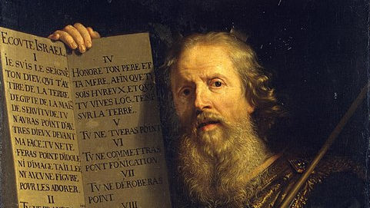
Chapter 18: Law and the 10 Commandments

Slide 205
Opening Prayer
O God, who founded all the commands of your sacred Law upon love of you and and of our neighbor, grant that, by keeping your precepts, we may merit to attain eternal life. Through our Lord Jesus Christ, your Son, who lives and reigns with you in the unity of the Holy Spirit, one God, for ever and ever. Amen.

Slide 206
Opening Scripture: Exodus 20:1-20
Please open your Bible to Exodus 20:1-20

Slide 207
Chapter 18: Law and the 10 Commandments
Key points from video
Law gives shape to the pursuit of the good.
Law is an ordination (an ordering, ordinance, or determination) of reason for the common good made and promulgated (or made known) by one who has care of the community.
The eternal law accounts for how all created things proceed from God and return to him.
Natural law is man’s participation in the eternal law working at the level of his his inclinations to secure what is true and good.
Human law extends and applies the natural law in a particular time and place.
Divine law is divided between the Old Law, which governed the life of the people of Israel, and the New Law, which is the very grace of the Holy Spirit given by Jesus Christ.
The Ten Commandments concern man’s relation to God and to neighbor; failure to observe the Ten Commandments often leads to mortal sin.

Slide 208
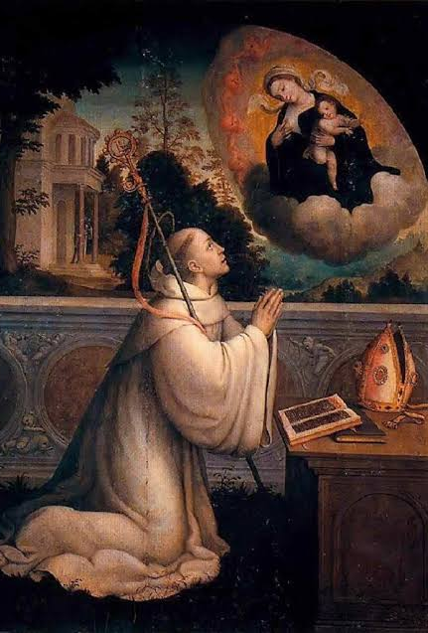
Wisdom of the Saints
Love is the eternal law whereby the universe was created and is ruled. Since all things are ordered in measure and number and weight, nothing is left outside the real of law, that universal law cannot itself be without a law, which is itself. So love thought it did not create itself, does surely govern itself by its own decree. – St. Bernard of Clairvaux

Slide 209
Chapter 18: Discussion Questions
Which of the laws described is all-encompassing? In what sense does it include all other laws?
What does it mean to say that we are governed by the natural law? Where is this law inscribed? How does one gain access to it? (See CCC 1954, 1955, and 1960).
How do we understand the difference between mortal and venial sins? See CCC 2072 and 1855.
What is the Old Law, and in what sense is it helpful or saving? What is the New Law, and in what sense is it helpful or saving? See CCC 1963-1965.

Slide 210
From the Catechism
The moral law is the work of divine Wisdom. Its biblical meaning can be defined as fatherly instruction, God's pedagogy. It prescribes for man the ways, the rules of conduct that lead to the promised beatitude; it proscribes the ways of evil which turn him away from God and his love. It is at once firm in its precepts and, in its promises, worthy of love.– CCC 1813

Slide 211
Chapter 18: Life Application Questions
What is your attitude toward civil law? Does that, perhaps, color your bearing toward Church law, specifically the Church’s moral teachings?
Can you point to a time when you had a profound experience of right and wrong, when you senses the natural law in the marrow of your bones?
We said that the New Law of grace actually justifies, which is to say that it eventually makes your good. Have you, perhaps, ceased to hope for improvement in your life? What can you reasonably expect in the way of conversion as you come under the sway of this New Law?

Slide 212
From St. Pope John Paul II
Only God can answer the question about the good, because he is the Good. But God has already given an answer to this question: he did so by creating man and ordering him with wisdom and love to his final end, through the law which is inscribed in his heart. – Veritatis Splendor, no. 12

Slide 213
Chapter 18: Key Terms
Key Terms
Law: An ordination (an ordering, ordinance, or determination) of reason for the common good made and promulgated (or made known) by one who has care for the community.
Natural law: The moral law inscribed in the heart and known by human reason. It is at work in man’s tendency to know the true and love the good, enabling him to “discern by reason the good and the evil, the truth and the lie” (CCC 1954). It’s most fundamental precept is: “Do good and avoid evil.”
Mortal sin: A grave offense against the law of God that kills the divine life (charity/love) in the soul of the sinner, thus driving out sanctifying grace. It constitutes a turn away from God, loving something created more than doing what God asks of us. For a sin to be mortal, three conditions must be present: it must involve something serious (grave matter), you must have full knowledge that the act is wrong, and you must give free consent of your will.
Venial sin: AN act that fails to observe the necessary rule or order in lesser matters but does not destroy the divine life of charity in the soul. Venial sins can be pardoned without sacramental confession, but it is strongly recommended to confess them on a regular basis.
New (Evangelical) Law: The New Covenant established by God in Jesus Christ to succeed and perfect the Old Covenant. It is the perfection of the divine law. It is, most properly, the very grace of the Holy Spirit poured into the heart of man.

Slide 214
Closing Scripture Jeremiah 31:31-33
The days are surely coming, says the Lord, when I will make a new covenant with the house of Israel and the house of Judah. ³² It will not be like the covenant that I made with their ancestors when I took them by the hand to bring them out of the land of Egypt—a covenant that they broke, though I was their husband, says the Lord. ³³ But this is the covenant that I will make with the house of Israel after those days, says the Lord: I will put my law within them, and I will write it on their hearts; and I will be their God, and they shall be my people.

Slide 215
Closing Prayer
O Lord, Holy Father, almighty and eternal God, deign to direct and sanctify today our hearts and bodies in your law and in the works of your commandments; that, by your help here in eternity, we may always merit to be saved. Through Christ our Lord. Amen.

Slide 216
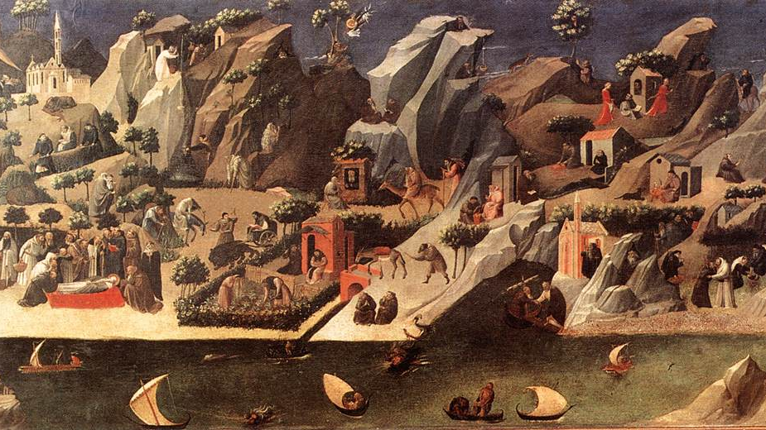
Chapter 19: The life of Grace

Slide 217
Opening Prayer
O God our Father, whose mercies are new every morning and who gives immeasurably more than we ask for or imagine, shower your grace updon us, heal the effects of sin in us, increase charity in our hearts, and strengthen us for good works. We ask this through Christ our lord. Amen.

Slide 218
Opening Scripture: Exodus 20:1-20
“I am the true vine, and my Father is the vinegrower. ² He removes every branch in me that bears no fruit. Every branch that bears fruit he prunes to make it bear more fruit. ³ You have already been cleansed by the word that I have spoken to you. ⁴ Abide in me as I abide in you. Just as the branch cannot bear fruit by itself unless it abides in the vine, neither can you unless you abide in me. ⁵ I am the vine, you are the branches. Those who abide in me and I in them bear much fruit, because apart from me you can do nothing. ⁶ Whoever does not abide in me is thrown away like a branch and withers; such branches are gathered, thrown into the fire, and burned. ⁷ If you abide in me, and my words abide in you, ask for whatever you wish, and it will be done for you. ⁸ My Father is glorified by this, that you bear much fruit and become^{[c]} my disciples. ⁹ As the Father has loved me, so I have loved you; abide in my love. ¹⁰ If you keep my commandments, you will abide in my love, just as I have kept my Father’s commandments and abide in his love. ¹¹ I have said these things to you so that my joy may be in you, and that your joy may be complete.

Slide 219
Chapter 19: The Life of Grace
Key points from video
Grace is sharing in God’s life, a spiritual gift that he freely gives to us. Grace makes us partakers of the divine nature and children of God.
We need grace in order to be saved. We cannot reach heaven solely by our own human strength.
Grace moves us to conversion. This can be found in the Scriptures and in stories of conversion.
Grace heals the effects of sin and justifies the sinner. Grace brings about spiritual transformation and elevates our human nature.
Sanctifying grace (habitual grace) makes us holy and pleasing to God.
The Holy Trinity dwells within us by grace. We participate in God’s own knowledge and love.

Slide 220
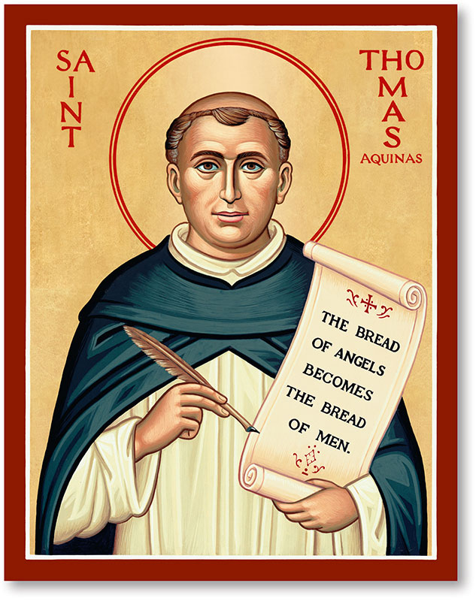
Wisdom of the Saints
God dwells spiritually as in a family home in the just, whose minds are capable of God through knowledge and love, through faith which operates through charity. – St. Thomas Aquinas

Slide 221
Chapter 19: Discussion Questions
What is grace and why do we need it?
List some of the effects of grace.
What is the difference between actual and sanctifying grace?
What does it mean to say the Holy Trinity “dwells in us”?

Slide 222
From the Catechism
The grace of Christ is the gratuitous gift that God makes to us of his own life, infused by the Holy Spirit into our soul to heal it of sin and to sanctify it. It is the sanctifying or deifying grace received in Baptism. It is in us the source of the work of sanctification:
Therefore if any one is in Christ, he is a new creation; the old has passed away, behold, the new has come. All this is from God, who through Christ reconciled us to himself. - CCC 1999

Slide 223
Chapter 19: Life Application Questions
Have you ever decided to grow closer to God by just “trying harder”? Were you successful? If not, how do you think the Catholic teaching on grace could help you?
In the Gospel of John, Jesus says: “Abide in me, and I in you. As the branch cannot bear fruit by itself, unless it abides in the vine, neither can you, unless you abide in me” (Jn 15:4). Relate this to the teaching on grace. Do you desire to abide in the grace of God? What fruit do you think you can bear with God’s grace?
Do you think this teaching on grace could benefit your prayer life? If so, how?

Slide 224
From the Council of Trent
In the very act of justification, together with the remission of sins, man receives through Jesus Christ, into who he is inserted, the gifts of faith, hope, and charity, all infused at the same time. – Council of Trent, Session 6, chapter 7.

Slide 225
Chapter 19: Key Terms
Key Terms
Pelagianism: A heresy in the Church that claimedhuman beings could reach heaven through their own moral strength and will power.
Justification: The transformation of the sinner by God’s grace.
State of sanctifying (grace): The state of friendship with God where he gives us a habitual gift, a stable and supernatural disposition that enables the soul to live with him and to act by his love. Those in a state of sanctifying grace have the virtues of faith, hope, and charity. Baptism infuses sanctifying grace into the soul. If it is lost through mortal sin, it can be recovered through sacramental confession. Thomas Aquinas says that sanctifying grace gives us a “participation in the divine nature.”
Indwelling of the Trinity: The dwelling of the Father, Son, and Holy Spirit in the soul by grace.

Slide 226
Closing Scripture John 14:23
If a man loves me, he will keep my word, and my Father will love him, and we will come to him and make our home with him.

Slide 227
Closing Prayer
O my God, Trinity whom I adore, help me to become utterly forgetful of myself so that I may establish myself in you, as changeless and calm as though my soul were already in eternity. Let nothing disturb my peace nor draw me forth from you, O my unchanging God, but at every moment may I penetrate more deeply into the depths of your mystery. Give peace to my soul; make it your heaven, your cherished dwelling-place and the place of your repose. Let me never leave you there alone, but keep me there, wholly attentive, wholly alert in my faith, wholly adoring and fully given up to your creative action. Amen. – St. Elizabeth of the Trinity

Slide 228
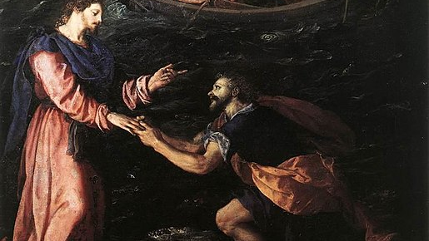
Chapter 20: Faith

Slide 229
Opening Prayer
O God, our Father, increase our faith that we may believe what you have revealed and live in accord with the truths we profess. Amen.

Slide 230
Opening Scripture: 1 Thessalonians 1:2-10
2 We always give thanks to God for all of you and mention you in our prayers, constantly 3 remembering before our God and Father your work of faith and labor of love and steadfastness of hope in our Lord Jesus Christ. 4 For we know, brothers and sisters beloved by God, that he has chosen you, 5 because our message of the gospel came to you not in word only, but also in power and in the Holy Spirit and with full conviction; just as you know what kind of persons we proved to be among you for your sake. 6 And you became imitators of us and of the Lord, for in spite of persecution you received the word with joy inspired by the Holy Spirit, 7 so that you became an example to all the believers in Macedonia and in Achaia. 8 For the word of the Lord has sounded forth from you not only in Macedonia and Achaia, but in every place your faith in God has become known, so that we have no need to speak about it. 9 For the people of those regions[b] report about us what kind of welcome we had among you, and how you turned to God from idols, to serve a living and true God, 10 and to wait for his Son from heaven, whom he raised from the dead—Jesus, who rescues us from the wrath that is coming.

Slide 231
Chapter 20: Faith
Key points from video
Supernatural faith is a supernatural light by which we accept and assent to the whole truth God has revealed.
Faith is an elevation of the human mind that enables us to believe divine mysteries.
Professing the Faith puts us in contact with God. It demands a complete acceptance of God and what he has revealed.
Faith seeks understanding, but the limitations of human reason do not enable us to completely comprehend divine mysteries.
Catholics are called to grow in faith through prayer and study throughout the course of their lives.
Faith never contradicts reason.

Slide 232
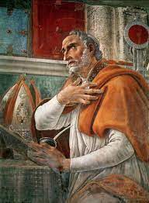
Wisdom of the Saints
Do no seek to understand in order to believe, but believe that you may understand. – St. Augustine

Slide 233
Chapter 20: Discussion Questions
What is supernatural faith? Explain how it is different from other ways we use the word faith?
Explain how faith involves a relationship with God. Why is it dangerous to be a “selective believer”?
Is it wrong to seek better explanations for what we believe? How should one resolve confusion about the Faith?
Does faith ever contradict reason?

Slide 234
From the Catechism
Throughout her life and until her last ordeal when Jesus her son died on the cross, Mary's faith never wavered. She never ceased to believe in the fulfillment of God's word. And so the Church venerates in Mary the purest realization of faith. – CCC 149

Slide 235
Chapter 20: Life Application Questions
Think of ways you have seen faith at work in you already.
Think of another person you really trust. How is the faith you have in them like supernatural faith? How is it different?
Is there anything you have learned about the Catholic faith that you have found confusing or difficult to accept? What exactly do you find confusing or difficult? Have you approached God about this in prayer? What are some ways you can seek further explanation?

Slide 236
From St. Pope John Paul II
Men and women can accomplish no more important act in their lives than the act of faith; it is here that freedom reaches the certainty of truth and chooses to live in that truth. – Fides et Ratio, no. 13

Slide 237
Chapter 20: Key Terms
Key Terms
Obedience of Faith: The proper response to God who has revealed himself. The obedience of faith involves a certain surrender of the mind to God who is truth itself.
Profession of Faith: The Creed, or summary of beliefs, that all Catholics profess. It is recited at Mass on Sundays and Solemnities.
Sense of the Faith: A supernatural confirmation of the Faith that is manifested in the universal agreement of members of the Church on matters of faith and morals. It also allows believers to instinctively reject whatever is opposed to the Faith.
Apostasy: The complete rejection and renunciation of the Faith

Slide 238
Closing Scripture Hebrews 11:8-10
By faith Abraham obeyed when he was called to set out for a place that he was to receive as an inheritance; and he set out, not knowing where he was going. ⁹ By faith he stayed for a time in the land he had been promised, as in a foreign land, living in tents, as did Isaac and Jacob, who were heirs with him of the same promise. ¹⁰ For he looked forward to the city that has foundations, whose architect and builder is God.

Slide 239
Closing Prayer
O my God, I firmly believe that you are one God in three Divine Persons, Father, Son, and Holy Spirit. I believe that your divine Son became man and died for our sins and that he will come again to judge the living and the dead. I believe all these things and all the truths which the holy Catholic Church teaches because in revealing them you can neither deceive nor be deceived. Amen.

Slide 240
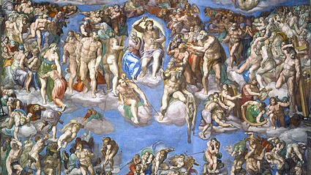
Chapter 21: The Virtue of Hope and the Last Things

Slide 241
Opening Prayer
O God, source of all goodness, fill our hearts with your love and increase hope within us. May we never be discouraged by difficulties but reach forward in expectation to the good things you promise to those who love you. Give us boldness to seek the things of heaven and confidence in your desire to bring us to everlasting life. Through Christ our Lord. Amen.

Slide 242
Opening Scripture: John 5:19-29
19 Jesus said to them, “Very truly, I tell you, the Son can do nothing on his own, but only what he sees the Father doing; for whatever the Father does, the Son does likewise. 20 The Father loves the Son and shows him all that he himself is doing; and he will show him greater works than these, so that you will be astonished. 21 Indeed, just as the Father raises the dead and gives them life, so also the Son gives life to whomever he wishes. 22 The Father judges no one but has given all judgment to the Son, 23 so that all may honor the Son just as they honor the Father. Anyone who does not honor the Son does not honor the Father who sent him. 24 Very truly, I tell you, anyone who hears my word and believes him who sent me has eternal life, and does not come under judgment, but has passed from death to life.
25 “Very truly, I tell you, the hour is coming, and is now here, when the dead will hear the voice of the Son of God, and those who hear will live. 26 For just as the Father has life in himself, so he has granted the Son also to have life in himself; 27 and he has given him authority to execute judgment, because he is the Son of Man. 28 Do not be astonished at this; for the hour is coming when all who are in their graves will hear his voice 29 and will come out—those who have done good, to the resurrection of life, and those who have done evil, to the resurrection of condemnation.

Slide 243
Chapter 21: The Virtue of Hope and the Last Thins
Key points from video
Hope is the opposite of despair. In hope, we cling to God as our promised final good while contending with the obstacles that we meet on the way to him.
Although hope acknowledges the difficulty of arriving at heaven, hope nonetheless looks with confidence toward enjoying our eternal paradise. As a result, hope prompts us to contemplate our future. We look ahead in expectation of the glory that awaits us.
Christian reflection on our future has traditionally taken the form of a meditation on what are called the four last things: death, judgment, heaven, and hell.
Death constitutes the final earthly hurdle that we must overcome before enjoying our final happiness. It is a mystery through which we must pass through if we are to arrive at the other side of life. Jesus Christ is our shepherd and guide through this mystery.
We should have utter confidence in the justice and mercy that will attend our judgment before God.
Persons condemned to hell condemn themselves insofar that they die in mortal sin, their wills turn decidedly away from God and his grace.
Purgatory provides the dead destined for heaven a final moment of purification that readies them for the joys and delights of heaven.

Slide 244
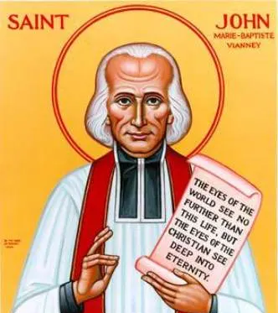
Wisdom of the Saints
Our home is heaven. On earth we’re like travelers staying at a hotel. When you’re away, you’re always thinking of going home.

Slide 245
Chapter 21: Discussion Questions
What is the difference between faith and hope? Explain what both are.
What are the four last things as taught by the Church?
Is it accurate to say that God sends souls to hell? Why or why not?
What does the Church teach about the doctrine of purgatory?

Slide 246
From the Catechism
Each man receives his eternal retribution in his immortal soul at the very moment of his death, in a particular judgment that refers his life to Christ: either entrance into the blessedness of heaven-through a purification or immediately, -- or immediate and everlasting damnation.
At the evening of life, we shall be judged on our love. – CCC 1022

Slide 247
Chapter 21: Life Application Questions
How could the virtue of hope help you in your everyday life?
Are you scared of being judged by God? How do you think fear can be a good thing? How do you think fear is balanced by hope?
Many people think that death is the end of our existence. How do you think the belief in everlasting life changes the way you act? Does the need to be purified from sin in purgatory make sense? Does it go along with a sense of justice?

Slide 248
From Pope Benedict XVI
A distinguishing mark of Christians [is] the fact that they have a future: it is not that they know the details of what awaits them, but they know in general terms that their life will not end in emptiness. –Spe Salvi, no. 2

Slide 249
Chapter 21: Key Terms
Key Terms
Hope: The theological virtue that enables us to desire and expect from God eternal life and the grace we need to attain it. Hope allows us to cling to God as our promised final good while contenting with the obstacles that we meet on the way to him.
Four Last Things: The final realities human beings must face; they include death, judgment, and heaven or hell. Meditating on the four last things helps us to consider our moral choices with the proper seriousness.
Purgatory: A place of purification for those who died with their minds and hearts fixed on God and who have been entirely forgiven of the guilt of their sins but who still carry the effects of their sins. Purgatory allows for persons to endure certain punishments aimed at atoning for their sins. The Church prays constantly for the souls in purgatory in order to support and speed along their purification.

Slide 250
Closing Scripture Luke 23:43
Truly, I say to you, today you will be with me in Paradise.

Slide 251
Closing Prayer
O my God, relying on your infinite goodness and promises, I hope to attain pardon for my sins, the help of your grace and life everlasting, through the merits of Jesus Christ, my Lord and Redeemer. Amen.

Slide 252
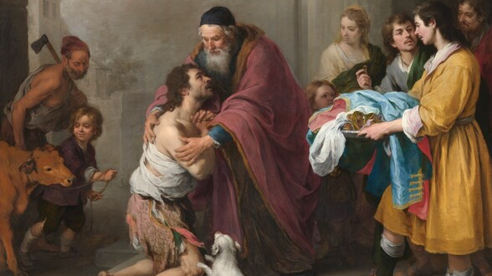
Chapter 22: Love of God

Slide 253
Opening Prayer
O God, our Father, you sent your Son to offer his life for the salvation of the world. Pour out your Holy Spirit upon us and fill our hearts with love of you that we might hold fast to your commands and attain the promised reward of heaven. Through Christ our Lord. Amen.

Slide 254
Opening Scripture: 1 Corinthians 13:1-13
If I speak in the tongues of mortals and of angels, but do not have love, I am a noisy gong or a clanging cymbal. ² And if I have prophetic powers, and understand all mysteries and all knowledge, and if I have all faith, so as to remove mountains, but do not have love, I am nothing. ³ If I give away all my possessions, and if I hand over my body so that I may boast, but do not have love, I gain nothing.
4 Love is patient; love is kind; love is not envious or boastful or arrogant 5 or rude. It does not insist on its own way; it is not irritable or resentful; 6 it does not rejoice in wrongdoing, but rejoices in the truth. 7 It bears all things, believes all things, hopes all things, endures all things.
8 Love never ends. But as for prophecies, they will come to an end; as for tongues, they will cease; as for knowledge, it will come to an end. 9 For we know only in part, and we prophesy only in part; 10 but when the complete comes, the partial will come to an end. 11 When I was a child, I spoke like a child, I thought like a child, I reasoned like a child; when I became an adult, I put an end to childish ways. 12 For now we see in a mirror, dimly,[b] but then we will see face to face. Now I know only in part; then I will know fully, even as I have been fully known. 13 And now faith, hope, and love abide, these three; and the greatest of these is love.

Slide 255
Chapter 22: The Love of God
Key Points from the Video
Love is the heart of how we live our Christian faith. Christ gives us a double command to love God and our neighbor. The virtue by which we fulfill this double command to love is called charity.
Charity is supernatural in two important ways: in the way it comes about and in what it empowers us to do.
God does not love us because we are good. Very often, we a not good. good!. Rather, he loves us even when we are sinners because he is good.
The Christian tradition has long understood this virtue of charity in terms of friendship.
If we are friends with God, we will obey his commandments and worship him as he asks us to. Therefore, friendship with God, obedience to his commands, and divine worship are all connected.
The best way we worship him, and therefore love him, is through the Mass. This can be compared to a family meal where loved ones gather to be together, but with the Mass, it is the whole human family God is gathering.

Slide 256
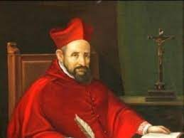
Wisdom of the Saints
The School of Christ is the school of charity. On the last day, when the general examination takes place, there will be no question at all on the text of Aristotle, the aphorisms of Hippocrates, or the paragraphs of Justinian. Charity will be the whole syllabus. – St. Robert Bellarmine

Slide 257
Chapter 22: Discussion Questions
What is charity?
What does supernatural mean and how is charity supernatural?
If faith supplies the beginnings of Christian life, how does charity supply its perfection
Even though God desires friendship with us, we are not equals with him. Who two other things must we do to show God our love for him?
How does the celebration of the Eucharist (the Mass) constitute the principal form of Christian worship?

Slide 258
From the Catechism
The practice of all the virtues is animated and inspired by charity, which "binds everything together in perfect harmony"; it is the form of the virtues; it articulates and orders them among themselves; it is the source and the goal of their Christian practice. Charity upholds and purifies our human ability to love, and raises it to the supernatural perfection of divine love. – CCC 1827

Slide 259
Chapter 22: Life Application Questions
How does it make you feel to know that God does not love you for any good you do but rather just because he is good? What comfort or freedom does this give you?
What does it mean to be a friend of God? Answer in plain language.
What is one way you try to show your love for God in your ordinary everyday life?

Slide 260
From Pope Francis
God does not love us because there is some reason that causes love. God loves us because He Himself is love, and love tends to spread and give by its nature. – Weekly Audience, 2017

Slide 261
Chapter 22: Key Terms
Key Terms
Charity: One of the theological virtues, along with faith and hope. It comes from the Latin word for love, caritas; thus, it is the “virtue of love” that informs or shapes the acts of faith and hope we make, animating them and giving them the right motive and direction so that we actually reach out in love toward the object of our belief and hope.
Supernatural: Something that goes beyond, or flies above, what we are naturally capable of.
Re-presentation: To make present again, used in the context of the Mass (the sacramental re-presentation), which makes Christ’s sacrifice on Calvary present again in our own lives.

Slide 262
Closing Scripture 1 Corinthians 16:14
Let all that you do be done in love.

Slide 263
Closing Prayer
O my God, I love you above all things with my whole heart and soul, because you are all good and worthy of all my love. I love my neighbor as myself for the love of you. I forgive all who have injured me, and ask pardon for all whom I have injured. Amen.

Slide 264
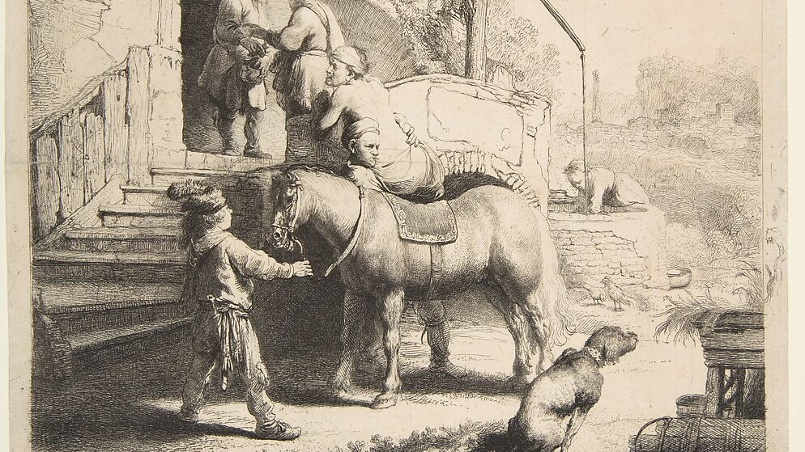
Chapter 23: Love of Neighbor

Slide 265
Opening Prayer
Direct, O Lord, we pray, the hearts of your faithful, and in your kindness grant your servants this grace: that, abiding in the love of you and their neighbor, they may fulfill the whole of your commands. Through Christ our Lord. Amen.

Slide 266
Opening Scripture: Matthew 25:31-46
31 “When the Son of Man comes in his glory, and all the angels with him, then he will sit on the throne of his glory. 32 All the nations will be gathered before him, and he will separate people one from another as a shepherd separates the sheep from the goats, 33 and he will put the sheep at his right hand and the goats at the left. 34 Then the king will say to those at his right hand, ‘Come, you that are blessed by my Father, inherit the kingdom prepared for you from the foundation of the world; 35 for I was hungry and you gave me food, I was thirsty and you gave me something to drink, I was a stranger and you welcomed me, 36 I was naked and you gave me clothing, I was sick and you took care of me, I was in prison and you visited me.’ 37 Then the righteous will answer him, ‘Lord, when was it that we saw you hungry and gave you food, or thirsty and gave you something to drink? 38 And when was it that we saw you a stranger and welcomed you, or naked and gave you clothing? 39 And when was it that we saw you sick or in prison and visited you?’ 40 And the king will answer them, ‘Truly I tell you, just as you did it to one of the least of these who are members of my family,[g] you did it to me.’ 41 Then he will say to those at his left hand, ‘You that are accursed, depart from me into the eternal fire prepared for the devil and his angels; 42 for I was hungry and you gave me no food, I was thirsty and you gave me nothing to drink, 43 I was a stranger and you did not welcome me, naked and you did not give me clothing, sick and in prison and you did not visit me.’ 44 Then they also will answer, ‘Lord, when was it that we saw you hungry or thirsty or a stranger or naked or sick or in prison, and did not take care of you?’ 45 Then he will answer them, ‘Truly I tell you, just as you did not do it to one of the least of these, you did not do it to me.’ 46 And these will go away into eternal punishment, but the righteous into eternal life.”

Slide 267
Chapter 23: The Love of Neighbor
Key Points from the Video
It is traditional to speak of an "order of charity" by which we arrange what we love. GOd comes first in this order.
After loving God, and after the good of our souls, we are called to love our neighbors as ourselves.
The corporal and spiritual works of mercy are aspects of the love of neighbor.
God commands us to respect human life from conception to natural death.
At the end of life, an act of direct killing (euthanasia) is very different from withdrawing extraordinary treatment

Slide 268

Wisdom of the Saints
You learn to speak by speaking, to study by studying, to run by running, to work by working; and just so, you learn to love by loving. All those who think to learn in any other way deceive themselves. – St. Frances de Sales

Slide 269
Chapter 23: Discussion Questions
What is the order of charity?
Why are the spiritual works of mercy “higher” than the corporal works of mercy?
Why is it important to stress that human beings have dignity, and their lives are valuable, because of what they are instead of what they do?
What are the important elements of the Church’s teaching on providing care and treatment at the end of life?

Slide 270
From the Catechism
"If I . . . have not charity," says the Apostle, "I am nothing." Whatever my privilege, service, or even virtue, "if I . . . have not charity, I gain nothing." Charity is superior to all the virtues. It is the first of the theological virtues: "So faith, hope, charity abide, these three. But the greatest of these is charity.”- CCC 1826

Slide 271
Chapter 23: Life Application Questions
Has your experience of the love and mercy of Go helped you be more loving and merciful to others? How so?
How can you take some realistic and concrete first steps toward acts of love of neighbor (for example, either corporal or spiritual works of mercy)?
What are some concrete ways that you might help advance a culture of life?

Slide 272
From Pope St. John Paul II, Evangelium Vitae, no. 2
Every person sincerely open to truth and goodness can, by the light of reason and the hidden action of grace, come to recognize in the natural law written in the heart (cf. Rom 2:14-15) the sacred value of human life from its very beginning until its end, and can affirm the right of every human being to have this primary good respected to the highest degree. Upon the recognition of this right, every human community and the political community itself are founded.

Slide 273
Chapter 23: Key Terms
Key Terms
In vitro fertilization: A method of bringing about a new human life by technicians fertilizing an egg taken from a woman with sperm from a man. This is gravely wrong, both because it intends the coneption of life outside the marital embrace of two loving parents, but also because it almost always involves the intentional production of many more embryos than will survive. Many are then discarded or frozen indefinitely; effectively, this is like an early-term abortion.
Abortion: The direct and intentional termination of a pregnancy by killing the unborn child. Such direct abortion, willed either as an end or as a means to some other end, is gravely contrary to the moral law. To highlight the gravity and irreparable harm of abortion, the Church attaches an automatic penalty of excommunication to anyone who procures an abortion.
Euthanasia: An action or an omission which, of itself or by intention, causes the death of disabled, distressed, sick, or dying persons, sometimes with an attempt to justify the act as a means of eliminating suffering. Euthanasia violates the Fifth Commandment of the law of God.
Order of charity: The traditional teaching about the order in which one should prioritize one’s loves: (1) love of God; (2) love of the good of your soul; (3) love of neighbor; (4) love of the good of your body.
Works of mercy: charitable actions by which we come to the aid of our neighbors in their bodily and spiritual needs. These works are traditionally divided into seven corporal works of mercy and seven spiritual works of mercy.

Slide 274
Closing Scripture Galatians 5:14-15; 26
For the whole law is summed up in a single commandment, “You shall love your neighbor as yourself.” ¹⁵ If, however, you bite and devour one another, take care that you are not consumed by one another…Let us not become conceited, competing against one another, envying one another.

Slide 275
Closing Prayer
Leader: Our Help is in the name of the Lord
Response: Who made heaven and earth
All make the sign of the cross

Slide 276
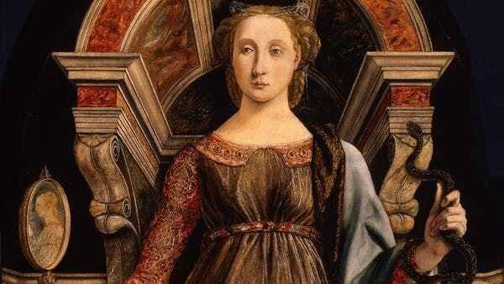
Chapter 24: Prudence and Conscience

Slide 277
Opening Prayer
O God our creator, who have endowed us with intelligence and freedom, guide us, we pray, that we may prudently seek your will and by your grace accomplish it. Through Christ our Lord. Amen.

Slide 278
Opening Scripture: Wisdom 7:7-14
Therefore I prayed, and understanding was given me; I called on God, and the spirit of wisdom came to me. ⁸ I preferred her to scepters and thrones, and I accounted wealth as nothing in comparison with her. ⁹ Neither did I liken to her any priceless gem, because all gold is but a little sand in her sight, and silver will be accounted as clay before her. ¹⁰ I loved her more than health and beauty, and I chose to have her rather than light, because her radiance never ceases. ¹¹ All good things came to me along with her, and in her hands uncounted wealth. ¹² I rejoiced in them all, because wisdom leads them; but I did not know that she was their mother. ¹³ I learned without guile and I impart without grudging; I do not hide her wealth, ¹⁴ for it is an unfailing treasure for mortals; those who get it obtain friendship with God, commended for the gifts that come from instruction.

Slide 279
Chapter 24: Prudence and Conscience
Key Points from the Video
It matters for human happiness not simply that we move at all but more importantly that we move well toward the ends that perfect us.
The moral virtues – prudence, justice, courage, and temperance – are those qualities of soul that allow us to move rationally toward whatever good end we set out to pursue.
Prudence enjoys pride of place among the moral virtues.
The act of prudence unfolds in three principal steps: deliberation, judgment, and command.
At the step of judgment, the person has to judge both the goodness and the appropriateness of the preferred means to his chosen end.
The prudent man acts confidently according to his conscience, which he allows to be informed by all truth pertaining to moral action.

Slide 280
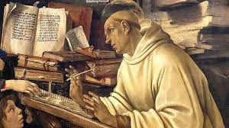
Wisdom of the Saints
A good conscience is a mine of wealth. And in truth what greater riches can there be, what thing more sweet, than a good conscience? – St. Bernard of Clairvaux

Slide 281
Chapter 24: Discussion Questions
What are the moral virtues and what do they do for us?
Why is prudence the most important of the moral virtues?
What are the three principal steps in an act of prudence? Discuss what each is briefly?
Explain why it is not enough merely to “follow one’s conscience.” Is every judgment we make infallibly made? Why or why not?

Slide 282
From the Catechism
Prudence is the virtue that disposes practical reason to discern our true good in every circumstance and to choose the right means of achieving it; "the prudent man looks where he is going." "Keep sane and sober for your prayers." Prudence is "right reason in action," writes St. Thomas Aquinas, following Aristotle. It is not to be confused with timidity or fear, nor with duplicity or dissimulation. It is called auriga virtutum (the charioteer of the virtues); it guides the other virtues by setting rule and measure. It is prudence that immediately guides the judgment of conscience. The prudent man determines and directs his conduct in accordance with this judgment. With the help of this virtue we apply moral principles to particular cases without error and overcome doubts about the good to achieve and the evil to avoid. – CCC 1806

Slide 283
Chapter 24: Life Application Questions
How does your faith help you make prudent decisions, both big and small? How does it help form your conscience??
Looking back on any decisions that you regret, which step of prudence did you fail in: deliberation, judgment, or command?
How do you view conscience differently after completing this chapter? If so, how?

Slide 284
From Pope Benedict XVI
Prudence, according to the Greek philosophical tradition, is the first of the cardinal virtues. It indicates the primacy of the truth which, through “prudence”, becomes a criterion for our action. Prudence demands humble, disciplined and watchful reason that does not let itself be blinded by prejudices; it does not judge according to desires and passions but rater seeks the truth, even though it may prove uncomfortable. Prudence means searching for the truth and acting in confirmation with it. The prudent servant is first and foremost a man of truth and a man of sincere reason. – Homily, September 12, 2009

Slide 285
Chapter 24: Key Terms
Key Terms
Moral Virtues: Qualities of soul that allow us to move rationally toward whatever good end we set out to pursue; these include prudence, justice, courage, and temperance.
Prudence: One of the moral virtues, and in fact, the foundation of the moral virtues. It perfects our intellect, helping us deliberate well about how best to achieve a chosen goal in a given situation. The act of prudence unfolds in three principal stages: deliberation, judgment, and command.
Deliberation: The first step of the prudent act when one considers all the mans possible to achieve his chosen end.
Judgment: The second step of a prudent act when one judges (considers and weighs outcomes) both the goodness and the appropriateness of the preferred means to his chosen end.
Command: The third and final stage of a prudent act when one carries out the best possible action deemed through deliberation and judgment.
Conscience: A practical judgment of the mind, assessing (from general principles of faith and reason) the goodness or evil of a concrete action. It is an operation of the intellect and not of the feelings or even the will. It is a specific act of the mind applying its knowledge to a concrete moral situation. Conscience stand under the objective moral law and should be formed by it so that “the truth about moral good, as that truth declared in the law of reason, is practically and concretely recognized by the judgment of conscience” (St. John Paul II, Veritatis Splendor, no. 61)

Slide 286
Closing Scripture Proverbs 15:5
A fool despises his father’s instruction,/but he who heeds admonition is prudent.

Slide 287
Closing Prayer
O Holy Spirit of God, take me as your disciple; guide me, illuminate me, sanctify me. Bing my hands that they may do no evil; cover my eyes that they may see it no more; sanctify my heart that evil may not dwell within me. Be my God; be my guide. Where you lead me, I will go; whatever you forbid me, I will renounce; and whatever you command me, in your strength, I will do. Lead me, then, unto the fullness of your truth. Amen.

Slide 288
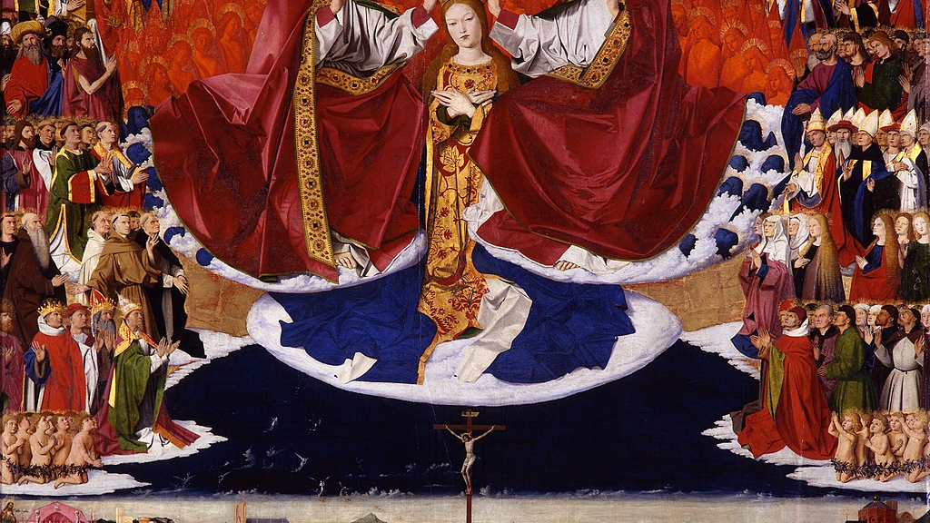
Chapter 25: Justice

Slide 289
Opening Prayer
O God you are just and all of your ways are true. Look upon us an help us to give our neighbor what is his due. Through Christ our Lord. Amen.

Slide 290
Opening Scripture: Psalm 37:27-34, 37-40
27Depart from evil, and do good; so you shall abide forever. 28 For the Lord loves justice; he will not forsake his faithful ones. The righteous shall be kept safe forever, but the children of the wicked shall be cut off. 29 The righteous shall inherit the land, and live in it forever. 30 The mouths of the righteous utter wisdom, and their tongues speak justice. 31 The law of their God is in their hearts; their steps do not slip. 32 The wicked watch for the righteous, and seek to kill them. 33 The Lord will not abandon them to their power, or let them be condemned when they are brought to trial. 34 Wait for the Lord, and keep to his way, and he will exalt you to inherit the land; you will look on the destruction of the wicked…Mark the blameless, and behold the upright, for there is posterity for the peaceable. 38 But transgressors shall be altogether destroyed; the posterity of the wicked shall be cut off. 39 The salvation of the righteous is from the Lord; he is their refuge in the time of trouble. 40 The Lord helps them and rescues them; he rescues them from the wicked, and saves them, because they take refuge in him.

Slide 291
Chapter 25: Justice
Key Points from the Video
None of us are an island unto ourselves. Everything we do affects others. This makes justice an extremely important topic.
Christian tradition defines justice as “to render to each what is his due.” Justice is thus with respect to another.
Commutative justice is the agreed upon equality between what is being given and received between individuals.
General justice and distributive justice are two other kinds of justice that involve the relationship between the individual and the community (or civil authority).
Christian citizens and Christian leaders are obliged both by nature and by Christ’s teaching and example to render the other his due, and also to surpass the rule of justice when charity demands it.
The just Christian renders what he owes to God through acts of religion; he renders what he owes to country through acts of patriotism; he renders what he owes his family through acts of honor and respect; and through acts of gratitude, he render what he owes to those who do good to him.

Slide 292

Wisdom of the Saints
The rule of justice is plain: namely, that a good man ought not to swerve from the truth, nor inflict any unjust loss on anyone, nor act in any way deceitfully or fraudulently. – St. Ambrose of Milan

Slide 293
Chapter 25: Discussion Questions
Why is justice so concerned with our relations with other people?
What is the most common form of justice? Describe it.
Explain the meaning of the relationship between general and distributive justice.
How is the Christian concept of justice understood?

Slide 294
From the Catechism
Justice is the moral virtue that consists in the constant and firm will to give their due to God and neighbor. Justice toward God is called the "virtue of religion." Justice toward men disposes one to respect the rights of each and to establish in human relationships the harmony that promotes equity with regard to persons and to the common good. The just man, often mentioned in the Sacred Scriptures, is distinguished by habitual right thinking and the uprightness of his conduct toward his neighbor. "You shall not be partial to the poor or defer to the great, but in righteousness shall you judge your neighbor." "Masters, treat your slaves justly and fairly, knowing that you also have a Master in heaven.” –CCC 1807

Slide 295
Chapter 25: Life Application Questions
Do you think our contemporary culture misunderstands justice? How so?
In what aspects of your life do you most often fail to render someone else his due? In your family? With your friends? In the workplace? To those you know?
Does the idea of God’s justice frighten or comfort you? How so?

Slide 296
From Pope Leo XIII
There is no intermediary more powerful than religion (whereof the Church is the interpreter and guardian) in drawing the rich and the working class together, by reminding each of its duties to the other, and especially of the obligations of justice. – Rerum Novarum, no.19

Slide 297
Chapter 25: Key Terms
Key Terms
Justice: Defined by the Christian tradition as rendering to each what is due. We judge whether an action is just by whether we have rendered to another what is due to him.
Commutative Justice: Concerns the interactions (what is being given and what is being received) between individuals according to a kind of equality. In buying and selling, for example, what is typically due depends on the value of the things being exchanged and the terms of the exchange agreed upon by the two parties.
General (or legal) Justice: Concerns the relationship between individuals and a larger “body” (the family, community, government, etc.), specifically what the individual owes to the community based on what is established by the rightful authority (for example, we must pay our taxes, obey traffic rules, serve on juries when called, etc.).
Distributive Justice: Concerns the treatment of individual citizens by the larger “body,” ensuring they receive not only their equitable portion of commonly held goods (like water, electricity, and transportation) but also equitable access to common benefits (like security, education, and prosperity).

Slide 298
Closing Scripture Amos 5:24
For the whole law is summed up in a single commandment, “You shall love your neighbor as yourself.” ¹⁵ If, however, you bite and devour one another, take care that you are not consumed by one another…Let us not become conceited, competing against one another, envying one another.

Slide 299
Closing Prayer
The Divine Praises
Blessed be God. (Repeat) Blessed be his holy Name. Blessed be Jesus Christ, true God and true Man. Blessed be the name of Jesus. Blessed be his most Sacred Heart. Blessed be his most Precious Blood. Blessed be Jesus in the most holy Sacrament of the altar. Blessed be the Holy Spirit, the Paraclete. Blessed be the great Mother of God, Mary most holy. Blessed be her holy and Immaculate Conception. Blessed be her glorious Assumption. Blessed be the name of Mary, Virgin and Mother. Blessed be Saint Joseph, her most chaste spouse. Blessed be God in his angels and in his saints.

Slide 300

Chapter 26: Temperance and Chastity

Slide 301
Opening Prayer
Lord Jesus Christ, give us holy desires so that we may live in temperance and chastity. May we come to recognize in our bodies and in those of others that we are invited to be temples of the Holy Spirit. Help us by your grace to shape our desires and decisions in accord with your will so that we may grow in charity and love for you and our neighbor. You who live and reign, now and forever. Amen.

Slide 302
Opening Scripture: 1 Corinthians 6:13-20
13 “Food is meant for the stomach and the stomach for food,”[e] and God will destroy both one and the other. The body is meant not for fornication but for the Lord, and the Lord for the body. 14 And God raised the Lord and will also raise us by his power. 15 Do you not know that your bodies are members of Christ? Should I therefore take the members of Christ and make them members of a prostitute? Never! 16 Do you not know that whoever is united to a prostitute becomes one body with her? For it is said, “The two shall be one flesh.” 17 But anyone united to the Lord becomes one spirit with him. 18 Shun fornication! Every sin that a person commits is outside the body; but the fornicator sins against the body itself. 19 Or do you not know that your body is a temple[f] of the Holy Spirit within you, which you have from God, and that you are not your own? 20 For you were bought with a price; therefore glorify God in your body.

Slide 303
Chapter 26: Temperance and Chastity
Key Points from the Video
Chastity is the virtue by which we govern our sexual desires and instincts so as to maintain a just, serene, and and loving attitude toward other persons.
The married couple is chaste when they cultivate sexual desires for one another and have sexual relations in accord with mutual love, tenderness and respect, and with genuine openness to life.
A marriage of a man and a woman that is open to life is the unique and only context in which the gift of human sexuality can be exercised in accord with its true meaning purpose.
Contraception technically defined is any act that occurs before, during, or after conjugal union that seeks intentionally to thwart the conception of human life.
The Church teaches that the practice of Natural Family Planning (refraining from sexual union during times of fertility) is different from contraception.

Slide 304

Wisdom of the Saints
Only the chaste man and the chaste woman are capable of true love. – Pope St. John Paul II

Slide 305
Chapter 26: Discussion Questions
What is chastity and how should we distinguish chaste marriage from chastity outside of marriage.
How does the use of artificial contraception affect human sexuality?
How is Natural Family Planning specifically different from contraception? When is it morally permissible?

Slide 306
From the Catechism
Chastity includes an apprenticeship in self-mastery which is a training in human freedom. The alternative is clear: either man governs his passions and finds peace, or he lets himself be dominated by them and becomes unhappy. "Man's dignity therefore requires him to act out of conscious and free choice, as moved and drawn in a personal way from within, and not by blind impulses in himself or by mere external constraint. Man gains such dignity when, ridding himself of all slavery to the passions, he presses forward to his goal by freely choosing what is good and, by his diligence and skill, effectively secures for himself the means suited to this end.” –CCC 2339

Slide 307
Chapter 26: Life Application Questions
How do you think the widespread use of contraception has affected our culture?
How is chastity related to respect and love? Why is it an essential part of Christianity?
How can human weakness and frailty in the domain of human sexuality teach us about God’s mercy and forgiveness? How can you manifest this mercy to others in your daily life?

Slide 308
From Saint Pope Paul Vi
Not much experience is needed to be fully aware of human weakness and to understand that human beings—and especially the young, who are so exposed to temptation—need incentives to keep the moral law, and it is an evil thing to make it easy for them to break that law. Another effect that gives cause for alarm is that a man who grows accustomed to the use of contraceptive methods may forget the reverence due to a woman, and, disregarding her physical and emotional equilibrium, reduce her to being a mere instrument for the satisfaction of his own desires, no longer considering her as his partner whom he should surround with care and affection. – Humanae Vitae, no. 17.

Slide 309
Chapter 26: Key Terms
Key Terms
Temperance: The virtue that regulates sense pleasures in accord with human reason.
Chastity: The specific virtue that governs human sexual actions in accord with human reason.
Concupiscence: The disordered desire for sensible goods that makes it difficult to govern the senses; one of the consequences of original sin.
Contraception: Any act that occurs before, during, or after conjugal union that seeks to intentionally thwart the conception of human life.
Natural Family Planning (NFP): The practice of refraining from sexual relations during times of fertility in order to space out children, whether for reasons of physical health, psychological well-being, or economic duress.

Slide 310
Closing Scripture Ephesians 5:25-27
25 Husbands, love your wives, just as Christ loved the church and gave himself up for her, 26 in order to make her holy by cleansing her with the washing of water by the word, 27 so as to present the church to himself in splendor, without a spot or wrinkle or anything of the kind—yes, so that she may be holy and without blemish

Slide 311
Closing Prayer
Dear Jesus, I know that every perfect gift, and especially that of chastity, depends on the power of Your providence. Without You, a mere creature can do nothing. Therefore, I beg You to defend by Your grace the chastity and purity of my body and soul. And if I have ever sensed or imagined anything that could stain my chastity and purity, blot it out, Supreme Lord of my powers, that I may advance with a pure heart in Your love and service, offering myself on the most pure altar of Your divinity all the days of my life. Amen.
-The Prayer of St. Thomas for Purity

Slide 312

Chapter 27: Living out Catholic Teaching in a Secular Society

Slide 313
Opening Prayer
Pour your grace into hearts, we pray, O Lord, that we may be constantly drawn away from unruly desires and obey by your own gift the heavenly teaching you give us. Through our Lord Jesus Christ, you Son, who lives and reigns with you in the unity of the Holy Spirit, one God, for ever and ever. Amen.

Slide 314
Opening Scripture: Ephesians 4:11-15, 17-19, 22-25
4 The gifts he gave were that some would be apostles, some prophets, some evangelists, some pastors and teachers, 12 to equip the saints for the work of ministry, for building up the body of Christ, 13 until all of us come to the unity of the faith and of the knowledge of the Son of God, to maturity, to the measure of the full stature of Christ. 14 We must no longer be children, tossed to and fro and blown about by every wind of doctrine, by people’s trickery, by their craftiness in deceitful scheming. 15 But speaking the truth in love, we must grow up in every way into him who is the head, into Christ…Now this I affirm and insist on in the Lord: you must no longer live as the Gentiles live, in the futility of their minds. 18 They are darkened in their understanding, alienated from the life of God because of their ignorance and hardness of heart. 19 They have lost all sensitivity and have abandoned themselves to licentiousness, greedy to practice every kind of impurity…You were taught to put away your former way of life, your old self, corrupt and deluded by its lusts, 23 and to be renewed in the spirit of your minds, 24 and to clothe yourselves with the new self, created according to the likeness of God in true righteousness and holiness. So then, putting away falsehood, let all of us speak the truth to our neighbors, for we are members of one another.

Slide 315
Chapter 27: Living out Catholic Teaching in a Secular Society
Key Points from the Video
To be a Christian means to be consecrated in the truth, and the truth of Christ really is a saving message.
Jesus quotes the book of Genesis on marriage: “A man shall leave his father and mother and be joined to his wife, and the two shall become one flesh.”
Christ elevated marriage to the dignity of a sacrament, and it signifies his spousal love and his unbreakable fidelity to the Church.
The question of homosexuality and the new phenomenon of same-sex civil unions might mean you will face challenges to bear witness to the truth of human sexuality and to the Church’s teaching.
The Catholic Church does not condemn person who experience homosexual inclinations of desires, but it does say that homosexual acts are wrong.

Slide 316

Wisdom of the Saints
O you who are married,…it was God…who with an unseen hand tied your holy marriage bond and gave you to one another. Why then do you not cherish each other with a completely holy, completely sacred, and completely divine love?...God joins husband to wife with his own blood and for this reason the union is so strong that the soul must sooner break away from the body of one of them than the husband from the wife. – St. Francis de sales

Slide 317
Chapter 27: Discussion Questions
What deep truths about human life and marriage does Jesus point us to? (See Gn. 2:24)
What are the main features of the Catholic teaching on the permanence of the marriage bond?
What are the main elements of the Catechism’s teaching on homosexuality? See CCC 2357-2359
What is the relation between the Church’s understanding of marriage and the procreation and raising of children?

Slide 318
From the Catechism
It can seem difficult, even impossible, to bind oneself for life to another human being. This makes it all the more important to proclaim the Good News that God loves us with a definitive and irrevocable love, that married couples share in this love, that it supports and sustains them, and that by their own faithfulness they can be witnesses to God's faithful love. Spouses who with God's grace give this witness, often in very difficult conditions, deserve the gratitude and support of the ecclesial community. –CCC 1648

Slide 319
Chapter 27: Life Application Questions
What challenges do you anticipate facing in speaking with family or friends about Catholic teaching?
What aspects of Catholic moral teaching do you find attractive? Do you find some elements challenging?
What are some concrete steps you might take to witness more effectively to Catholic teaching?

Slide 320
From Saint Pope Paul Vi
Married love particularly reveals its true nature and nobility when we realize that it takes its origin from God, who "is love," the Father "from whom every family in heaven and on earth is named.” Marriage, then, is far from being the effect of chance or the result of the blind evolution of natural forces. It is in reality the wise and provident institution of God the Creator, whose purpose was to effect in man His loving design. As a consequence, husband and wife, through that mutual gift of themselves, which is specific and exclusive to them alone, develop that union of two persons in which they perfect one another, cooperating with God in the generation and rearing of new lives.
– Humanae Vitae, no. 8.

Slide 321
Chapter 27: Key Terms
Key Terms
Annulment: A decree of nullity; that is, a formal recognition by a Church tribunal, after an investigation, that determines a true and valid marriage bond never existed, even though there may have been the outward appearance of a marriage.
Marriage: A covenant or partnership of life between a man and a woman, which is ordered to the well-being of the spouses and to the procreation and upbring of children. When validly contracted between two baptized persons, marriage is a sacrament. A valid and consummated sacramental marriage cannot be dissolved b y any human authority.
Homosexuality: Sexual attraction toward persons of the same sex and/or sexual acts between persons of the same sex. Homosexual acts are morally wrong because they violate God’s purpose of human sexual activity. Homosexual inclinations or desires of themselves may not be sinful, however, especially when they are not deliberately chosen or willed.

Slide 322
Closing Scripture Ephesians 5:31-32
31 “For this reason a man shall leave his father and mother and be joined to his wife, and the two shall become one flesh.” 32 This mystery is a profound one, and I am saying that it refers to Christ and the church; 33 however, let each one of you love his wife as himself, and let the wife see that she respects her husband.

Slide 323
Closing Prayer
Leader: Our help is in the name of the Lord
Response: Who made heaven and earth
All make the sign of the cross

Slide 324

Chapter 28: The Beatitudes and the Gifts of the Holy Spirit

Slide 325
Opening Prayer
O God our Father, who with the Son sent the Spirit into the world to sanctify us in the truth, pour out your spirit upon us here and now. Fill us with his many gifts and strengthen us to live out the call of your Son. We ask this through Christ our Lord. Amen.

Slide 326
Opening Scripture: Isaiah 11:1-5
There shall come forth a shoot from the stump of Jesse, and a branch shall grow out of his roots. And the Spirit of the Lord shall rest upon him, the spirit of wisdom and understanding, the spirit of counsel and might, the spirit of knowledge and the fear of the Lord. And his delight shall be in the fear of the Lord. He shall not judge by what his eyes see, or decide by what his ears hear; but with righteousness he shall judge the poor, and decide with equity for the meek of the earth; and he shall smite the earth with the rod of his mouth, and with the breath of his lips he shall slay the wicked. Righteousness shall be the girdle of his waist, and faithfulness the girdle of his loins.

Slide 327
Chapter 28: The Beatitudes and the Gifts of the Holy Spirit
Key Points from the Video
The seven gifts of the Holy Spirit are knowledge, understanding, wisdom, counsel, piety, fortitude, and fear (or awe) of the Lord.
The gifts of the Holy Spirit assist and strengthen faith, hope, and charity. Every gift has a particular meaning and role.
The gifts of the Holy Spirit empower us to live up to the Beatitudes.
The Beatitudes are the pattern of holiness Christ proposed in the Sermon on the Mount.
The Beatitudes show us the Gospel’s call to fullness of life in Christ.

Slide 328
Wisdom of the Saints
Do all the things that you have to do prudently, holding God before your eyes; do and say what you have to say and do in the Presence of God…There you shall find the Master, the Holy Spirit, rich in clemency, who shall pour upon you a light of wisdom that shall make you discern and choose what shall be to his honor. – St. Catherine of Sienna

Slide 329
Chapter 28: Discussion Questions
Why does God give us the gifts of the Holy Spirit?
How does one receive the gifts of the Holy Spirit?
What are the Beatitudes? Why are they called “beatitudes”?
How do the Beatitudes relate to the gifts of the Holy Spirit?

Slide 330
From the Catechism
The moral life of Christians is sustained by the gifts of the Holy Spirit. These are permanent dispositions which make man docile in following the promptings of the Holy Spirit. –CCC 1830

Slide 331
Chapter 28: Life Application Questions
Choose a gift of the Holy Spirit. How do you think this gift could help you? Does it respond to a need in your life?
To many, the Beatitudes seem counterintuitive. How do the Beatitudes lead us away from what the world offers to what Christ offers?
Read through the list of Beatitudes again in fifth chapter of Matthew (vv. 3-11). Is there one you find particularly consoling? Is there one you find puzzling?

Slide 332
From Saint Pope John Paul II
The Beatitudes are also relevant to the answer given by Jesus to the young man's question: "What good must I do to have eternal life? ". Indeed, each of the Beatitudes promises, from a particular viewpoint, that very "good" which opens man up to eternal life, and indeed is eternal life.
– Veritatis Splendor, no. 16.

Slide 333
Chapter 28: Key Terms
Key Terms
Gifts of the Holy Spirit: Permanent dispositions that make man receptive to the Holy Spirit. They are Knowledge, Understanding, Wisdom, Counsel, Piety, Fortitude, and Fear (or awe) of the Lord.
Counsel: The gift of the Holy Spirit that strengthens our human prudence and moves us according to God’s plan.
Fear of the Lord: The gift of the Holy Spirit that strengthens our hope and gives us reverence or awe for God.
Beatitudes: The teachings of Jesus at the Sermon on the Mount about the true happiness. They show us the face of Christ and the vocation of all Christians.

Slide 334
Closing Scripture Romans 8:14
14 For all who are led by the Spirit of God are sons of God.

Slide 335
Closing Prayer
Come, Holy Spirit, fill the hearts of your faithful and kindle in them the fire of your love.
Send forth your Spirit and they shall be created. And you shall renew the face of the earth.
O God, who by the light of the Holy Spirit, did instruct the hearts of the faithful, grant that by the same Holy Spirit we may be truly wise and ever enjoy his consolations.
Through the same Christ Our Lord. Amen. – Prayer to the Holy Spirit

Slide 336

Chapter 29: Priesthood and the Religious Life

Slide 337
Opening Prayer
O God, who inspire men and women to follow you through lives of priestly and religious consecration and who enrich the Church with a variety of vocations, pour out upon us, your servants, the grace to follow you more closely and to offer ourselves as a perfect gift of loving service. Through Christ our Lord. Amen.

Slide 338
Opening Scripture: Matthew 19:16-22
16 And behold, one came up to him, saying, “Teacher, what good deed must I do, to have eternal life?” 17 And he said to him, “Why do you ask me about what is good? One there is who is good. If you would enter life, keep the commandments.” 18 He said to him, “Which?” And Jesus said, “You shall not kill, You shall not commit adultery, You shall not steal, You shall not bear false witness, 19 Honor your father and mother, and, You shall love your neighbor as yourself.” 20 The young man said to him, “All these I have observed; what do I still lack?” 21 Jesus said to him, “If you would be perfect, go, sell what you possess and give to the poor, and you will have treasure in heaven; and come, follow me.” 22 When the young man heard this he went away sorrowful; for he had great possessions.

Slide 339
Chapter 29: Priesthood and Religious life
Key Points from the Video
Man is created to share in the goodness of God and to manifest the glory of God.
A vocation is the calling or destiny we have in this life – how we are invited to share in the goodness of God and to manifest the glory of God.
To embark upon and to remain faithful to a vocation one needs grace; God gives grace especially in the form of virtues, which empower one to carry out a vocation.
All of us, no matter what vocation we have, are called to the perfection of charity.
In the religious life, one follows Christ more closely through poverty, chastity, and obedience for the purpose of loving unions with God and the great and difficult service of his kingdom.
The priest makes Christ present; he offers prayers and sacrifices for the people and gives them divine gifs from on high.

Slide 340
Wisdom of the Saints
Even as in the order of natural things, perfection, which in God is simple and uniform, is not to be found in the created universe except in a multiform and manifold manner, so too, the fullness of grace, which is centered in Christ as head, flows forth to His members in various ways, for the perfecting of the body of the Church. – St. Thomas Aquinas

Slide 341
Chapter 29: Discussion Questions
Did God have to create? How does this shape the Catholic understanding of vocation? See CCC 293-295
Why must one be called to embrace a vocation? Why is it impossible to give a vocation to yourself?
Who in the Church is called to perfection? See CCC 2013
Most men and women feel strongly about quality, and yet the Church seems to suggest that religious life is somehow better. In what sense is religious life perfect? Is this in conflict with the dignity and equality of man? See CCC 871-873, CCC 916, 1 Corinthians 12:14
How is the character given by the sacrament of Holy Orders different from the character given by the sacraments of Baptism and Confirmation? See CCC 1272-1273, 1304-1305, 1547, and 1581.

Slide 342
From the Catechism
Intrinsically linked to the sacramental nature of ecclesial ministry is its character as service. Entirely dependent on Christ who gives mission and authority, ministers are truly "slaves of Christ," in the image of him who freely took "the form of a slave" for us. Because the word and grace of which they are ministers are not their own, but are given to them by Christ for the sake of others, they must freely become the slaves of all.–CCC 876

Slide 343
Chapter 29: Life Application Questions
In what ways might religious life and the priesthood be more difficult than married life? How do you think the difficulties can benefit the person who is called to these ways of life?
What aspects of religious life are attractive? What aspects are intimidating?
Why do you think it might be important for all Catholic to understand the vocation of the priest? How might the witness of holy priests and religious be spiritually beneficial?

Slide 344
From Saint Pope Paul Vi
40. The Lord Jesus, the divine Teacher and Model of all perfection, preached holiness of life to each and everyone of His disciples of every condition. He Himself stands as the author and consumator of this holiness of life: "Be you therefore perfect, even as your heavenly Father is perfect”…Thus it is evident to everyone, that all the faithful of Christ of whatever rank or status, are called to the fullness of the Christian life and to the perfection of charity.– Lumen Gentium, no. 8.

Slide 345
Chapter 29: Key Terms
Key Terms
Vocation: Taken from a word meaning “to call,” a vocation is the calling or destiny we have in this life and hereafter. Priestly and religious vocations are dedicated to the service of the Church as the universal sacrament of salvation.
Perfection: To be complete and lacking in nothing which one should have for the Christian on earth, this means the fullness of charity which makes the individual a friend of God and inclines one to the loving vision of God in heaven.
Evangelical Counsels: These are the things Jesus recommends or “counsels” in the Gospel (see Mt. 19); namely, to follow him in poverty, chastity, and obedience. The counsels are what the religious promises when professing their vows.
Holiness: To be set apart of reserved for divine use; in the Christian understanding, it means to be made more perfectly like God or to be filled with grace.
Contemplative life: A form of religious life adopted by mons and nuns dedicated wholly to prayer, which builds up both the religious themselves and the Church through a life of union with God. Typically, those who pursue the contemplative life do so in monasteries or convents where the religious live the whole of their lives, sometime without leaving.
Active life: A form of religious life dedicated to prayer and to the direct service of those in need. Typically, those who pursue the active life carry out their mission in public settings by practicing corporal and/or spiritual works of mercy.
Mixed (Apostolic) life: A form of religious life adopted by friars dedicated first primarily to prayer. But, unlike monks or nuns, apostolic religious communicate to their contemporaries the Lord whom they have contemplated by learned preaching in a public context.

Slide 346
Closing Scripture Ephesians 4:11-12, 15-16
11 And his gifts were that some should be apostles, some prophets, some evangelists, some pastors and teachers, 12 to equip the saints for the work of ministry, for building up the body of Christ…15 Rather, speaking the truth in love, we are to grow up in every way into him who is the head, into Christ, 16 from whom the whole body, joined and knit together by every joint with which it is supplied, when each part is working properly, makes bodily growth and upbuilds itself in love.

Slide 347
Closing Prayer
Lord Jesus, teach me to be generous;
Teach me to serve you as you deserve,
To give and not count the cost,
To fight and not heed the wounds,
To toil and not to seek for rest,
To labor and not to seek reward,
Except that of knowing that I do your will.
Amen

Slide 348

Part IV: Mystagogy – Pillars for Catholic Living

Slide 349

Chapter 30: Introduction to Mystagogy

Slide 350
Opening Prayer
O God, who have been pleased to draw new members to your Church and make them your children, pour out you grace upon them and lead them through the mysteries so that what you have begun in them may be brought to proper completion. We ask this through Christ our Lord. Amen.

Slide 351
Opening Scripture: Philippians 2:12-18
12 Therefore, my beloved, as you have always obeyed, so now, not only as in my presence but much more in my absence, work out your own salvation with fear and trembling; 13 for God is at work in you, both to will and to work for his good pleasure.
14 Do all things without grumbling or questioning, 15 that you may be blameless and innocent, children of God without blemish in the midst of a crooked and perverse generation, among whom you shine as lights in the world, 16 holding fast the word of life, so that in the day of Christ I may be proud that I did not run in vain or labor in vain. 17 Even if I am to be poured as a libation upon the sacrificial offering of your faith, I am glad and rejoice with you all. 18 Likewise you also should be glad and rejoice with me.

Slide 352
Chapter 30: Introduction to Mystagogy
Key Points from the Video
Mystagogy is a word that means “leading through the mysteries.” The period of mystagogy follows entrance into the Church.
Mystagogy is a time to review the Faith with a fresh perspective, now enlightened by the grace of the sacraments.
Mystagogy is a time to strengthen your friendships with other Catholics and get involved in various groups that can help you strengthen your practice of the Faith.

Slide 353

Wisdom of the Saints
See how great a dignity Jesus bestows on you. You were called a Catechumen, while the word echoed round you from without; hearing of hope, and knowing it not; hearing mysteries, and not understanding them; hearing Scriptures, and not knowing their depth. The echo is no longer around you, but within you; for the indwelling Spirit henceforth makes your mind a house of God. – St. Cyril of Jerusalem

Slide 354
Chapter 30: Discussion Questions
What does mystagogy mean? What is the purpose of it?
What are the two parts to mystagogy?
Why does the Church call for a time of mystagogy?

Slide 355
From the Catechism
Liturgical catechesis aims to initiate people into the mystery of Christ (It is "mystagogy.") by proceeding from the visible to the invisible, from the sign to the thing signified, from the "sacraments" to the "mysteries.". –CCC 1075

Slide 356
Chapter 30: Life Application Questions
If you were recently baptized or received into the Church, explain what there experience was like. Did anything surprise you? Have you noticed any difference in your life?
What do you think are the biggest challenges that await you in living out the Faith? Are there any areas you would like to focus on? Who will help you?
Do you plan to get involved in a group at your parish? How do you think your friendship with other Catholics will nurture your faith?

Slide 357
From Saint Pope John Paul II
Catechesis is intrinsically linked with the whole of liturgical and sacramental activity, for it is in the sacraments, especially in the Eucharist, that Christ Jesus works in fullness for the transformation of human beings.– Catechesi Tradendae, no. 23.

Slide 358
Chapter 30: Key Terms
Key Terms
Mystagogy: The instruction that immediately follows being received into the Church. Newly initiated Catholics are “led through the mysteries” of the Faith with a fresh perspective enlightened by the grace of the sacrament.

Slide 359
Closing Scripture 1 Peter 2:2-3
Like newborn babes, long for the pure spiritual milk, that by it you may grow up to salvation; ³ for you have tasted the kindness of the Lord.

Slide 360
Closing Prayer
Leader: Queen of Heaven, rejoice, alleluia.
All: For He whom you did merit to bear, alleluia.
Leader: Has risen, as he said, alleluia.
All: Pray for us to God, alleluia.
Leader: Rejoice and be glad, O Virgin Mary, alleluia.
All: For the Lord has truly risen, alleluia.
Let us pray, O God, who gave joy to the world through the resurrection of Thy Son, our Lord jesus Christ, grant we beseech Thee, that through the intercession of the Virgin Mary, His Mother, we may obtain the joys of everlasting life. Through the same Christ our ord. Amen.

Slide 361

Chapter 31: Mental Prayer

Slide 362
Opening Prayer
Our Father, Who art in heaven, hallowed be Thy name; Thy kingdom come; Thy will be done on earth as it is in heaven. Give us this day our daily bread; and forgive us our trespasses as we forgive those who trespass against us; and lead us not into temptation, but deliver us from evil.

Slide 363
Opening Scripture: Romans 8:26-28
26 Likewise the Spirit helps us in our weakness; for we do not know how to pray as we ought, but the Spirit himself intercedes for us with sighs too deep for words. 27 And he who searches the hearts of men knows what is the mind of the Spirit, because[b] the Spirit intercedes for the saints according to the will of God.
28 We know that in everything God works for good[c] with those who love him,[d] who are called according to his purpose. 29 For those whom he foreknew he also predestined to be conformed to the image of his Son, in order that he might be the first-born among many brethren. 30 And those whom he predestined he also called; and those whom he called he also justified; and those whom he justified he also glorified.

Slide 364
Chapter 31: Mental Prayer
Key Points from the Video
Mental prayer is interior prayer cultivated by the personal search for a more conscious union with Christ. It should be a regular part of every Christian life and is one of the most essential ways that we discover Christ in a more personal and intimate way.
The practical way to develop this habit of mental prayer is to set time aside for it daily in a regular and committed way, usually at least twenty to thirty minutes.
The Christian who prays daily in profound ways can become progressively rooted in Christ and stable in his love for God so that his union with God affects the whole of his life.
Mental prayer disposes us to a deeper participation in the Mass and the other sacraments. It is best coupled with faithful Mass attendance and regular confession.

Slide 365
Wisdom of the Saints
We need no wings to go in search of God, but have only to find a place where we can be alone and look upon Him present within us. – St. Teresa of Avila

Slide 366
Chapter 31: Discussion Questions
What is mental prayer and why is it important?
How can we nourish mental prayer?
What is the relationship between prayer and the sacramental life?

Slide 367
From the Catechism
Contemplation is a gaze of faith, fixed on Jesus. "I look at him and he looks at me": this is what a certain peasant of Ars in the time of his holy curé used to say while praying before the tabernacle. This focus on Jesus is a renunciation of self. His gaze purifies our heart; the light of the countenance of Jesus illumines the eyes of our heart and teaches us to see everything in the light of his truth and his compassion for all men. Contemplation also turns its gaze on the mysteries of the life of Christ. Thus it learns the "interior knowledge of our Lord," the more to love him and follow him.–CCC 2715

Slide 368
Chapter 31: Life Application Questions
Do you take time to pray each day? How can you find time to make this part of your personal schedule?
Do you think you might make use of the Eucharistic Presence of Christ in order to grow in your prayer life? Does being in the presence of the Eucharist help you to pray?
Does mental prayer help you to grow in your spiritual life?

Slide 369
From Venerable Pope Pius XII
89. There are others who deny any impetratory power to our prayers, or who endeavor to insinuate into men's minds the idea that prayers offered to God in private should be considered of little worth, whereas public prayers which are made in the Name of the Church are those which really matter, since they proceed from the Mystical Body of Christ. This opinion is false; for the divine Redeemer is most closely united not only with His Church, which is His Beloved Spouse, but also with each and every one of the faithful, and He ardently desires to speak with them heart to heart, especially after Holy Communion.– Mystici Corporis Christi, no. 80.

Slide 370
Chapter 31: Key Terms
Key Terms
Mental Prayer: Interior prayer by which we seek personal union with Christ.
Lectio Divina: Sacred reading where we dwell on the words of Christ in the Gospels and the teachings of the apostles in the epistles so as to seek to encounter Christ personally.
Divine Office: The psalms and associated biblical prayers prayed daily by priests, members of the religious orders, and many of the lay faithful.

Slide 371
Closing Scripture 1 Peter 4:7
The end of all things is at hand; therefore, keep sane and sober for your prayers.

Slide 372
Closing Prayer
Direct, O Lord, we beseech you, all our actions by your holy inspirations, and carry them on by your gracious assistance, that every prayer and work of ours may begin always from you, and by you be happily ended. Through Christ our Lord. Amen.

Slide 373

Chapter 32: Frequent Confession

Slide 374
Opening Prayer
O God, author of very mercy and of all goodness, look graciously on the confession of our lowliness, that we, who are bowed down by our conscience, may always be lifted up by your mercy. Through our Lord Jesus Christ, you Son, who lives and reigns with you in the unity of the Holy Spirit, one God, for ever and ever. Amen.

Slide 375
Opening Scripture: 1 John 5-10
5 This is the message we have heard from him and proclaim to you, that God is light and in him is no darkness at all. 6 If we say we have fellowship with him while we walk in darkness, we lie and do not live according to the truth; 7 but if we walk in the light, as he is in the light, we have fellowship with one another, and the blood of Jesus his Son cleanses us from all sin. 8 If we say we have no sin, we deceive ourselves, and the truth is not in us. 9 If we confess our sins, he is faithful and just, and will forgive our sins and cleanse us from all unrighteousness. 10 If we say we have not sinned, we make him a liar, and his word is not in us.

Slide 376
Chapter 32: Frequent Confession
Key Points from the Video
The sacrament of confession is a powerful remedy against the devil’s blackmail.
Confession also provides a way to receive spiritual counsel when you’re struggling with some particular problem or sin.
It is necessary to confess all of the serious sins you’ve committed since your last confession.
It is very fruitful to confess venial sins by making a regular confession because every venial sin involves some spiritual negligence.
A great secret to growing in holiness is to realize, with St. Paul, that “when I am weak, then I am strong” (2 Corinthians 12:10)

Slide 377

Wisdom of the Saints
The greatest sinner would achieve great sanctity, if only they would trust in my mercy. – St. Faustina Kowalska (Christ’s word to her, as recorded in her diary, Divine Mercy in my Soul)

Slide 378
Chapter 32: Discussion Questions
How does confession help us acknowledge and receive the power of God as a remedy for our weakness?
What are the fruits of regular confession?
What happens when you let sins (even venial sins) build up?
How does frequent confession help develop a greater sensitivity to the joys of the life of grace?

Slide 379
From the Catechism
The whole power of the sacrament of Penance consists in restoring us to God's grace and joining us with him in an intimate friendship." Reconciliation with God is thus the purpose and effect of this sacrament. For those who receive the sacrament of Penance with contrite heart and religious disposition, reconciliation "is usually followed by peace and serenity of conscience with strong spiritual consolation." Indeed the sacrament of Reconciliation with God brings about a true "spiritual resurrection," restoration of the dignity and blessings of the life of the children of God, of which the most precious is friendship with God.. –CCC 1468

Slide 380
Chapter 32: Life Application Questions
In what ways do you fear making yourself vulnerable to God? Do you struggle to trust in his love and mercy? Why?
As you have grown in your relationship and friendship with God, how have you started to sense his goodness and love? Have you also started to see more clearly the evil of sin? How?
How do you see frequent confession benefiting a Christian more than just going once a year? How does making it a routine practice curb your sinful behavior and lead you to heaven?

Slide 381
From Saint Pope John Paul II
We will never be holy enough not to need this sacramental purification: humble confession, made lovingly, gives rise to an ever more delicate purity in our service to God and the motivation that sustains it…Those who make frequent use of Confession and do so desiring to make progress know that in this sacrament, together with God’s forgiveness and the grace of the Holy Spirit, they will receive a precious light for their journey towards perfection.
– Address to a conference of the Apostolic Penitentiary, March 17, 2004, no. 4.

Slide 382
Chapter 32: Key Terms
Key Terms
Mortal sin: a grave offense against the law of God that kills the divine life (charity/love) in the soul of the sinner, thus driving out sanctifying grace. It constitutes a turn away from God, loving something created more than doing what God asks of us. For a sin to be mortal, three conditions must be present: it must involve something serious (grave matter), you must have full knowledge that the act is wrong, and you must give free consent of your will.
Venial Sin: An act that fails to observe the necessary role or order in lesser matters but that does not destroy the divine life of charity in the soul. Venial sins can be pardoned even without sacramental confession, but it is strongly recommended to confess them on a regular basis.
Examination of conscience: Prayerful and careful inquiry within oneself to assess how one has sinned, and therefore what one should confess. This term can also refer to a document listing common sins or posing questions, typically used by someone in preparing to go to confession.
Original sin: The sin by which the first human beings disobeyed the commandment of God, choosing to follow their own will rather than God’s. In addition, this term describes the fallen state of human nature that affects every person born into the world.

Slide 383
Closing Scripture Proverbs 28:13-14
He who conceals his transgressions will not prosper, but he who confesses and forsakes them will obtain mercy. Blessed is the man who fears the Lord always; but he who hardens his heart will fall into calamity.

Slide 384
Closing Prayer
Leader: Our Help is in the name of the Lord
Response: Who made heaven and earth
All make the sign of the cross

Slide 385

Chapter 33: Holy Communion and Eucharistic Adoration

Slide 386
Opening Prayer
O God, who in this wonderful Sacrament have left us a memorial of your Passion, grant us, we pray, so to revere the sacred mysteries of you Body and Blood that we may always experience in ourselves the fruits of your redemption. Who live and reign with God the Father in the unity of the Holy Spirit, one God, for ever and ever. Amen.

Slide 387
Opening Scripture: John 6:48-58
48 I am the bread of life. 49 Your fathers ate the manna in the wilderness, and they died. 50 This is the bread which comes down from heaven, that a man may eat of it and not die. 51 I am the living bread which came down from heaven; if any one eats of this bread, he will live for ever; and the bread which I shall give for the life of the world is my flesh.”
52 The Jews then disputed among themselves, saying, “How can this man give us his flesh to eat?” 53 So Jesus said to them, “Truly, truly, I say to you, unless you eat the flesh of the Son of man and drink his blood, you have no life in you; 54 he who eats my flesh and drinks my blood has eternal life, and I will raise him up at the last day. 55 For my flesh is food indeed, and my blood is drink indeed. 56 He who eats my flesh and drinks my blood abides in me, and I in him. 57 As the living Father sent me, and I live because of the Father, so he who eats me will live because of me. 58 This is the bread which came down from heaven, not such as the fathers ate and died; he who eats this bread will live for ever.” 59 This he said in the synagogue, as he taught at Caper′na-um.

Slide 388
Chapter 33: Holy Communion and Eucharistic Adoration
Key Points from the Video
Man, as an embodied soul, experiences spiritual realities through bodily things.
The sacraments, and particularly the Mass, lead man through bodily signs to spiritual effects and graces.
All Catholics should strive for a full, conscious, and actual participation in Mass.
We participate in the Mass best by attending to what the liturgy presents in (1) its words and gestures, in (2) the sense of those words and gestures, and, finally, in (3) the goal of those words and gestures.
Frequent reception of Holy Communion is the source of many graces; above all, a more perfect union with Christ and the increase in charity.
The Blessed Sacrament is made available for periods of adoration outside of Mass to prolong our Eucharistic worship and to nourish our life of prayer.

Slide 389

Wisdom of the Saints
If angels could be jealous of men, they would be so for one reason: Holy Communion – Saint Maximilian Kolbe

Slide 390
Chapter 33: Discussion Questions
How do the sacraments communicate grace? More specifically, what is the connection between the visible and the invisible elements of the sacraments? See CCC 1123, 1127
What does it mean to participate attentively in Mass?
What are some of the fruits of frequent reception of Holy Communion? See CCC 1391, Jn 6:56, CCC 1392, 1394-1396

Slide 391
From the Catechism
It is highly fitting that Christ should have wanted to remain present to his Church in this unique way. Since Christ was about to take his departure from his own in his visible form, he wanted to give us his sacramental presence; since he was about to offer himself on the cross to save us, he wanted us to have the memorial of the love with which he loved us "to the end,"²⁰⁹ even to the giving of his life. In his Eucharistic presence he remains mysteriously in our midst as the one who loved us and gave himself up for us,²¹⁰ and he remains under signs that express and communicate this love:
The Church and the world have a great need for Eucharistic worship. Jesus awaits us in this sacrament of love. Let us not refuse the time to go to meet him in adoration, in contemplation full of faith, and open to making amends for the serious offenses and crimes of the world. Let our adoration never cease.²¹¹
CCC 1380

Slide 392
Chapter 33: Life Application Questions
Consider some of the gestures or postures adopted at Mass. What kind of spiritual realities do they communicate? What sort of effect does kneeling, genuflecting, folding your hands in prayer, et cetera have on you and your “inner life”?
What are the greatest sources of distraction for you at Mass? How might you rein in some of those distractions? What aids for worship can you use to that end?
Does your schedule permit for time in prayer before the Blessed Sacrament? Can this become a part of your weekly schedule? Daily schedule?

Slide 393
From Pope Pius X
He who approaches the Holy Table should do so…for the purpose of pleasing God, or being more closely united with him by charity, and of seeking the Divine remedy for his weakness and defects. – Sacra Tridentina Synodus

Slide 394
Chapter 33: Key Terms
Key Terms
Liturgy: The public worship of the Church. The liturgy is the participation of the Church in the “work of God” through divine worship, the proclamation of the Gospel, and active charity. Through the liturgy, Christ, our High Priest, continues the work of redemption.
Holy Communion: The reception of the Body and Blood of Christ in the Eucharist. More generally, our fellowship and union with Jesus and other baptized Christians in the Church, which has its source and summit in the celebration of the Eucharist.
Missal: The book used during the celebration of the Mass which contains the prayers read from the chair and the altar.
Intention: At each sacrifice of the Mass, all participants can formulate an intention – typically, a person or person to whom the individual wants the fruits of the Mass applied.
Eucharistic Adoration: A form of prayer in which a consecrated Host (the Precious Body) is displayed in a monstrance so that worshippers can pray in the presence of the Eucharistic Lord. Periods of adoration may be preceded by solemn exposition in which the consecrated Host is first displayed with some solemnity. It may also be concluded by solemn benediction and reposition in which the priest or deacon blesses those present with the Blessed Sacrament before placing the consecrated Host back in the tabernacle.

Slide 395
Closing Scripture 1 Corinthians 11:26
For as often as you eat this bread and drink the cup, you proclaim the Lord’s death until he comes.

Slide 396
Closing Prayer
Anima Christi
Soul of Christ, sanctify me. Body of Christ, save me. Blood of Christ, inebriate me. Water from the side of Christ, wash me. Passion of Christ, strengthen me. O good Jesus, hear me. Within your wounds conceal me. Do not permit me to be parted from you. From the evil foe protect me. At the hour of my death call me. And bid me come to you, to praise you with all your saints for ever and ever. Amen.

Slide 397

Chapter 34: Sacred Study: Scripture and Spiritual Reading

Slide 398
Opening Prayer
O God our Father, who with the Son sent the Spirit into the world to sanctify us in the truth, pour out your spirit upon us here and now. Fill us with his many gifts and strengthen us to live out the call of your Son. We ask this through Christ our Lord. Amen.

Slide 399
Opening Scripture: Psalm 1:1-6
Happy are those who do not follow the advice of the wicked, or take the path that sinners tread, or sit in the seat of scoffers; ² but their delight is in the law of the Lord, and on his law they meditate day and night. ³ They are like trees planted by streams of water, which yield their fruit in its season, and their leaves do not wither. In all that they do, they prosper.
4 The wicked are not so, but are like chaff that the wind drives away. 5 Therefore the wicked will not stand in the judgment, nor sinners in the congregation of the righteous; 6 for the Lord watches over the way of the righteous, but the way of the wicked will perish.

Slide 400
Chapter 34: Sacred Study: Scripture and Spiritual Reading
Key Points from the Video
Intellectual virtues build up our minds to better know God and everything in light of God.
Study of the Faith is an essential element in sanctification
Lectio Divina is a meditative reading of Sacred Scripture
In lectio divina, one progresses through a series of stages or distinct moments: reading, meditation, prayer, and contemplation
Lectio Divina gradually creates a contemplative culture in the heart of the believer.
The lives of the saint and the writings of the Fathers, theologians, and spiritual authors of the Church are testimony to the truth of the Catholic faith and solid food for our spiritual nourishment.

Slide 401

Wisdom of the Saints
[One] should…refer everything to our Lord, in whatever he reads or studies, conversing with Him and asking Him for understanding. While studying he should often turn his eyes away from his book for a moment, close them and hide himself in the wounds of Jesus Christ; then he should resume his reading. – St. Vincent Ferrer

Slide 402
Chapter 34: Discussion Questions
For present purposes, why is it significant that we are made in the image of God? How are we, as rational creatures, intended to reach our perfection?
Given what you have learned about Scripture to this point, why is it best to practice lectio divina on the Bible rather than on your favorite novel? See CCC 105-107
What are the four steps of lectio divina? Give a brief description of each step.

Slide 403
From the Catechism
Still, the Christian faith is not a "religion of the book." Christianity is the religion of the "Word" of God, a word which is "not a written and mute word, but the Word which is incarnate and living".⁷³ If the Scriptures are not to remain a dead letter, Christ, the eternal Word of the living God, must, through the Holy Spirit, "open [our] minds to understand the Scriptures. – CCC 108

Slide 404
Chapter 34: Life Application Questions
Holiness, as we have said, is a matter of both the head and the heart. What steps can you take to develop a habit of study in your pursuit of holiness?
When beginning lectio divina, it can be difficult to focus or stay awake. How can you cultivate an environment that is suitable for a meditative reading of Scripture? Think in practical terms: Is it possible at home? Do I have a good chair? How do I make a holy space? Do I have a good Bible that I enjoy reading with a nice typeface?
As RCIA winds down, what particular topics have piqued your interest? Where might you turn next to deepen your knowledge of the Faith?

Slide 405
From Saint Pope Paul Vi
For in the sacred books, the Father who is in heaven meets His children with great love and speaks with them; and the force and power in the word of God is so great that it stands as the support and energy of the Church, the strength of faith for her sons, the food of the soul, the pure and everlasting source of spiritual life.– Dei Verbum, no. 21.

Slide 406
Chapter 34: Key Terms
Key Terms
Lectio Divina: A meditative reading of Scripture, which begins with reading and proceeds through the stages of meditation, prayer, and contemplation.
Contemplation: A form of prayer in which God’s initiative is especially pronounced. Whereas, in other forms of prayer, the mind and heart of the human person are more actively engaged, in contemplation, God works in us and without us. It is alternately described as a form of wordless prayer in which the mind and heart focus on God’s greatness and goodness in affective loving adoration (See CCC 2628, 2715)
Fathers of the Church: Church teachers and writers of the early centuries whose teachings are witness to the Tradition of the Church. They occupy the period after the death of the apostles and before medieval theologians.

Slide 407
Closing Scripture Sirach 24:19-22
“Come to me, you who desire me, and eat your fill of my fruits. ²⁰ For the memory of me is sweeter than honey, and the possession of me sweeter than the honeycomb. ²¹ Those who eat of me will hunger for more, and those who drink of me will thirst for more. ²² Whoever obeys me will not be put to shame, and those who work with me will not sin.”

Slide 408
Closing Prayer
Grant us grace, O merciful God, to desire ardently all that is pleasing to thee, to examine it prudently, to acknowledge it truthfully, and to accomplish it perfectly, for the praise and glory of thy name. Who live and reign, forever and ever.

Slide 409

Chapter 35: Mary, the Saints, and Devotions

Slide 410
Opening Prayer
O God our Father, who have raised up a great number of saints to glorify your name, help us now by their intercession that, aided by those who have gone before us, we may safely reach the heavenly kingdom. Through Christ our Lord. Amen.

Slide 411
Opening Scripture: John 19:25-27
Meanwhile, standing near the cross of Jesus were his mother, and his mother’s sister, Mary the wife of Clopas, and Mary Magdalene. ²⁶ When Jesus saw his mother and the disciple whom he loved standing beside her, he said to his mother, “Woman, here is your son.” ²⁷ Then he said to the disciple, “Here is your mother.” And from that hour the disciple took her into his own home.

Slide 412
Chapter 35: Mary, the Saints, and Devotions
Key Points from the Video
The devotion of the Catholic faithful has given rise to various devotional prayers such as the Rosary, The Divine Mercy Chaplet, novenas, and the Stations of the Cross.
Devotional prayers embody particular mysteries of the Faith and allow them to permeate our life.
The Rosary is an especially powerful form of devotional prayer. Praying the Rosary is a way to obtain Mary’s intercession and meditate on the mysteries of Christ’s life.
We can cultivate a devotion to the saints by asking them to intercede for us or adopting them as our special patron or patroness.
Devotion to the Blessed Virgin Mary is critical. Devotion to Mary in no way detracts from the worship we owe to God.
Jesus has given Mary t us so that we can benefit from her motherly care and intercession. We can cultivate a devotion to her under many different titles.

Slide 413
Wisdom of the Saints
Never be afraid of loving the blessed virgin too much. You can never love her more than Jesus did. – St. Maximilian Kolbe

Slide 414
Chapter 35: Discussion Questions
What is a devotional prayer? Give some examples. How do they get started?
Why is the Rosary significant?
What does it mean to have a devotion to a saint? What are some concrete actions associated with this?
Why is devotion to Mary so important?

Slide 415
From the Catechism
By canonizing some of the faithful, i.e., by solemnly proclaiming that they practiced heroic virtue and lived in fidelity to God's grace, the Church recognizes the power of the Spirit of holiness within her and sustains the hope of believers by proposing the saints to them as models and intercessors.³⁰³ "The saints have always been the source and origin of renewal in the most difficult moments in the Church's history."³⁰⁴ Indeed, "holiness is the hidden source and infallible measure of her apostolic activity and missionary zeal."³⁰⁵–CCC 828

Slide 416
Chapter 35: Life Application Questions
Have you ever had a chance to pray different devotional prayers? If not, which devotion are you interested in learning more about?
Do you have a patron saint? If so, what do you know about him or her? Do you ever ask your patron for help?
Have you begun to have a devotion to the Blessed Virgin Mary? If so, what form has this taken? If not, what are some ways you could begin?

Slide 417
From Saint John Paul II
Mary’s motherhood, which becomes man’s inheritance, is a gift: a gift which Christ himself makes personally to every individual.
– Redemptoris Mater, no. 45.

Slide 418
Chapter 35: Key Terms
Key Terms
Devotional Prayer: A form of prayer such as the Rosary, the Divine Mercy Chaplet, the Stations of the Cross, litanies, and novenas. Devotions may be connected to a particular object (like the miraculous medal) or simply be a collection of prayers like litanies and novenas.
Novena: A set of prayers said every day for nine successive days for a particular intention. The tradition of a novena arises from the nine days the apostles spent in the upper room before the Holy Spirit descended upon them in Pentecost.
Litany: A collection of various short invocations or prayers to God and the saints.
Sacramental Object (or Sacramentals): Holy objects, such as a rosary, medal, or holy water by means of which spiritual effects are signified and obtained through the prayers of the Church.
Venerate: To honor or hold in high esteem.

Slide 419
Closing Scripture Luke 1:46-49
And Mary said,
“My soul magnifies the Lord, and my spirit rejoices in God my Savior, for he has looked with favor on the lowliness of his servant. Surely, from now on all generations will call me blessed; for the Mighty One has done great things for me, and holy is his name.”

Slide 420
Closing Prayer
Remember, O most gracious Virgin Mary, that never was it known that anyone who fled to thy protection, implored thy help, or sought thine intercession was left unaided.
Inspired by this confidence, I fly unto thee, O Virgin of virgins, my mother; to thee do I come, before thee I stand, sinful and sorrowful. O Mother of the Word Incarnate, despise not my petitions, but in thy mercy hear and answer me. Amen. – The Memorare

Slide 421

Chapter 36: Stewardship and Handing on the Faith

Slide 422
Opening Prayer
O God, our Father, you have commanded us to tell the good news of salvation to the nations. Give us your strength that we might boldly proclaim the name of Jesus to those we meet. Through Christ our Lord. Amen.

Slide 423
Opening Scripture: Matthew 28: 16-20
Now the eleven disciples went to Galilee, to the mountain to which Jesus had directed them. ¹⁷ When they saw him, they worshiped him; but some doubted. ¹⁸ And Jesus came and said to them, “All authority in heaven and on earth has been given to me. ¹⁹ Go therefore and make disciples of all nations, baptizing them in the name of the Father and of the Son and of the Holy Spirit, ²⁰ and teaching them to obey everything that I have commanded you. And remember, I am with you always, to the end of the age.”

Slide 424
Chapter 36: Stewardship and Handing on the Faith
Key Points from the Video
Just before the Risen Lord ascended to heaven, he entrusted the apostles with the Church’s missionary mandate to make disciples of all nations.
In recent decades, however, Christians have renewed their understanding that all disciples, not just missionaries, are called by Christ to evangelize.
For lay men and women who live out their Christian vocation in the world, the life of a missionary disciple begins at home.
Parents have a particular duty in the home to evangelize.
One of the reasons why the family is called the “domestic church” Saint Pope Paul VI, Lumen Gentium, no. 11) is that the family constitutes the primary community in which the Faith is passed on from generation to generation.
The Christian must also evangelize at his place of work, community, and through the parish.

Slide 425

Wisdom of the Saints
Give me ten truly detached men, and I will convert the world with them – St. Philip Neri

Slide 426
Chapter 36: Discussion Questions
How have the Church’s evangelical efforts shifted in the last century?
Where is the principal place Christian must evangelize? Why is this place so important?
What other places must the Christian evangelize?

Slide 427
From the Catechism
Missionary motivation. It is from God's love for all men that the Church in every age receives both the obligation and the vigor of her missionary dynamism, "for the love of Christ urges us on."³⁴³ Indeed, God "desires all men to be saved and to come to the knowledge of the truth";³⁴⁴ that is, God wills the salvation of everyone through the knowledge of the truth. Salvation is found in the truth. Those who obey the prompting of the Spirit of truth are already on the way of salvation. But the Church, to whom this truth has been entrusted, must go out to meet their desire, so as to bring them the truth. Because she believes in God's universal plan of salvation, the Church must be missionary.–CCC 851

Slide 428
Chapter 36: Life Application Questions
Have you ever tried to talk to other people about God? Are you comfortable discussing the Catholic faith with non-Catholics?
Think of people in your life whom God may be calling you to evangelize. Where will you begin?
What can you do for your parish? How can you be more active in the parish community?

Slide 429
From Saint Pope Paul Vi
Modern man listens more willingly to witnesses than to teachers and if he does listen to teachers, it is because they are witnesses.
– Evangelii Nuntiandi, no. 41.

Slide 430
Chapter 36: Key Terms
Key Terms
Missionary: A person sent on a religious mission to promote Christianity. In centuries past, this was reserved for clergy and religious, but in modern times, lay people are also called to take up missionary efforts first and foremost by living lives of holiness according to their vocation.
Evangelization: To preach the Gospel and spread the Good News of Christ; the efforts one undertakes to draw others to God.
Stewardship: the task of supervising or taking care of something or someone; in the Christian context, to be a good steward is to make good use of the gifts God has gien us (whether personal, material, or spiritual) for his glory and the spread of the kingdom.
Domestic Church: A name given to the home, referencing the family’s duty to foster an atmosphere where Christ is welcomed, loved, discussed, and worshiped.

Slide 431
Closing Scripture 1 Peter 4:9-11
9 Be hospitable to one another without complaining. 10 Like good stewards of the manifold grace of God, serve one another with whatever gift each of you has received. 11 Whoever speaks must do so as one speaking the very words of God; whoever serves must do so with the strength that God supplies, so that God may be glorified in all things through Jesus Christ. To him belong the glory and the power forever and ever. Amen.

Slide 432
Closing Prayer
O God, who wills all to be saved and to come to the knowledge of the truth, send forth, we beseech you, laborers into your harvest and grant them with all confidence to preach the Word; that everywhere your Gospel may be heard and glorified, and that all nations may know you, the one True God, and him whom you have sent, Jesus Christ, your Son, our Lord. Amen.

